Slide 2
Cheese production basic operations
Prof. Stefano Virgili

Slide 3
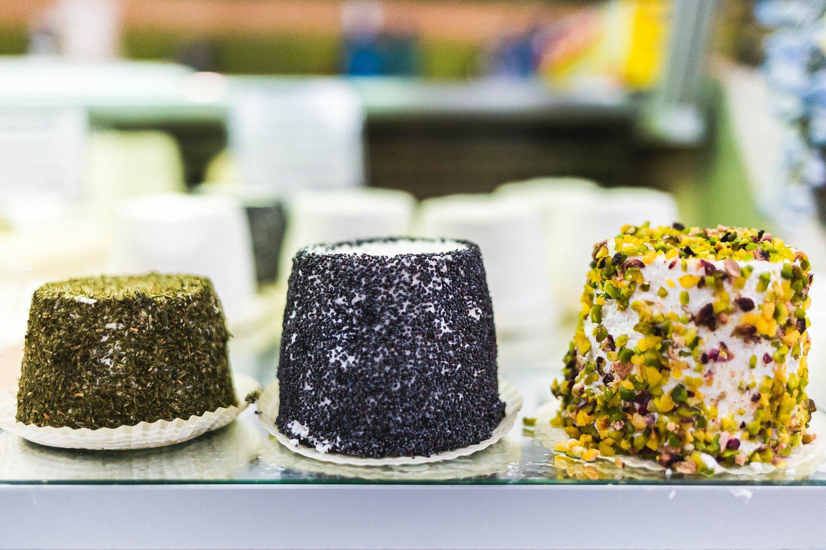
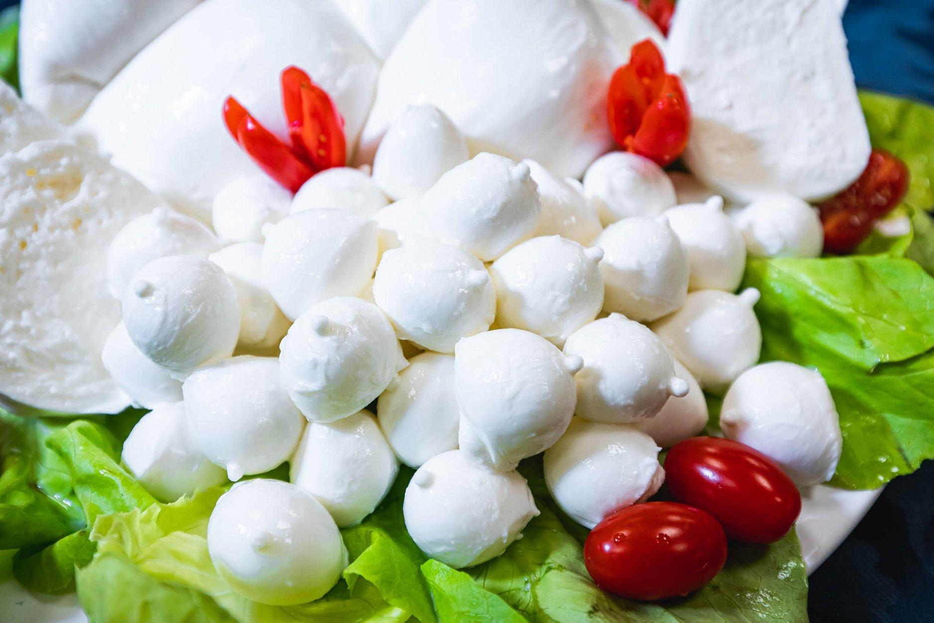
Cheese production basic operations

Slide 4
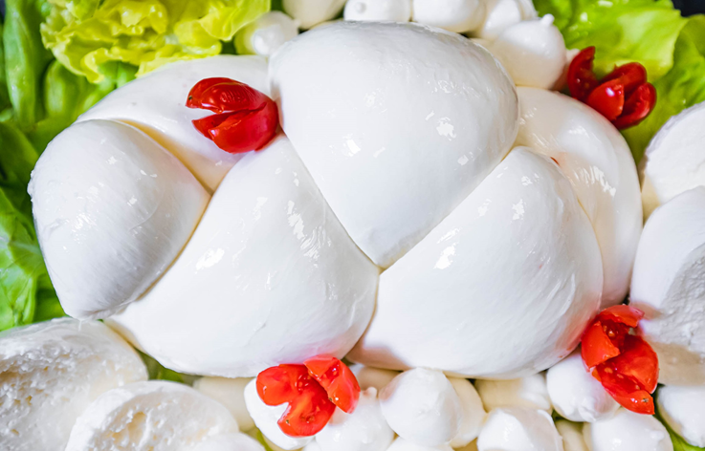
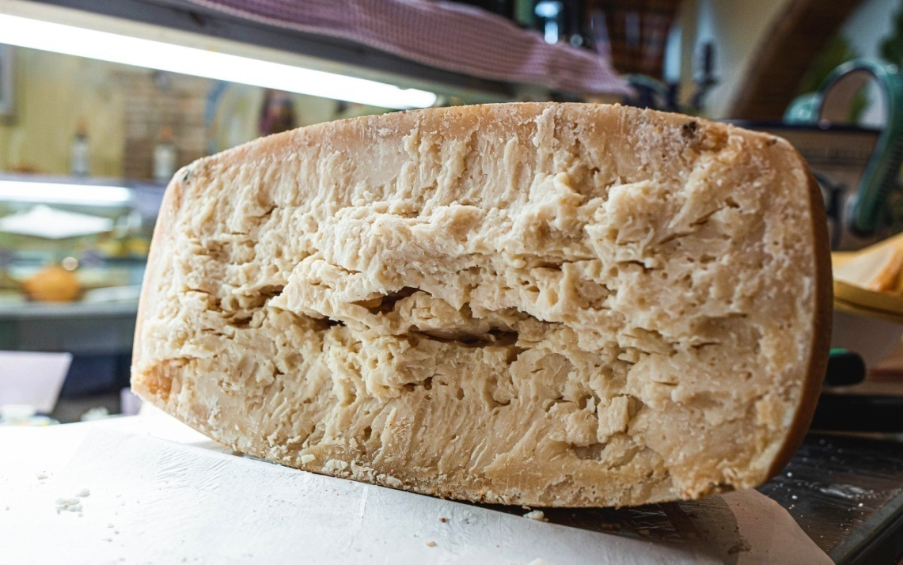
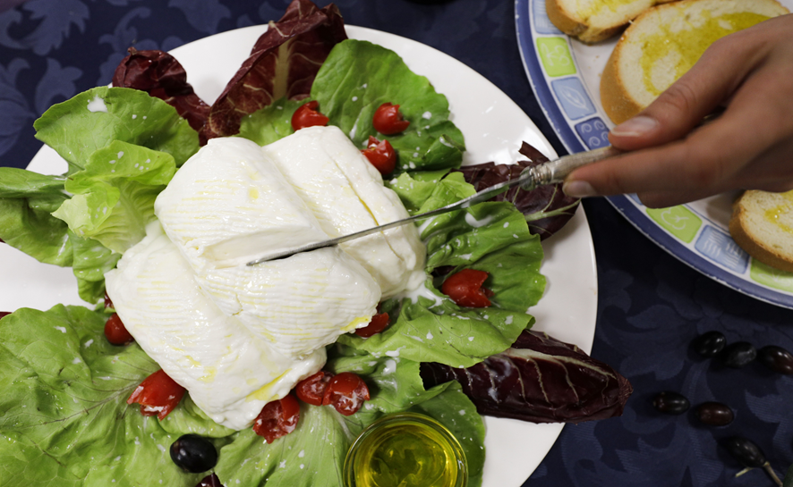
Cheese: Cheese is the product of milk coagulation and subsequent curd maturation. Depending on the technique used and the resulting consistency of the curd, cheese can be divided into three categories: hard or cooked, soft and pulled-curd.

Slide 5
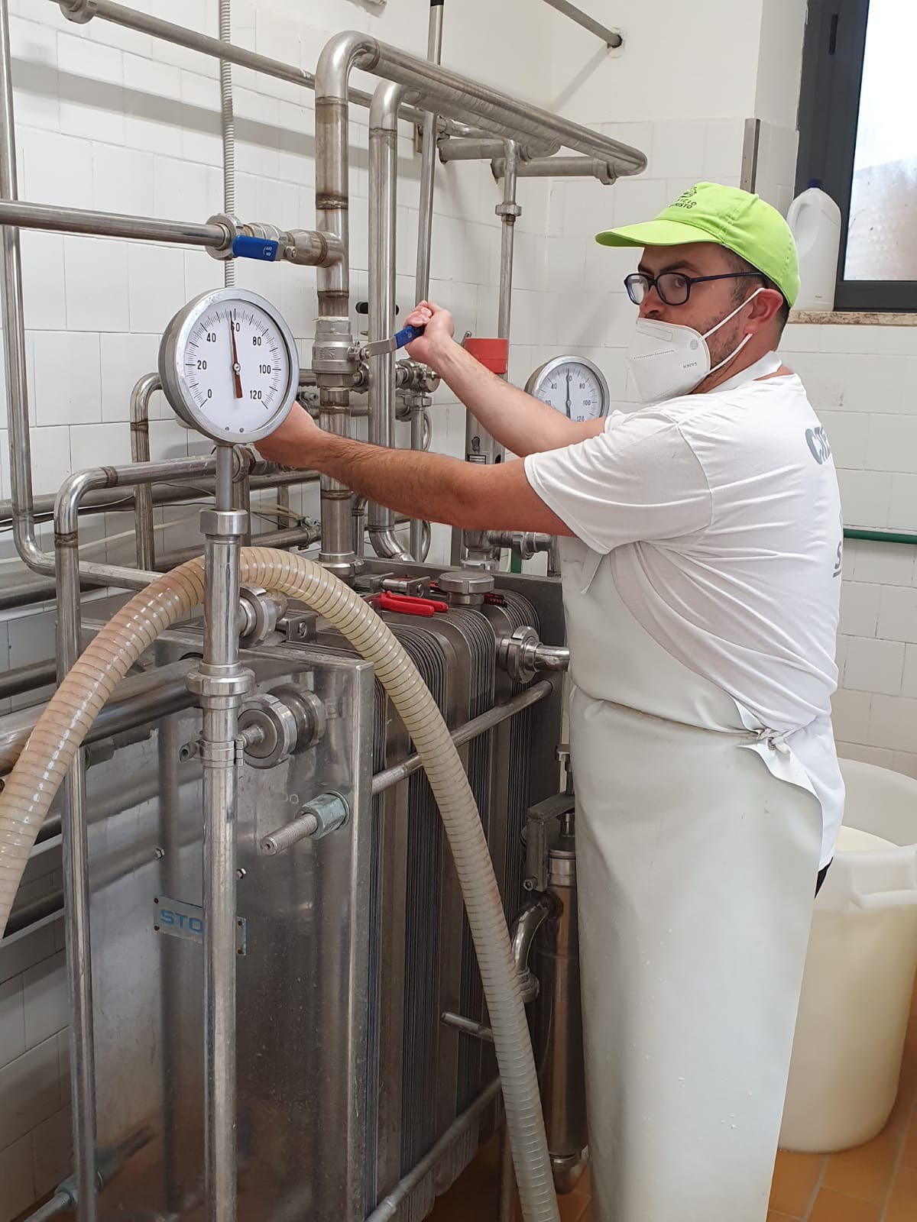
The milk used is cow's, sheep's or goat's milk and can be used directly (raw milk), or after undergoing a light heat treatment (thermisation) or a more vigorous one (pasteurisation).
These heat treatments are usually carried out using a plate pasteuriser where the temperature (65 to 90°C) and the time the milk stays (10 to 30 seconds) are regulated.
Higher temperatures and longer residence times make the milk more stable (better preserved cheese) but cause it to lose the aromatic substances present (cheese with a more standard taste).

Slide 6
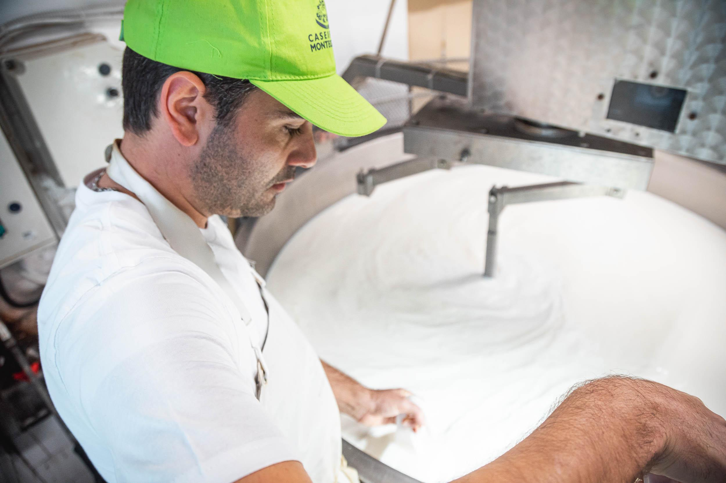
The milk, either untreated or heat-treated, is placed in the coagulation vessel (boiler) and heated to the optimum temperature for the development of lactic ferments (34 to 38°C). The heating can be done either directly or through an external cavity where hot water circulates.
Coagulation is a process that consists of precipitating (condensing) the casein of the milk.
This process, depending on the characteristics of the cheese, can be acidic, enzymatic or mixed (first acidic then enzymatic).

Slide 7
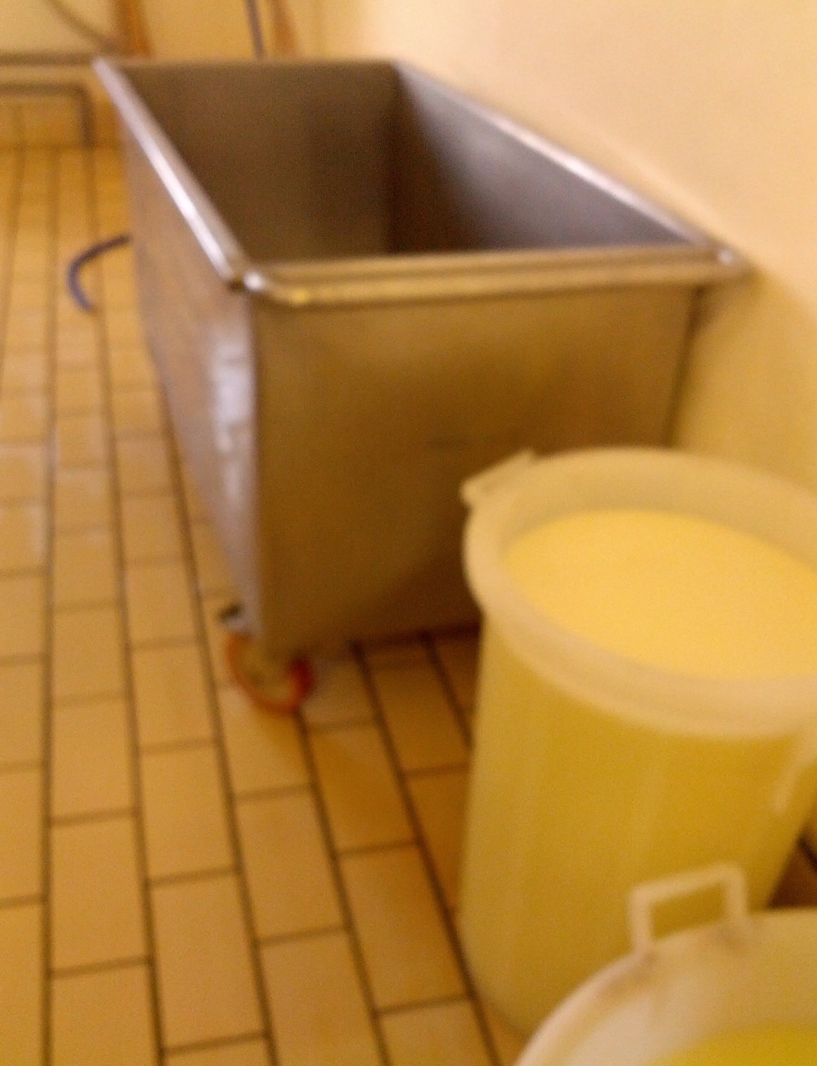
THE ACID CURD:
Casein coagulates by reaching the corresponding isoelectric point PH 4.65. Lowering the pH of the milk from 6.7 to 4.65 is achieved by developing cultures of lactic acid bacteria which transform lactose into lactic acid and lower the pH.
To achieve this, a pre-start culture of lactic acid bacteria (starter) is added to the milk to initiate lactic fermentation. This can be of two types:
-MILK START: milk of excellent hygienic and chemical quality previously incubated at 42-45°C for 7-8 hours until it reaches an acidity of 20°SH. This starter is used for soft cheeses.
-SERUM START: serum of the previous processing very successful, incubated at 42-45°C for 20-24 hours until an acidity of 60° SH is reached.
The acid curd is very porous, permeable, crumbly but not contractile.

Slide 8
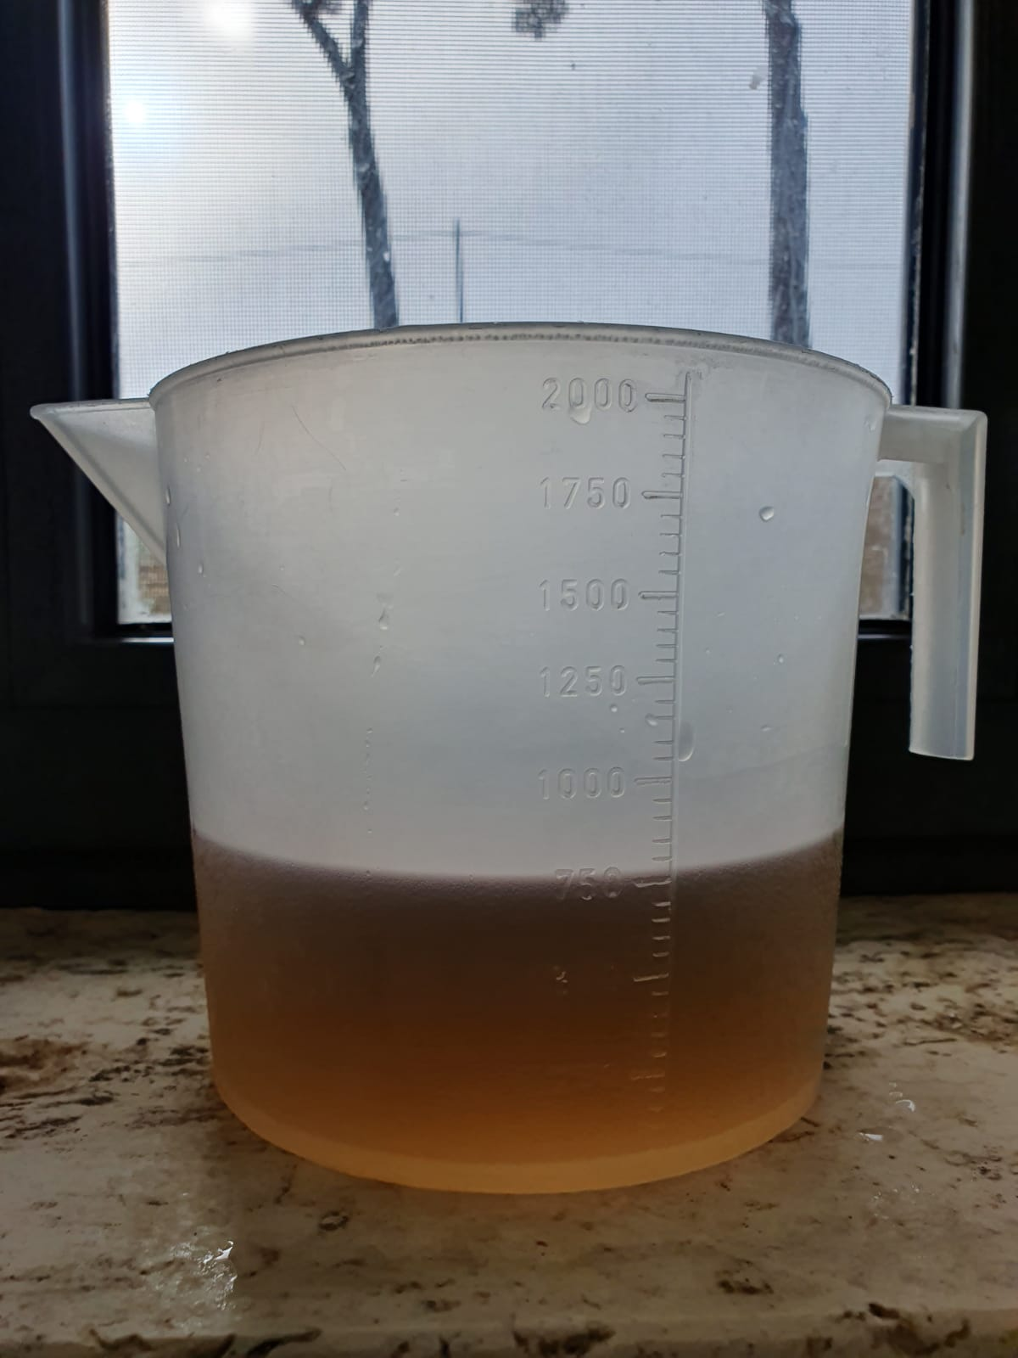
ENZYMATIC CURD:
Casein precipitates by the action of an enzyme complex that cuts it down and causes it to precipitate as calcium para k caseinate.
The enzyme complex is added through rennet or presame, an enzyme extract from the glandular stomach of calves, lambs or kids.
It is important that they are suckling animals as the casein-specific enzyme CHYMASI prevails, to the detriment of the non-specific enzyme PEPSIN which would reduce cheese yield.
Vegetable curds extracted from mushrooms (Endotia Parasitica, Mucor Miei, Mucor fusillus etc.) are commercially available.
An important parameter is the RENNET TITLE, the quantity of milk that can coagulate at 37°C in 45 minutes.
On the market there are liquid rennet (count 1:10.000), paste rennet (count 1:100.000) and powder rennet (count 1:200.000).
All commercial formulas must be rehydrated and reactivated with hot water before being added to the milk.
The enzymatic curd is contractile and elastic but compact and impermeable.

Slide 9
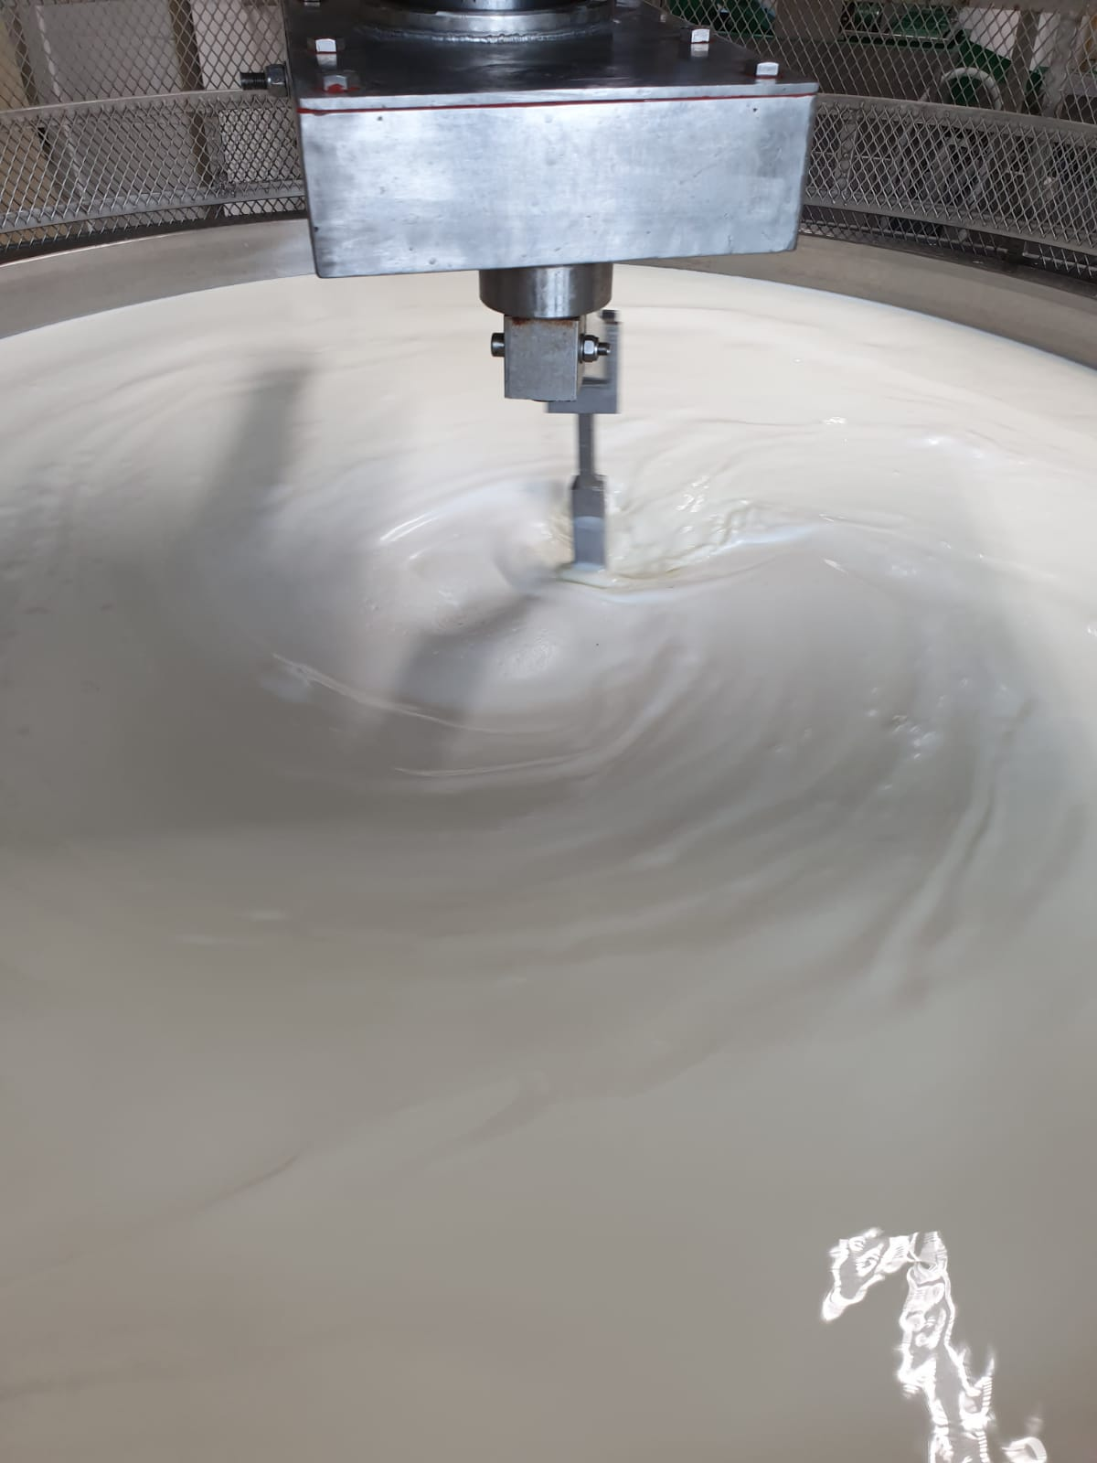
To the milk, which has been brought to the right temperature, 1-2 litres are added for each hectolitre of milk:
-for soft cheeses, milk starter at 34-35°C;
-for hard cheeses, serum starter at 37-38°C.
It is stirred well and left to ferment for 30 to 45 minutes.

Slide 10
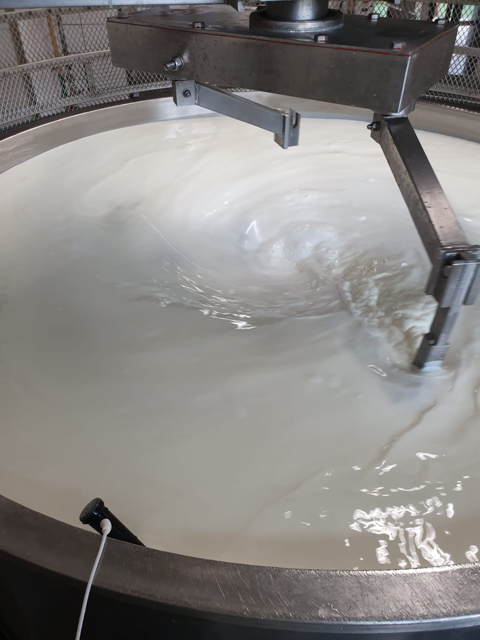
Fermentation is continued until the desired pH is reached.
In general:
-For soft cheeses that need to drain little whey, the pH is higher (6,4-6,2);
-for hard cheeses that need to purge more whey, lower pH are reached (5,8-5,6).

Slide 11
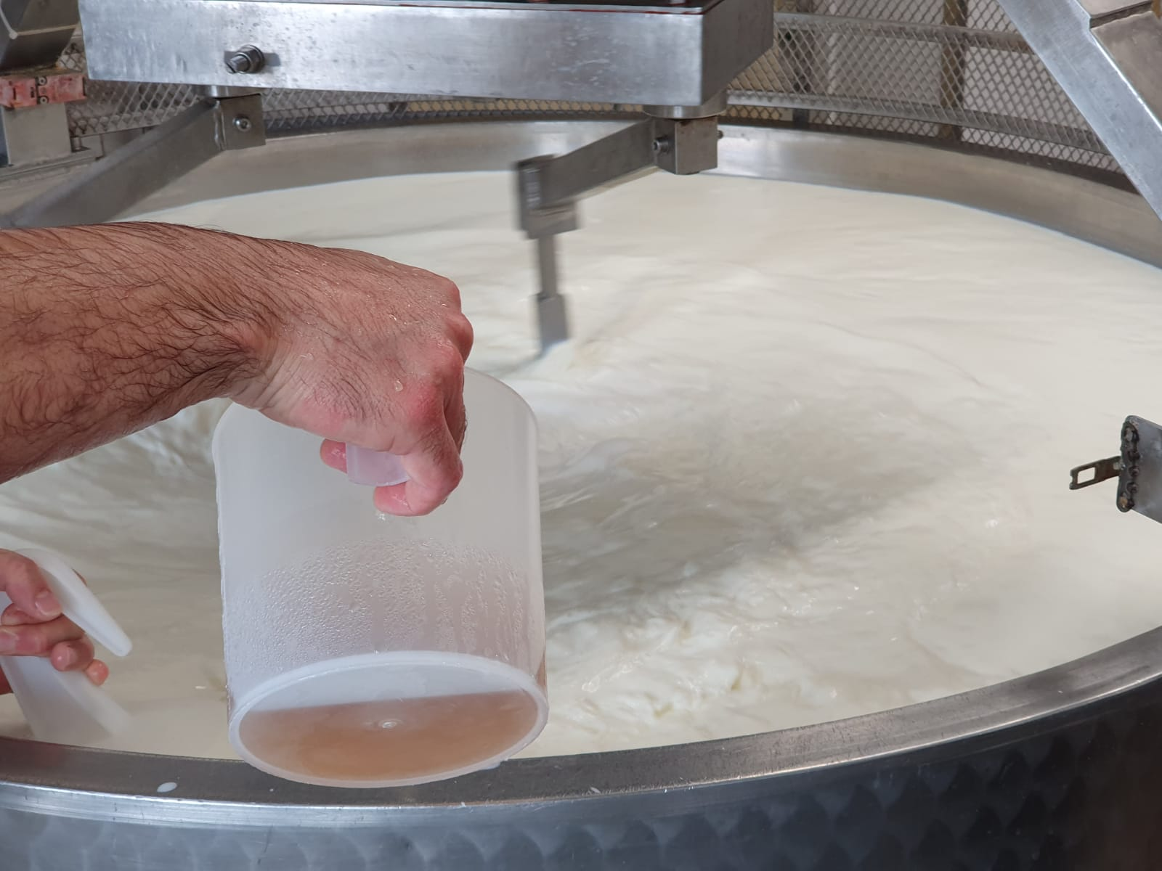
Then liquid (20 ml per hectolitre of milk) or powder rennet (1,5-2 g per hectolitre of milk) is added and slowly stirred for 10-15 minutes to form the curd.

Slide 12
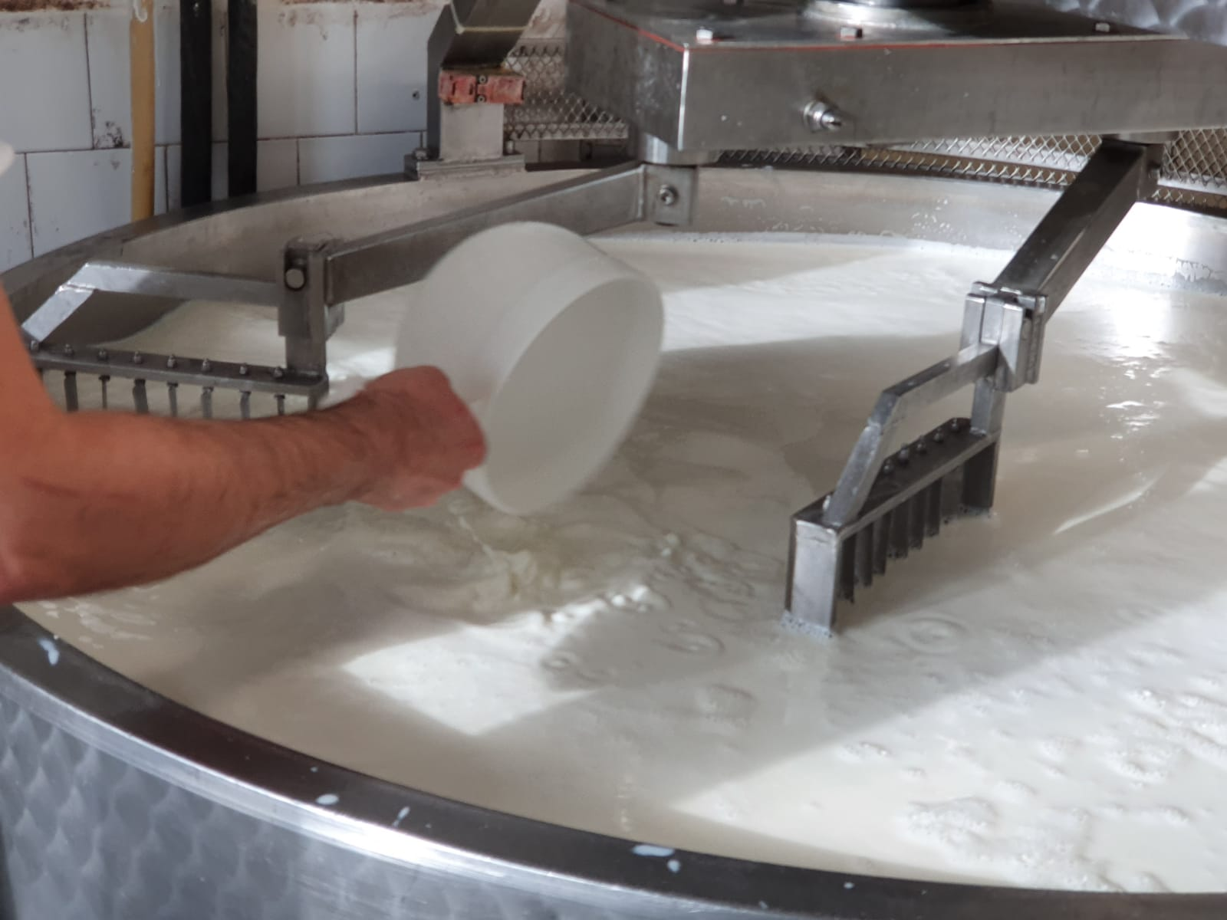
The curd is left to rest and, if necessary, the surface of the curd is turned over to strengthen it.
In order to facilitate the draining of the whey, the curd is then broken with various tools.

Slide 13
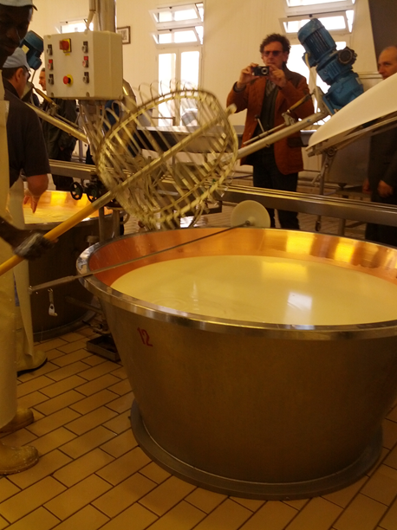
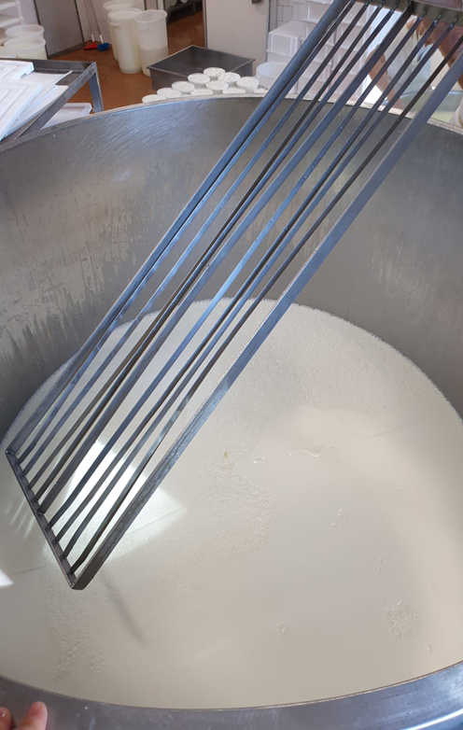
The «THORN»
Curd breaking can be done by hand or mechanically with these two types of tools
The «LIRA»

Slide 14
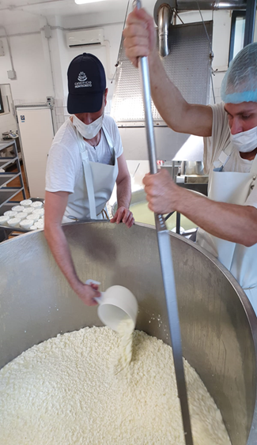
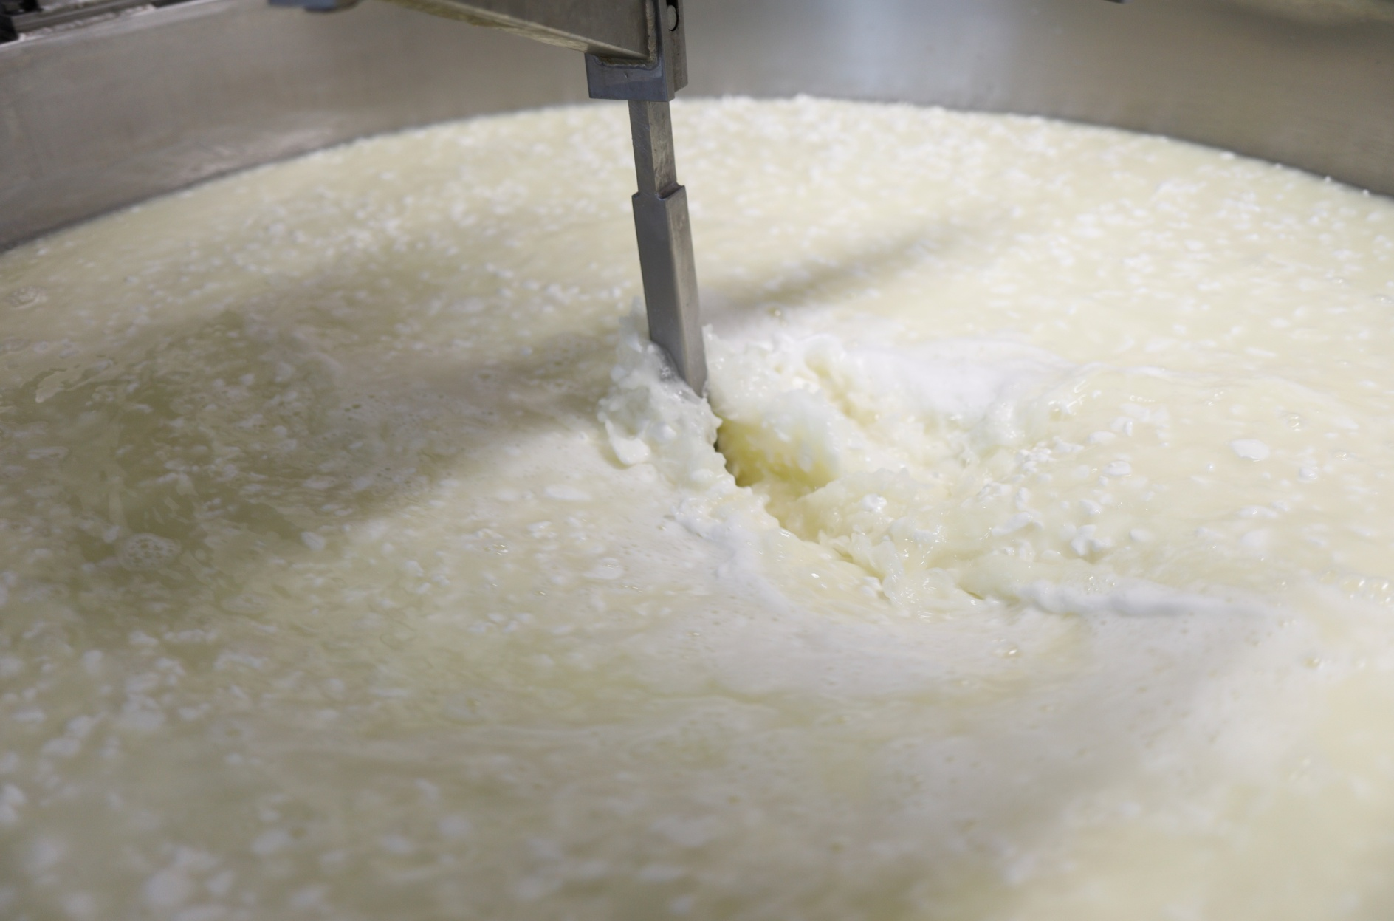
Very important is the "degree of thinning" of the curd, the more or less intense breaking up of the granules.
The more the curd breaks, the smaller the granules and the easier it is to drain the whey.
The less the curd breaks, the larger the granules and the more difficult it is to drain the whey.

Slide 15
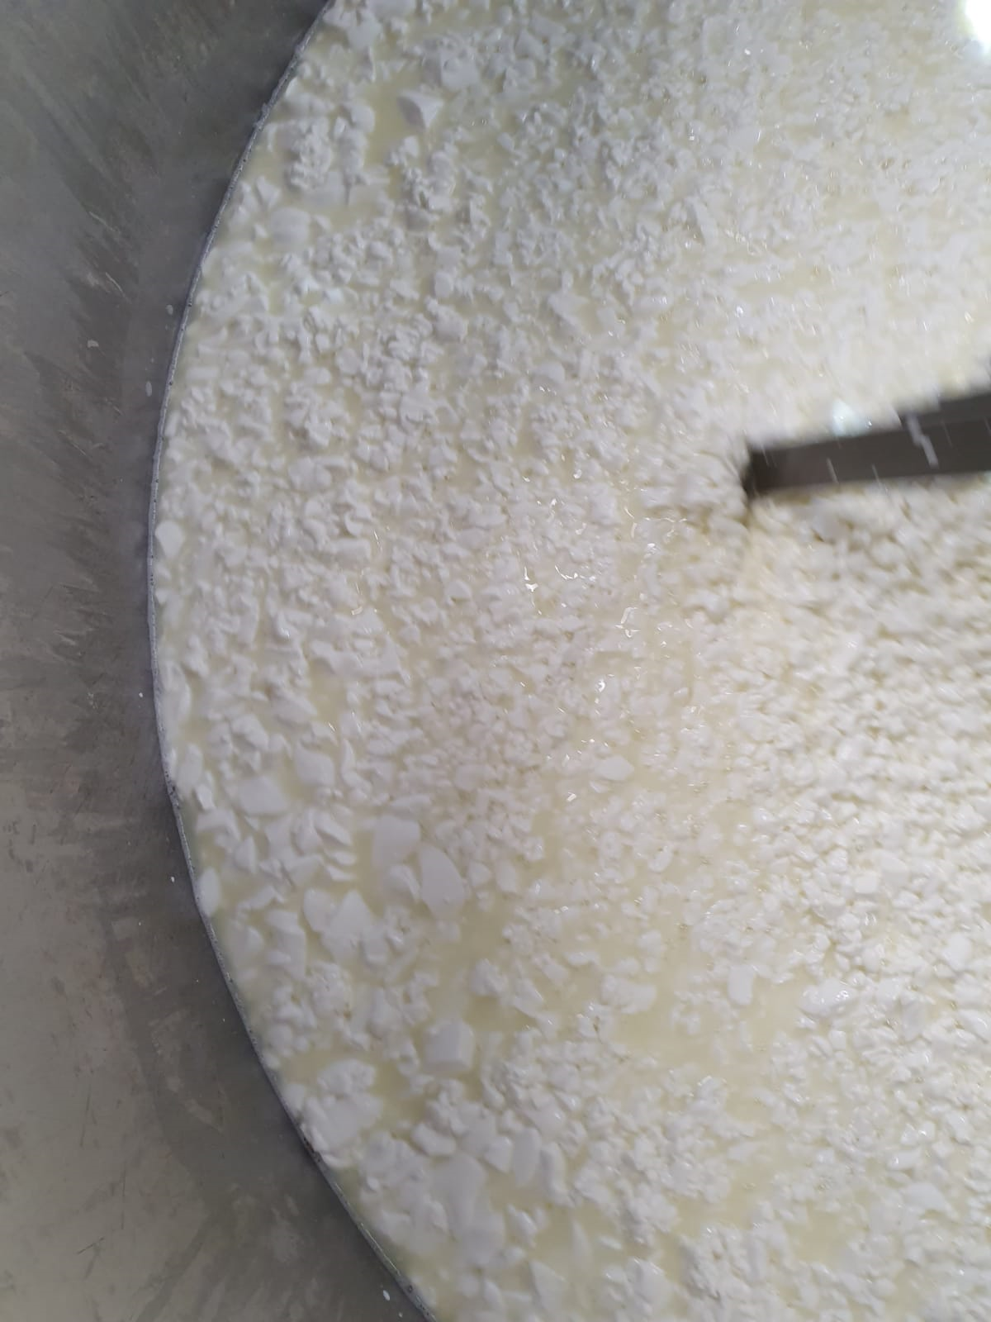
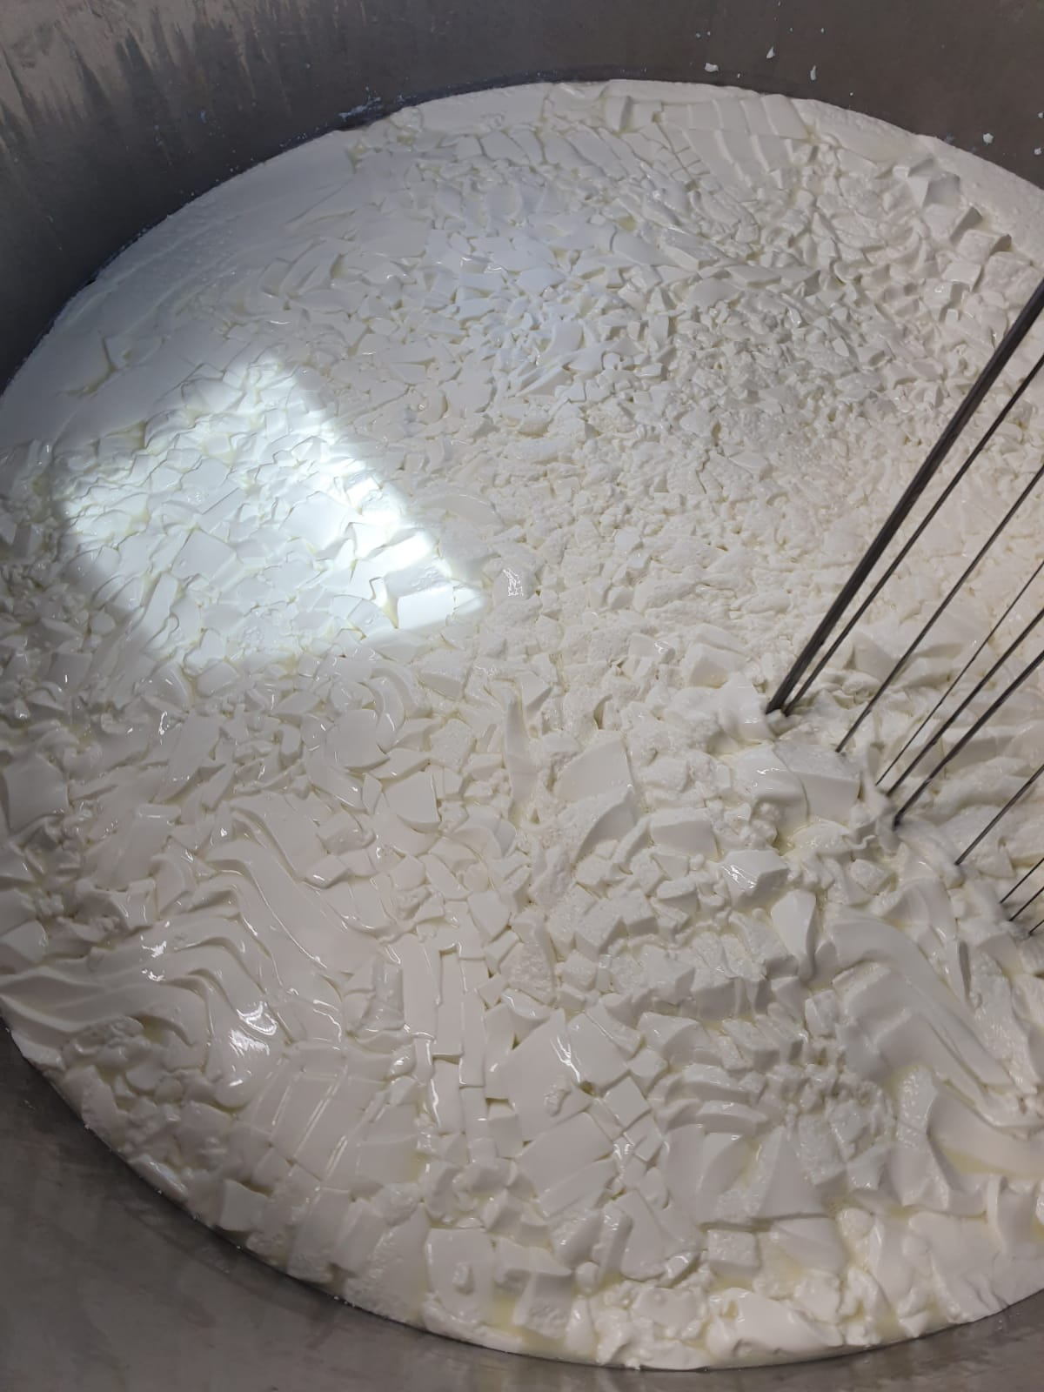
-for soft cheeses: the size of a walnut
So……
-for hard cheeses: as small as a grain of rice

Slide 16
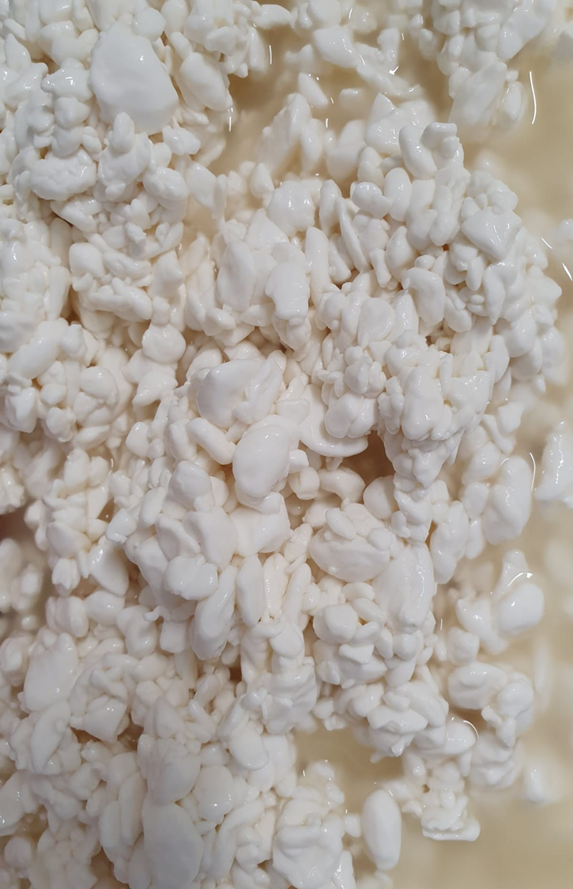
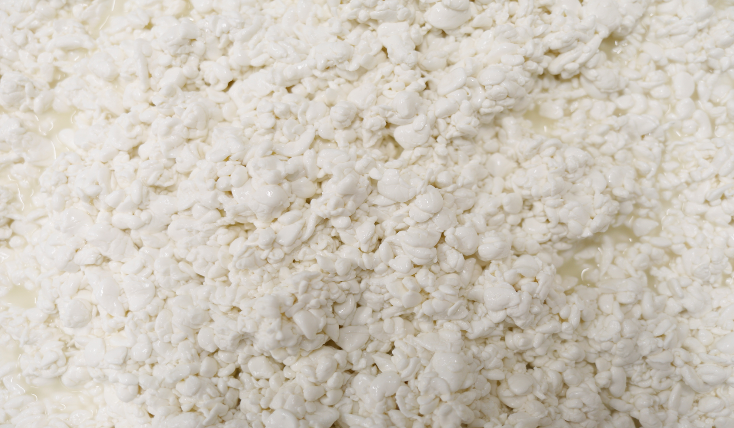
Example of curd granule or grains size

Slide 17
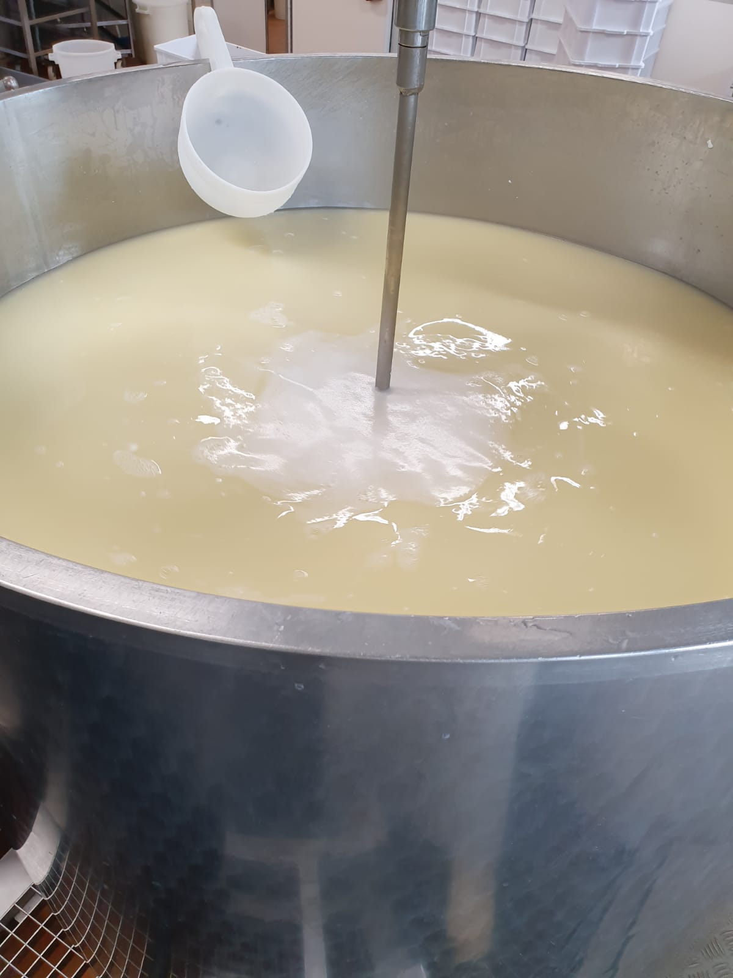
After coagulation, the operations are different according to the type of cheese:
-For soft paste cheeses, the curd is left to rest for just 10-15 minutes before being put into moulds.

Slide 18
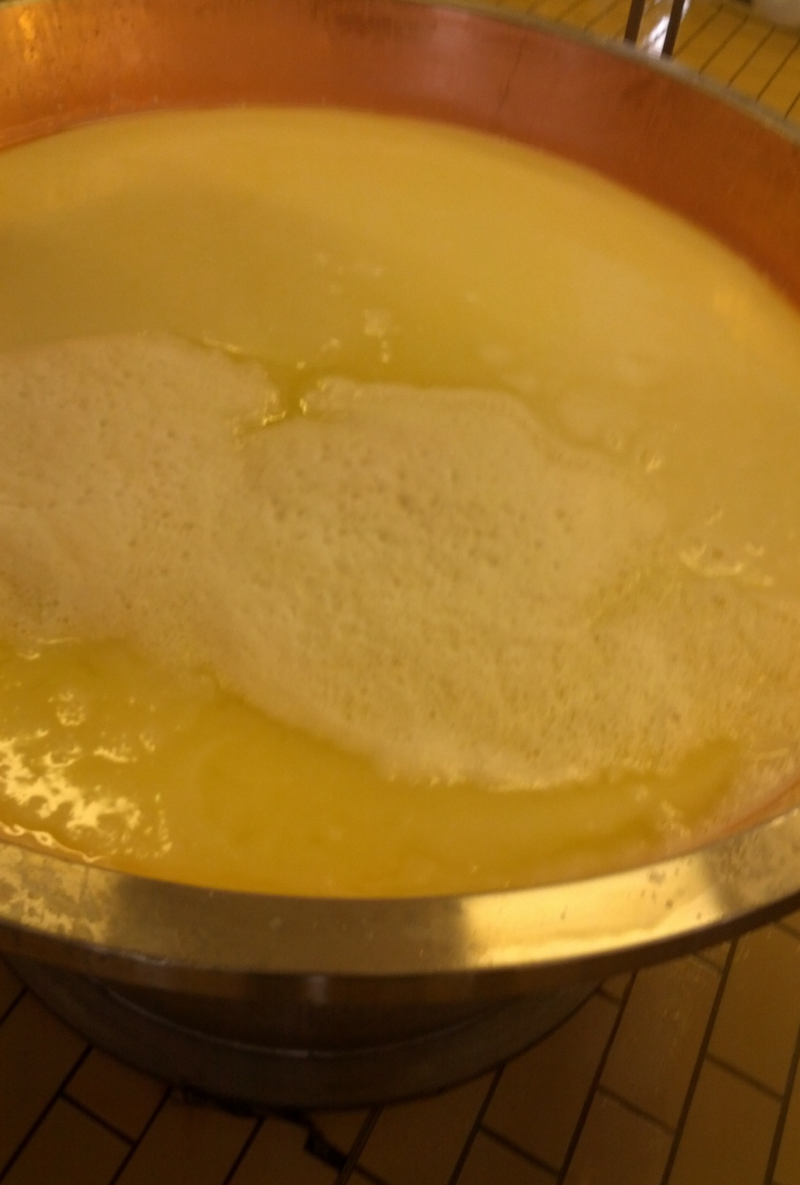
-For hard or cooked cheeses, the whey is drained and the hardness of the granules in the curd is increased by heating the cheese in a vat at a temperature of 50 °C to 65 °C for 20 to 30 minutes, depending on the consistency of the cheese.

Slide 19
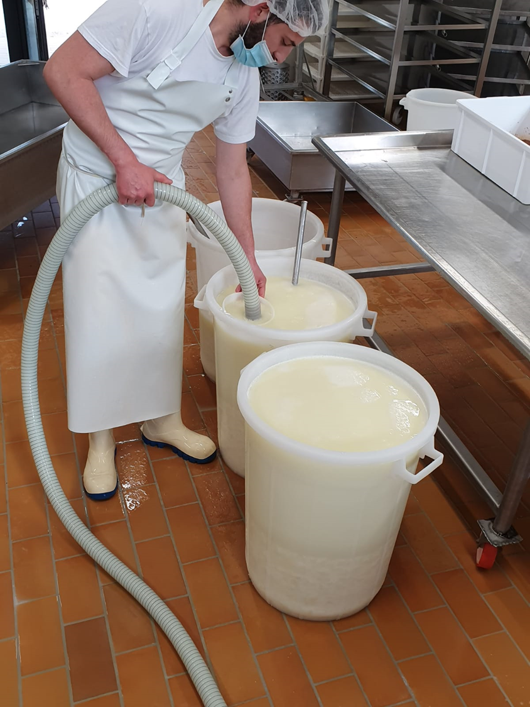
In the case of stretched curd cheese, most of the whey is extracted and the curds are left to rest for 6-8 hours in whey to allow demineralisation to take place and thus facilitate the stretching of the curds.
The right degree of demineralisation (PH=5) corresponds to adequate stretching.

Slide 20
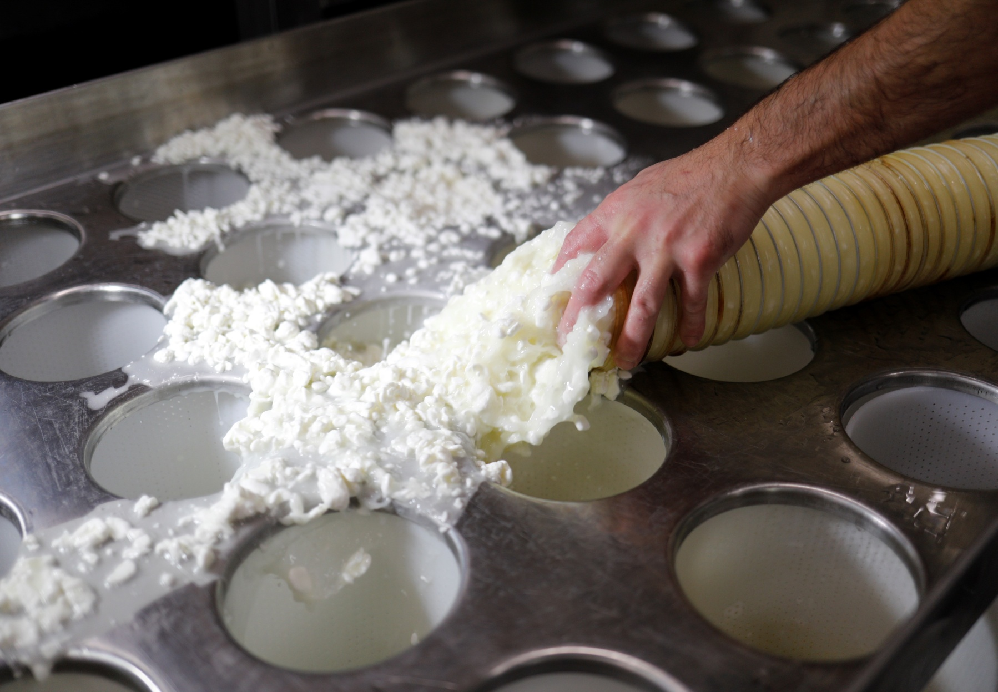
FORMING:
The curd is removed from the whey and placed in baskets of different shapes and sizes where the whey is drained off and the cheese begins to take on the desired shape.

Slide 21
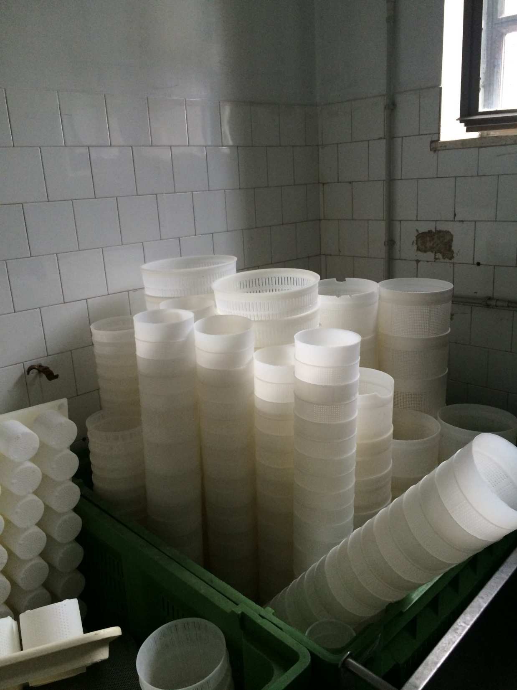
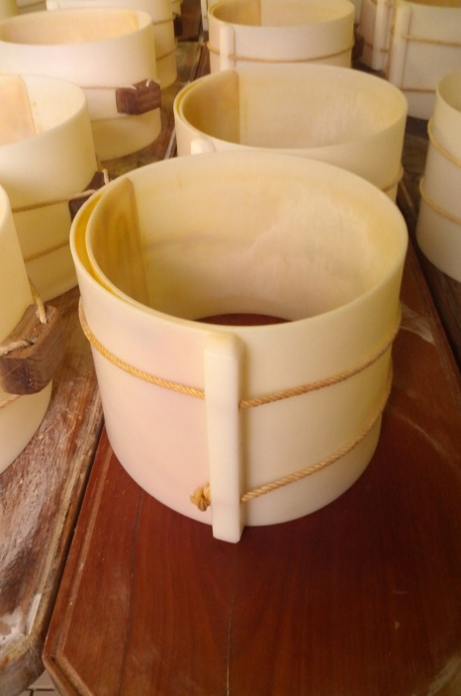
The baskets can be of different shapes and sizes depending on the type of cheese, usually ranging from 0,5 kg to 5 kg.
For larger cooked cheeses, from 12 to 18 kg, plastic or metal wrappers with manual filling are used.

Slide 22
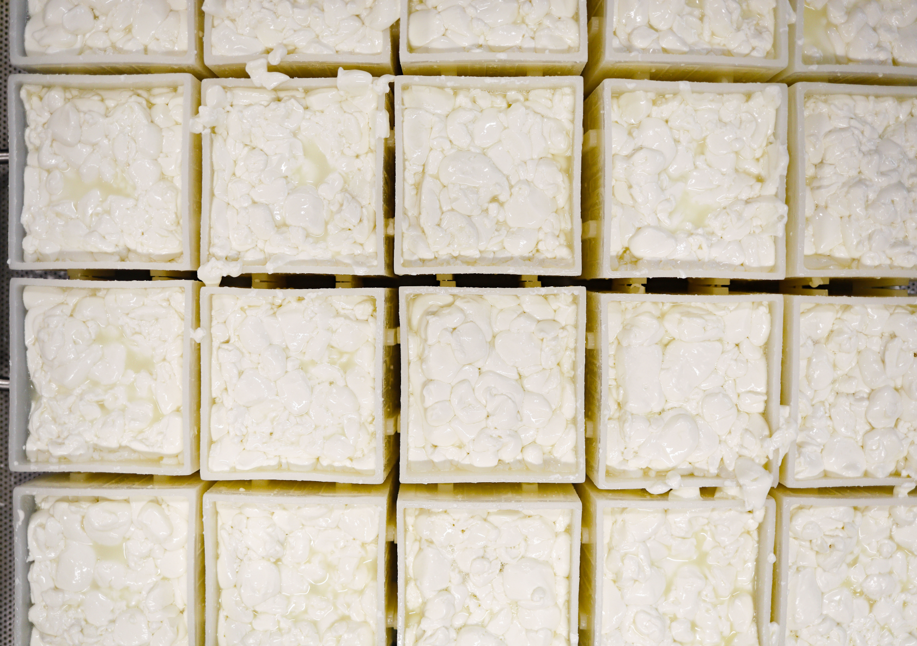
For very soft cheeses to be packed in paper or plastic, the baskets have different shapes (square or rectangular) and are held together by metal frames to facilitate turning them over.

Slide 23
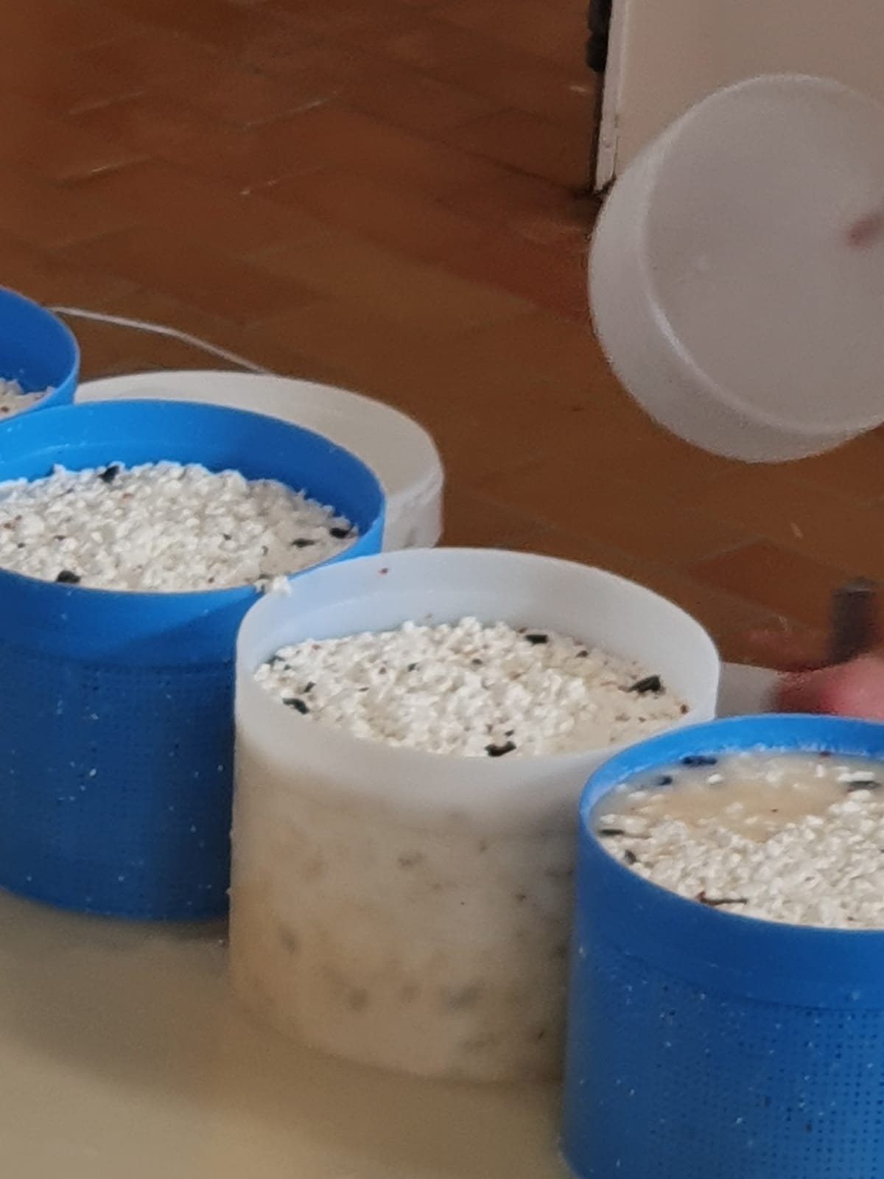
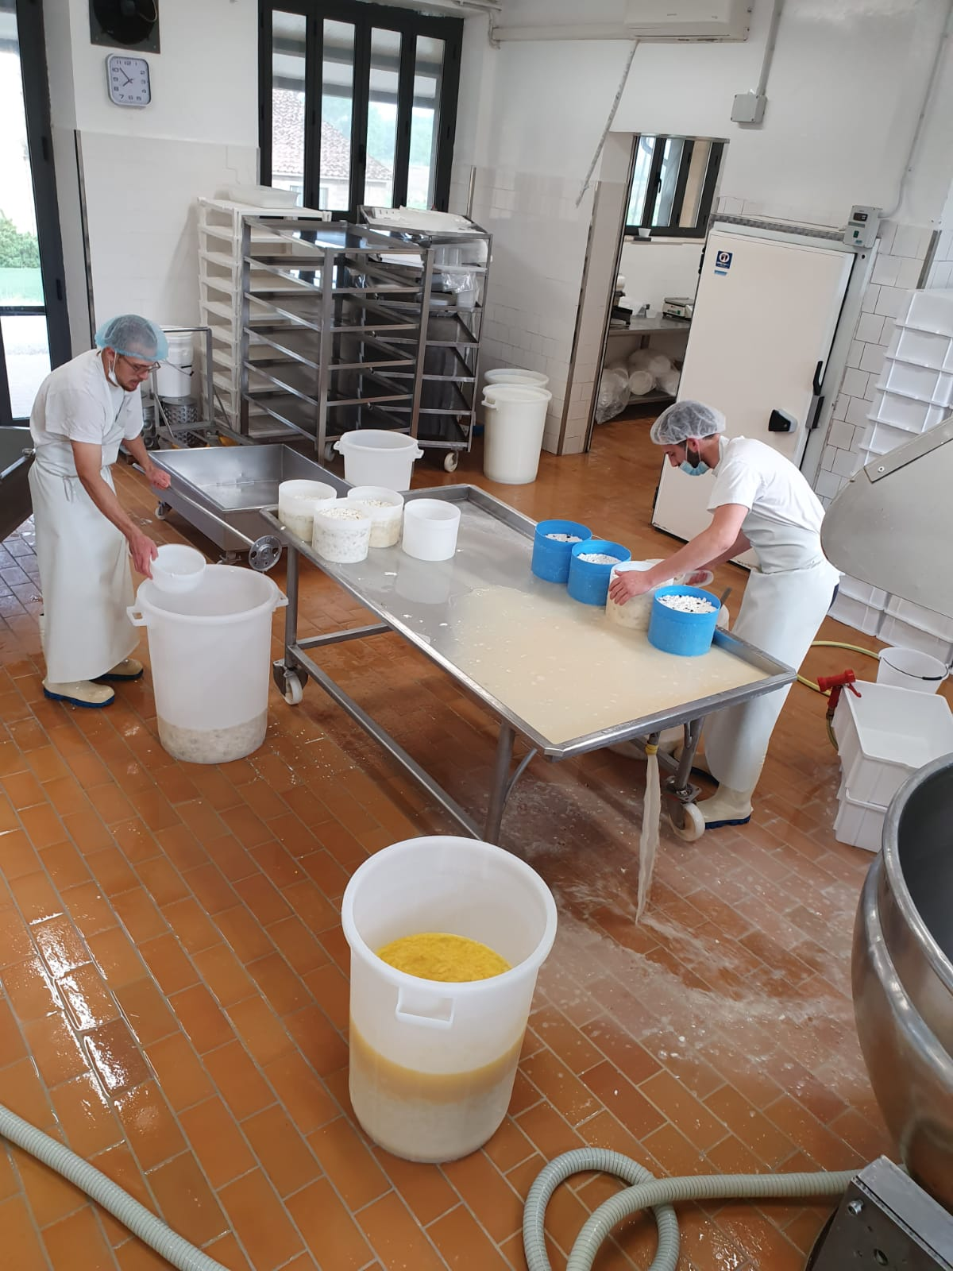
For special cheeses, additives such as truffles, saffron, dried fruit, spices etc. can be added during moulding.

Slide 24
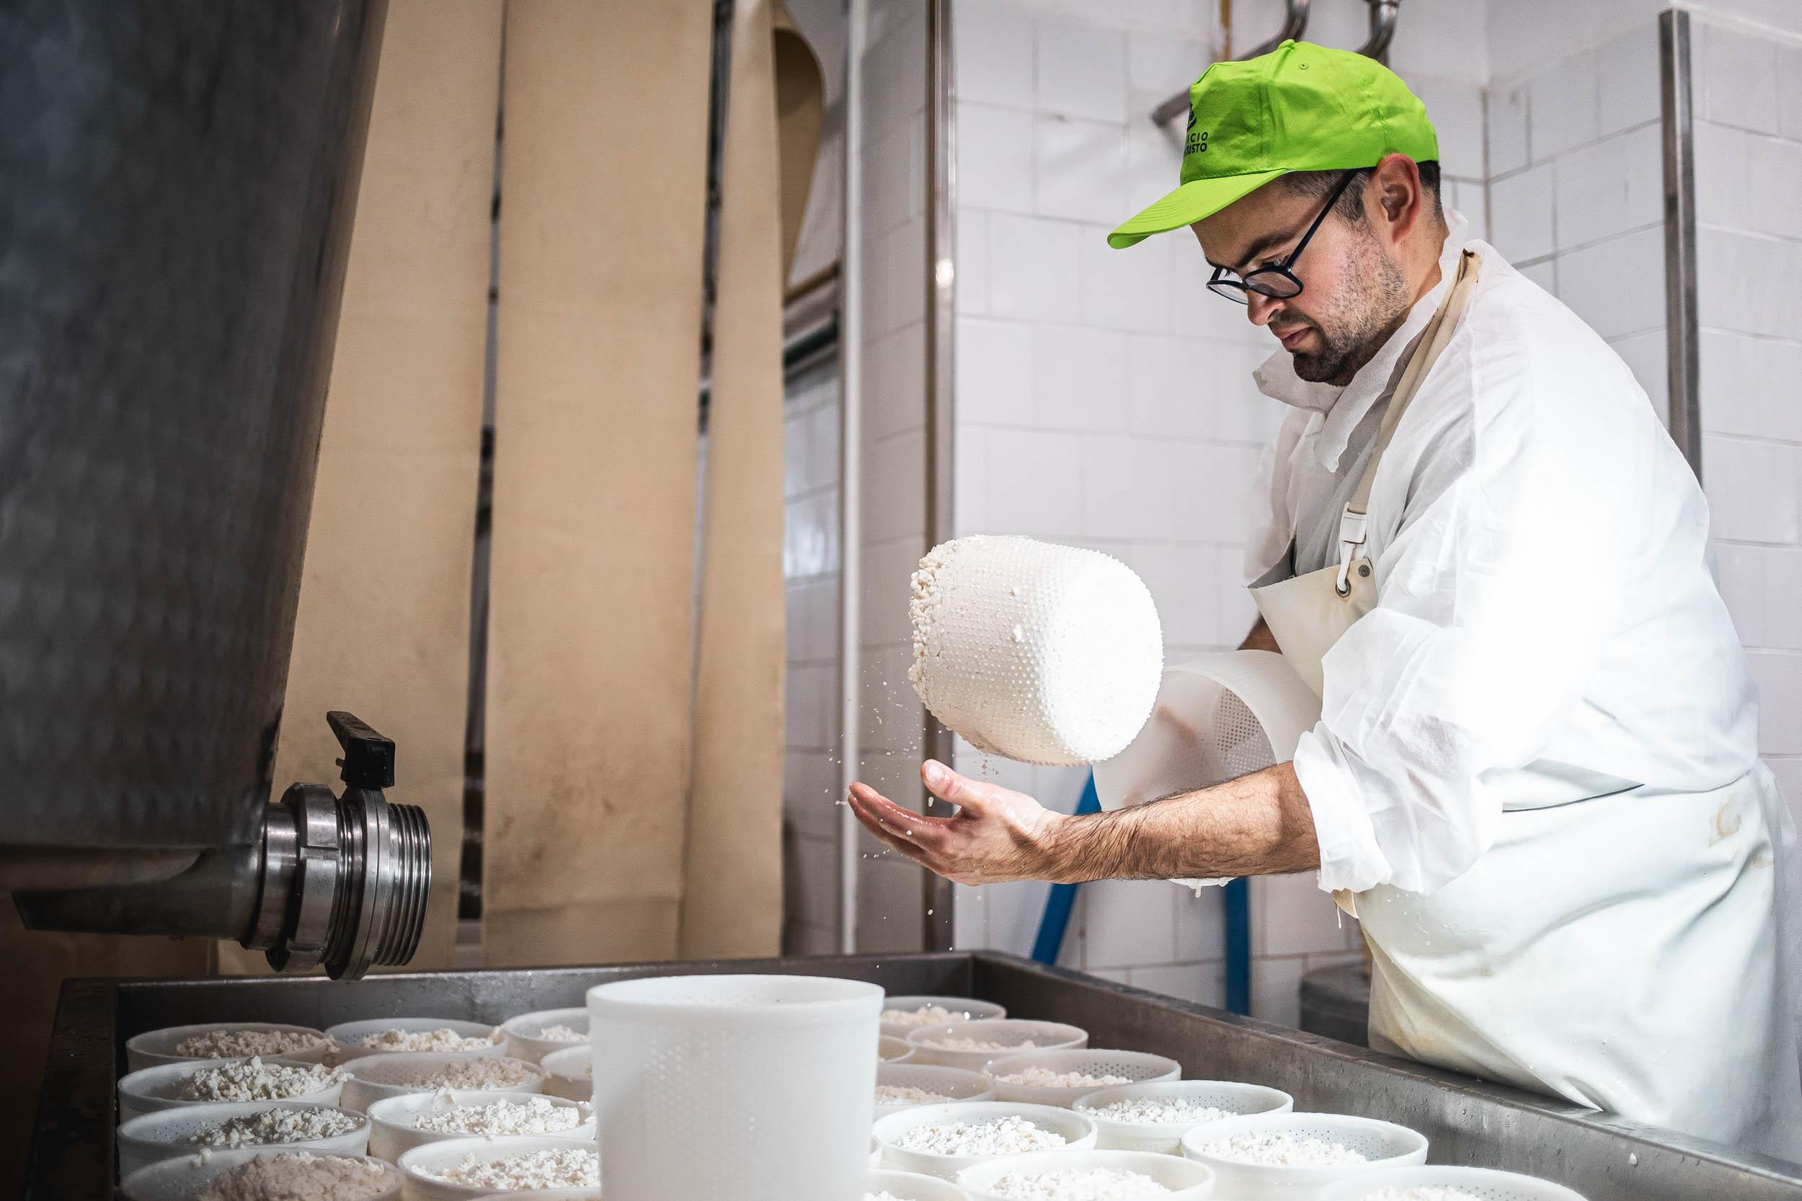
TURNING THE MOULDS:
In order to facilitate the draining of the whey, after about an hour the moulds are turned inside the same basket so that the curd above, with its weight, favours the compacting of the curd below.

Slide 25
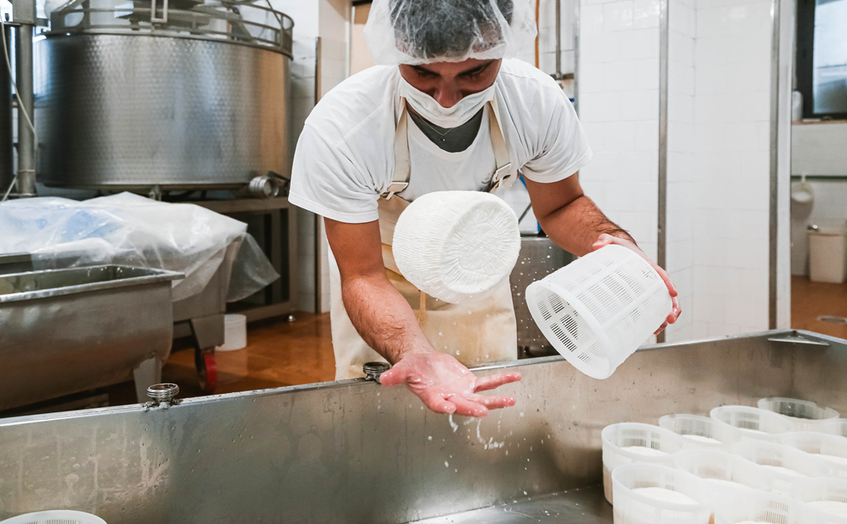
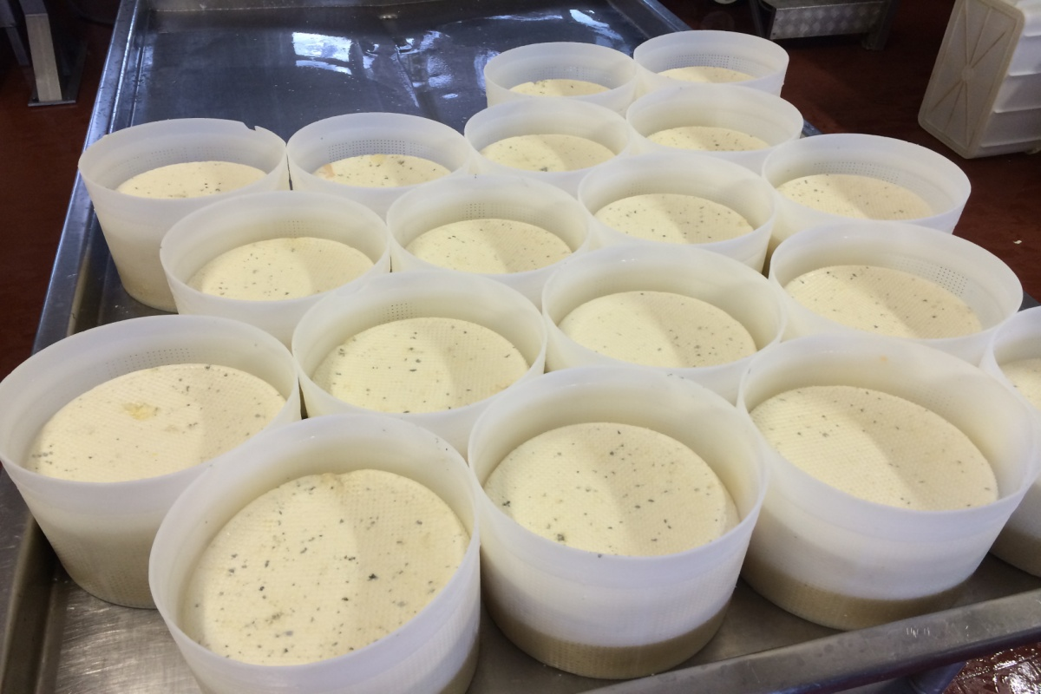
This operation is repeated 3-4 times until the desired shape height is reached.

Slide 26
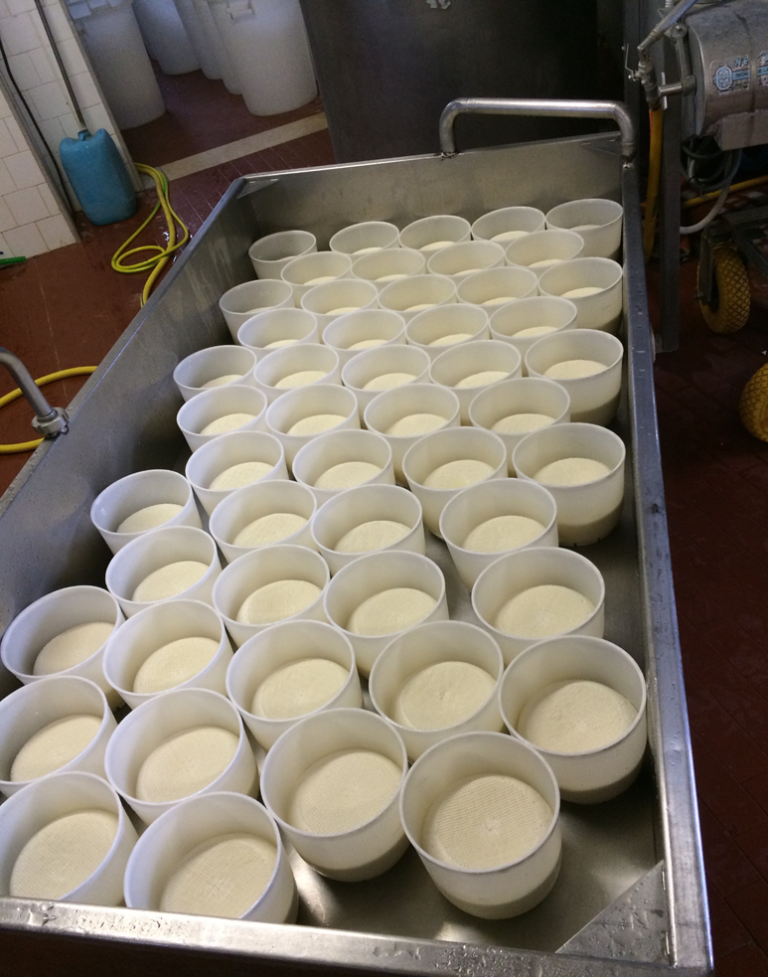
STUFFING:
The cheeses obtained in this way can be covered with waterproof nylon cloths, placed in special rooms and heated to 45°C with steam for 5 to 15 hours.
This operation, carried out for soft cheeses, favours the acidification of the cheese wheel through the production of lactic acid and the consequent dehydration and "settlement" of the cheese.

Slide 27
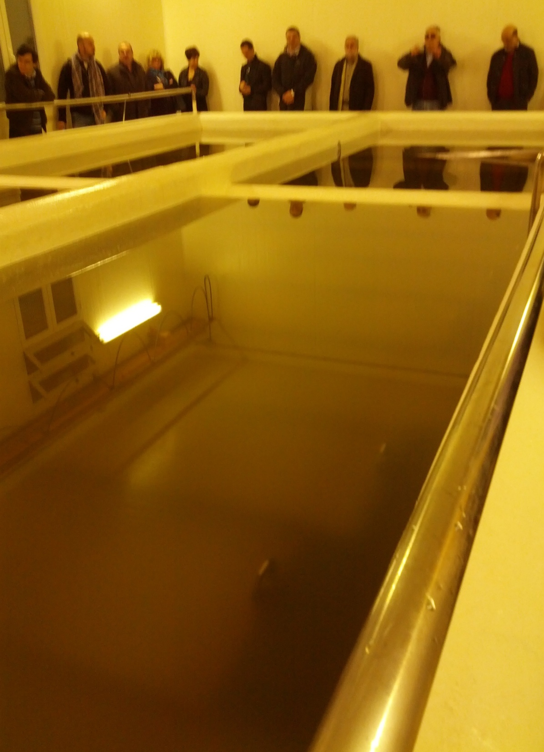
SALTING:
Sodium chloride (table salt) is added in order to:
-promote the release of whey by osmosis;
-perform an antiseptic action, improving cheese preservation;
-give flavor to the cheese.
Usually the cheeses are immersed in brine, that is a saturated solution of sodium chloride with concentrations varying from 15 to 30% depending on the type of cheese and the size of the cheese wheel. The cheeses are left to soak for varying lengths of time, usually one day per kg of weight of the cheese at a temperature of 15-18°C.
The floating cheeses must be turned once or more times a day.
The brine must be renewed at least once a month.

Slide 28
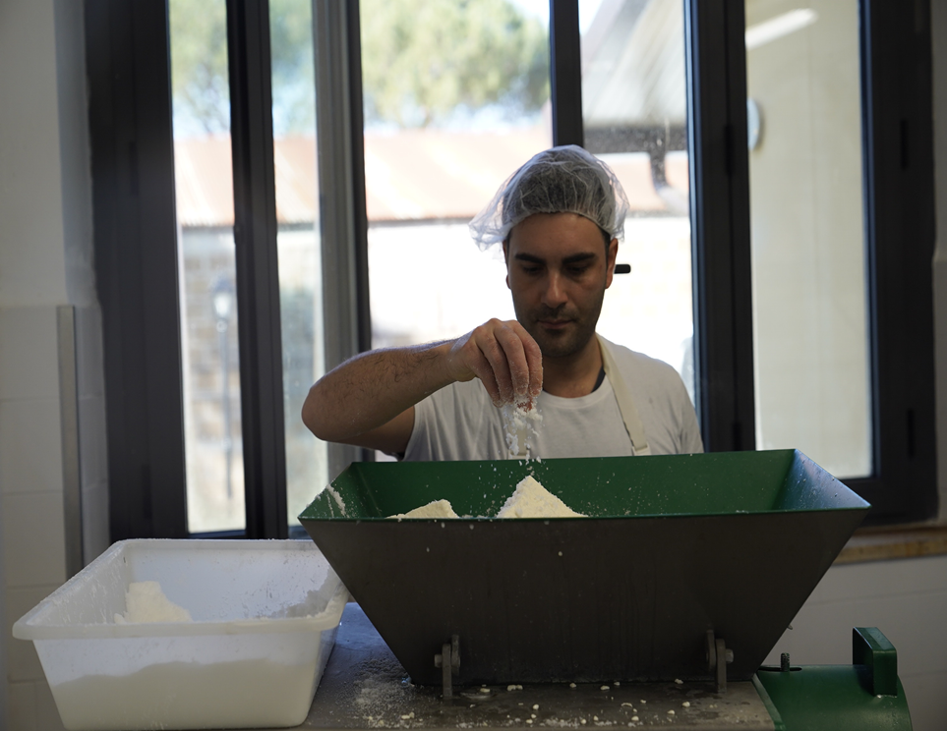
Soft or pulled-curd cheeses with a short shelf-life (consumed within 30-40 days) can be directly salted by adding salt to the newly formed curds in quantities varying from 3 to 5% of the cheese weight.
For hard but small cheeses (max. 1 kg weight), dry salting can be carried out by sprinkling the cheese wheel with salt for 2-3 days. This operation, by dehydrating the external part, favours the formation of a very thick rind on the outside of the cheese wheel.

Slide 29
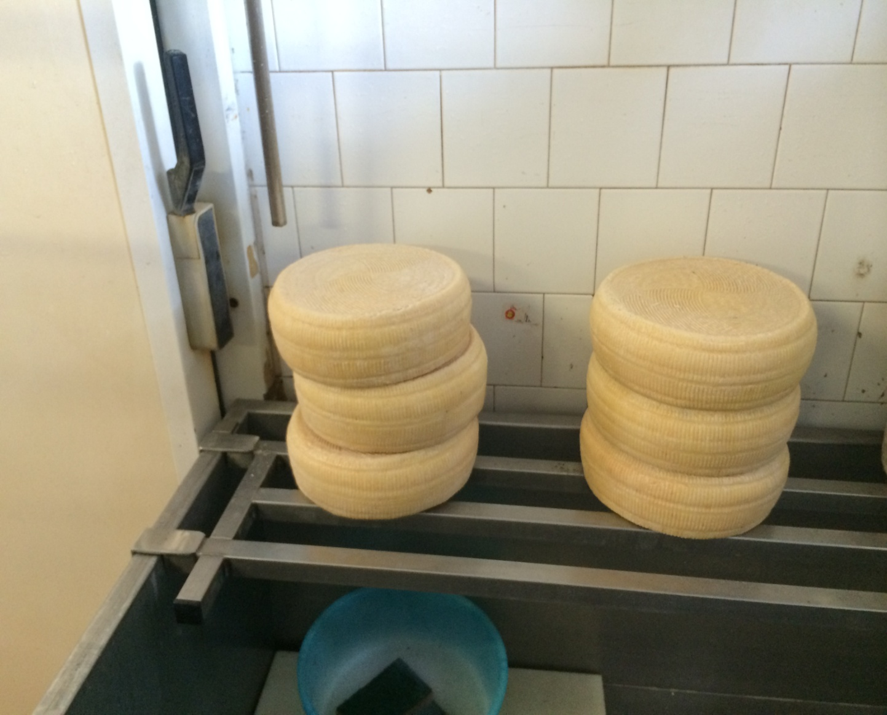
MATURATION:
Some types of cheese, after being salted, must undergo a more or less long period of maturation.
During maturation, transformations take place due to:
-milk enzymes (especially in raw milk cheeses);
- residual rennet activity (rennin);
-enzymes from bacterial (lactic) starters;
-enzymes of non-starter micro-organisms (moulds, propionic bacteria already present in the milk or added later (blue cheeses).

Slide 30
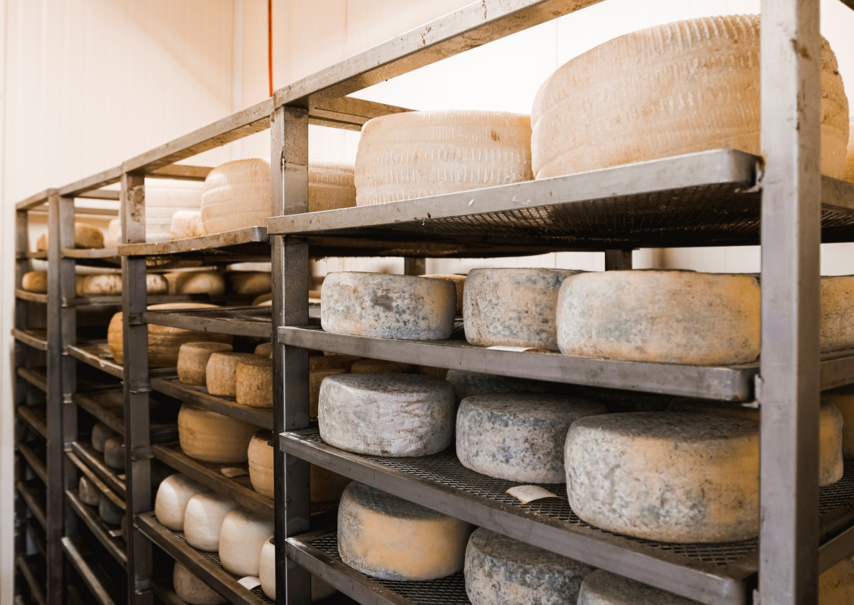
Transformations that occur during ripening:
-reduction of the water content from 25 to 60%;
-transformation of lactose into lactic acid by homolactic bacteria or into propionic acid, acetic acid and carbon dioxide (propionobacteria) with a lowering of the pH and the formation of holes in the paste;
-transformation of proteins into peptones or amino acids or ammonia with the formation of particular flavours;
-hydrolysis of glycerides (fats) by rennet lipase or moulds, with the formation of fatty acids with a piquant flavour (piquant sheep's milk cheese, provolone or gorgonzola);

Slide 31
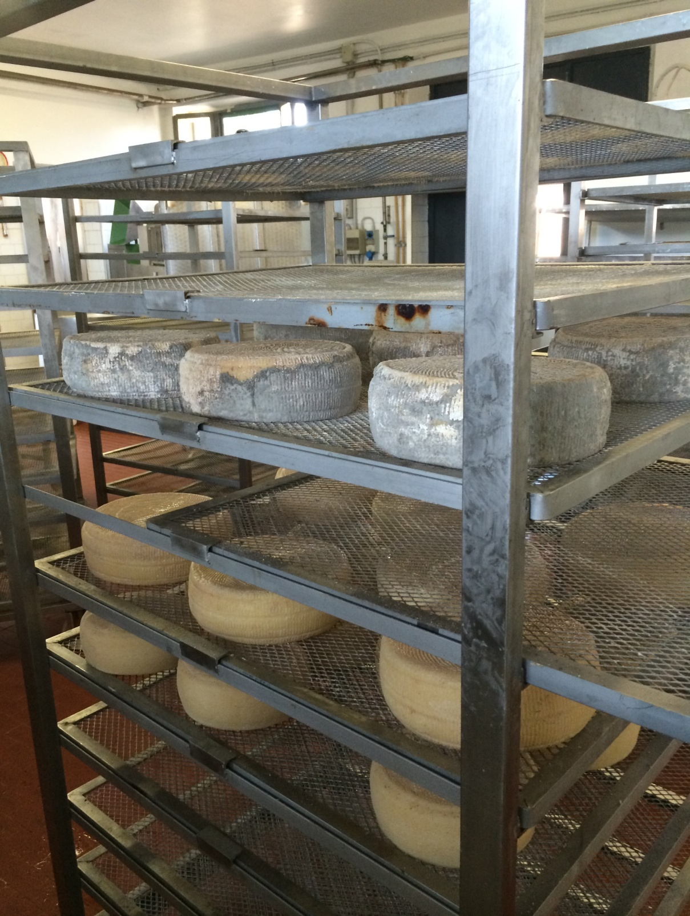
AGEING:
The maturation of the cheeses is also called maturing.
It is carried out inside basements or cold rooms with controlled temperature and humidity.
The cheese, placed on wooden racks or boards, is left to stand for a period varying from 15 days (for soft cheeses) to 6-12 months (for hard cheeses) at low temperatures (from 12 to 18°C) and high relative humidity (80-90%).
At least once a week the cheeses should be checked for surface cleaning, turning and drying, and for any abnormalities or outbreaks of disease.
The cheese acquires its typical consistency, colour and flavour depending on the length of time it has been in the mould and the environmental conditions.

Slide 32
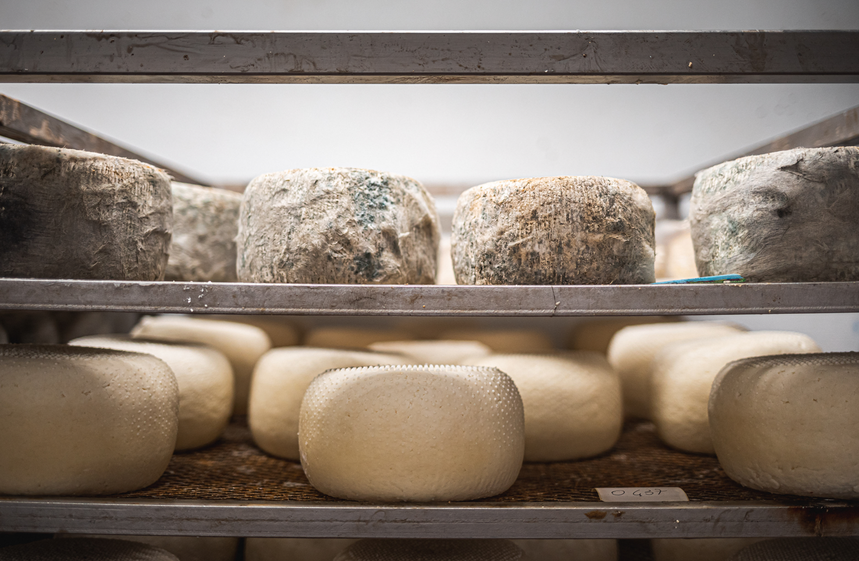
In the case of cheeses with a flowered rind (such as Brie or Camembert) the rind is formed by the development of white moulds (Penicillium candidum, P. camemberti, Geotricum candidum) which are brushed onto the rind.
On the other hand, in the case of cheeses with green or blue paste (Gorgonzola, Rokford or Stilton), it is due to the development of moulds inoculated in the milk (by mouldy rye bread) before the formation of the curd and made to develop through the "brucatura" that is the formation of holes in the paste to bring in oxygen..

Slide 33
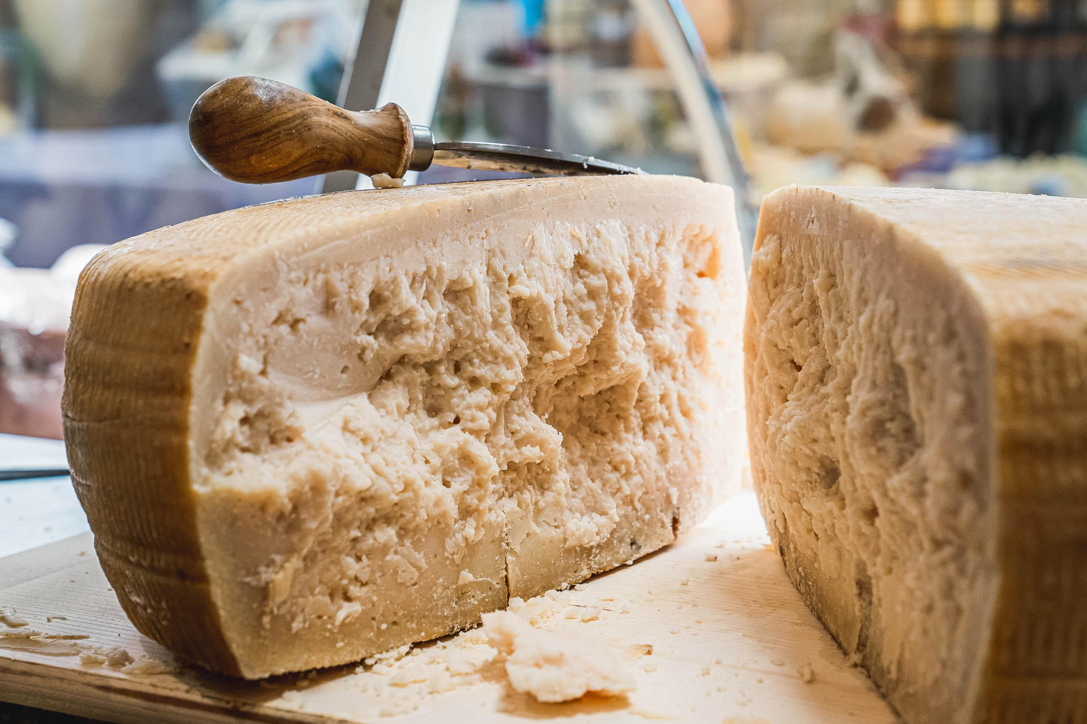
-Taste is detected by taking a sample with a toothpick and tasting;
-Smell is detected through the nose;
-a hammer to detect the consistency.......
.....when all this is typical of the desired cheese, the ripening process is interrupted and the cheese is ready to be marketed.

Slide 34
Thank You!
💛

Slide 35
Thank You!
💛

