Slide 2
Cooked cheese production (Reggiano Parmesan)
Prof. Stefano Virgili

Slide 3
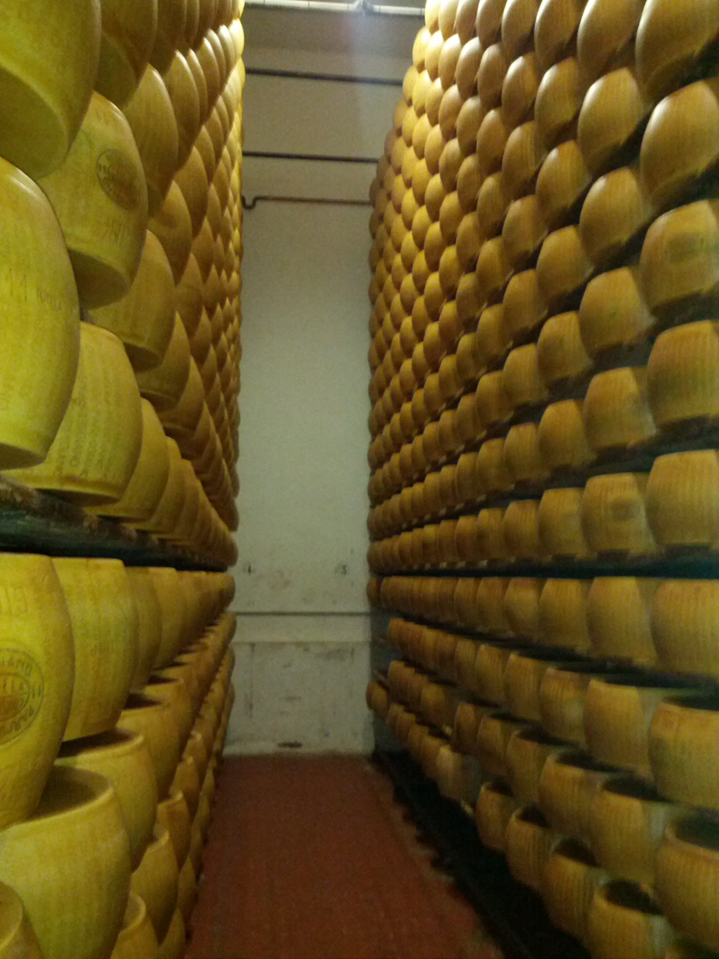
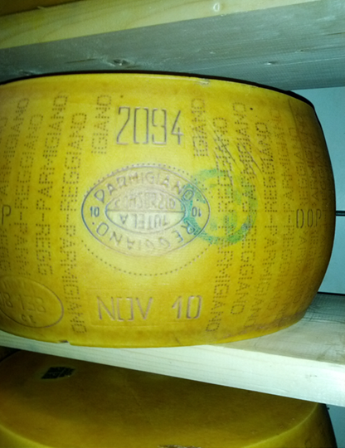
Cooked cheese
production
(Parmigiano reggiano)

Slide 5
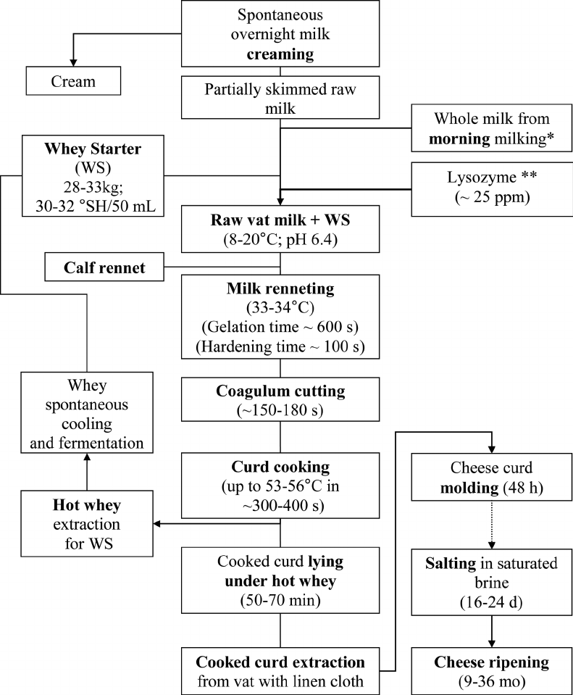
The operations for the production of Parmesan

Slide 6
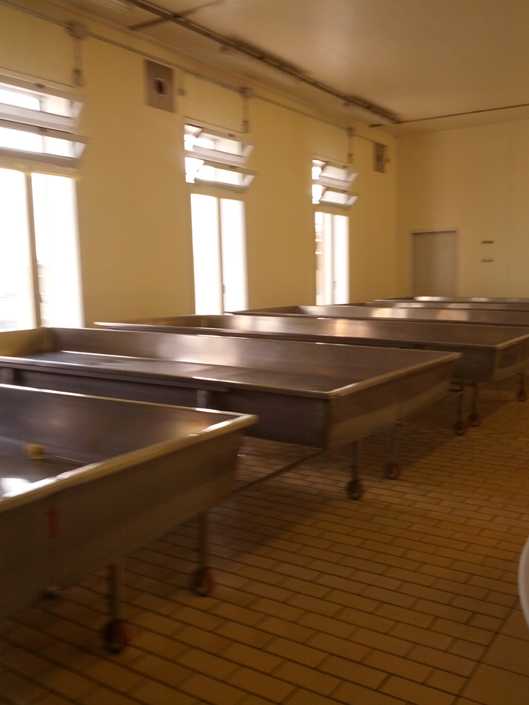
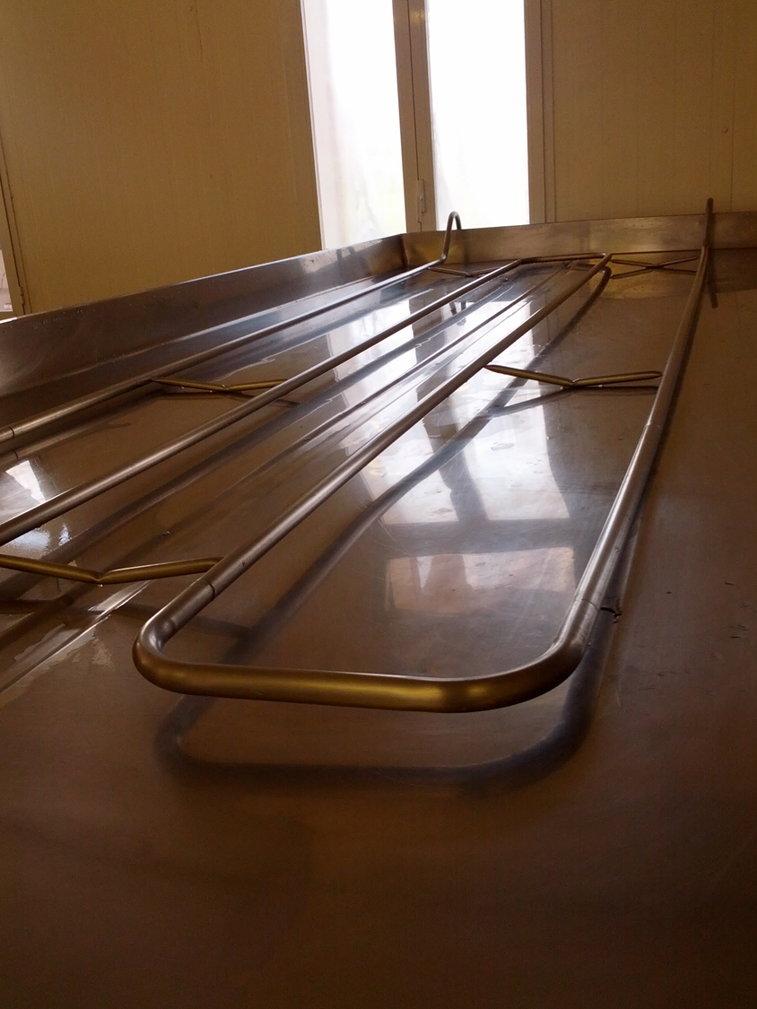
Dutch basins:
fat outcrop at 15°C for 12 hours (one night) with production of sour cream and semi-skimmed milk with 1.5 % fat.

Slide 7
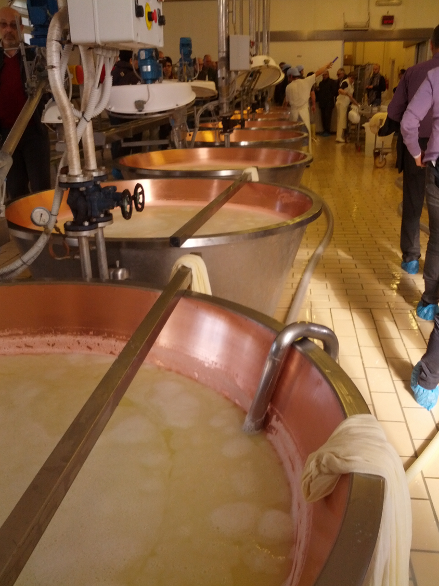
Boiler set:
The skimmed milk in the evening is mixed with whole milk in the morning to reach 2,3% fat and fed into the boilers.

Slide 8
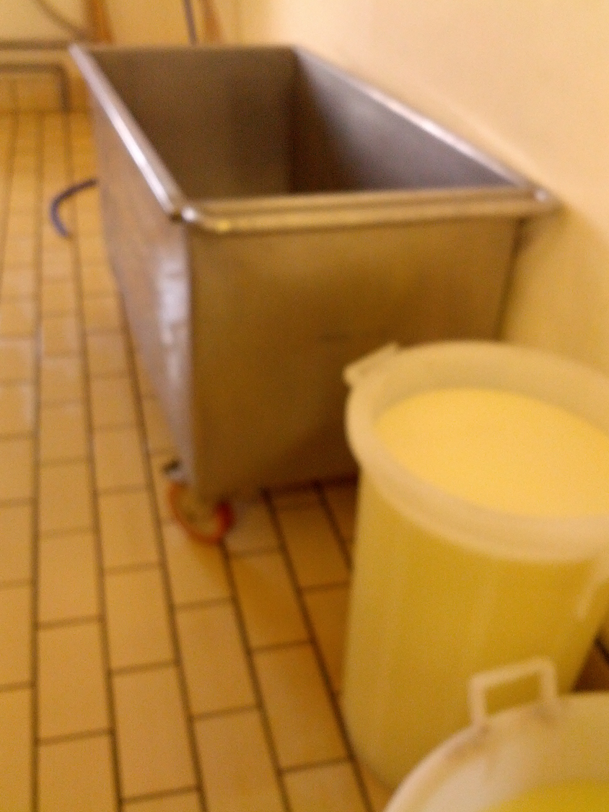
The serum graft:
serum from previous processing well incubated at 37°C for 24 hours up to 30°SH. (Lactobacillus lactis, L. helveticum and L. bulgaricus).

Slide 9
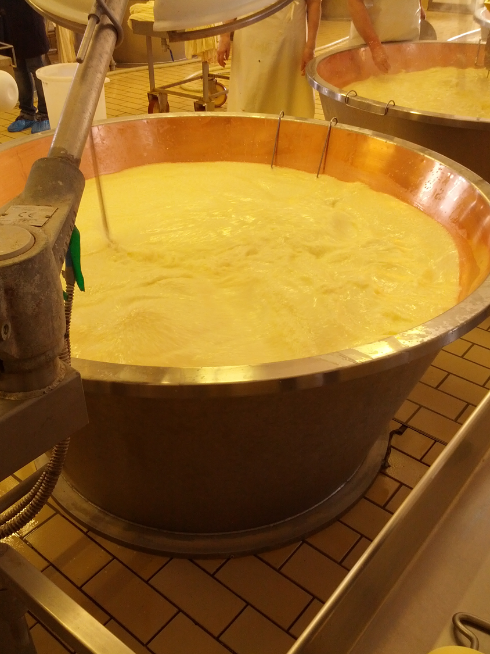
Bell-shaped copper milk boiler with 2 quintals with double bottom:
hot water flows in the cavity.
The milk is shaken and 3-4 liters / quintal of whey are added and wait about 30 minutes until 8 ° SH

Slide 10
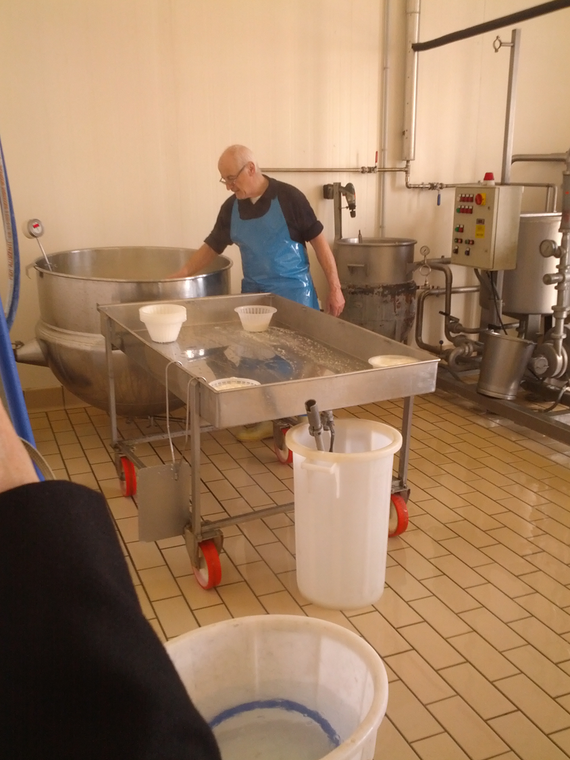
Rennet preparation: dissolve the rennet powder in 0,5-1 litre of milk.
Rennet titre: 1:100.000 (volume of milk that can coagulate in 40 minutes at 35°C).

Slide 11
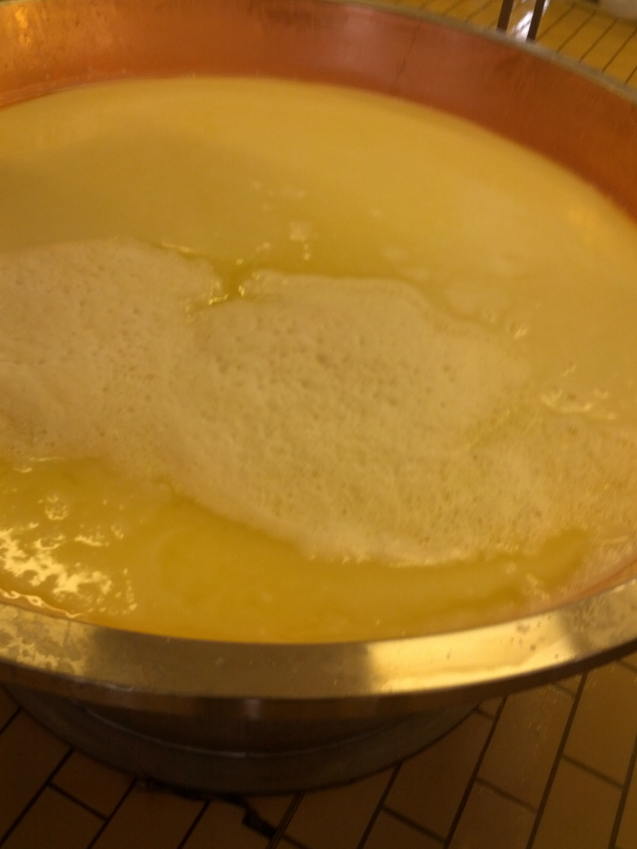
Formation of the curd:
It is heated to 33-37°C and the powdered rennet is added (1-2 gr/q.le) and waits 10-15 minutes.

Slide 12
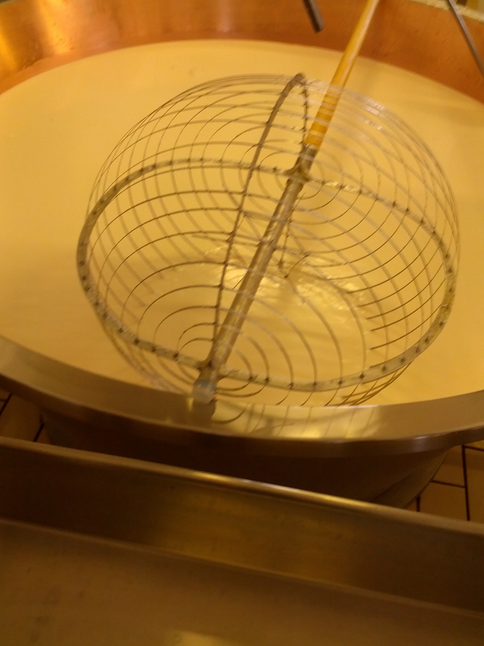
Lo spino:
breaking of the curd down to a grain of rice to favor the purging of the whey.

Slide 13
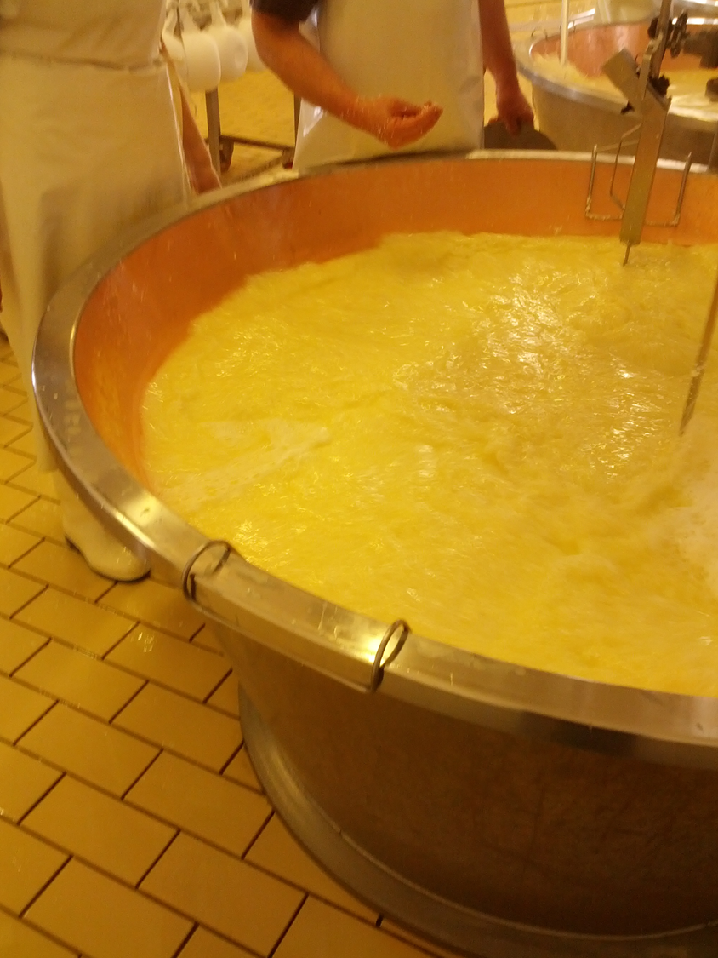
Cooking:
The temperature is raised gradually up to 45°C by stirring the curd to distribute the heat evenly until the right consistency of the granule is reached for 10-15 minutes then "firestroke" at 55°C for 1 minute to promote the heaviness of the granule.

Slide 14
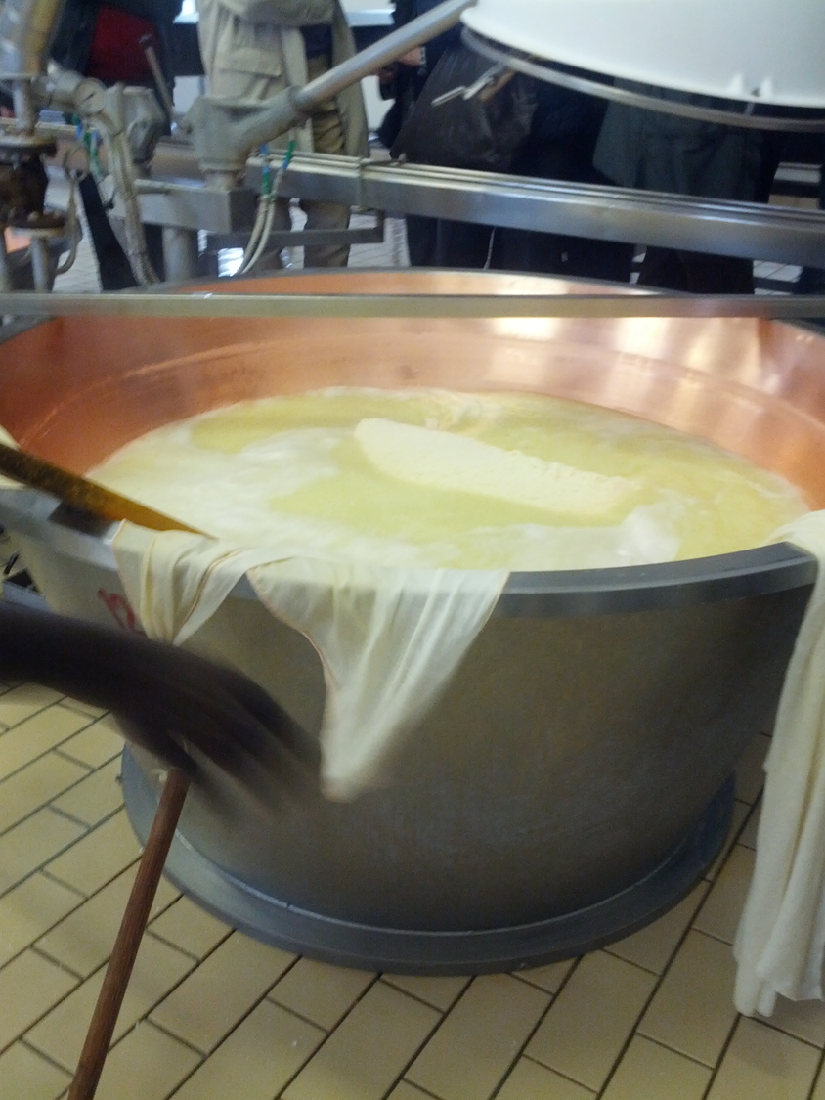
Rest:
at 55-53°C for 45 minutes: the lumps bind and the curd settles on the bottom of the boiler.
The thermophilic lactobacilli acidify up to Ph 6: the demineralisation and increase in porosity favours the purging of the serum.

Slide 15
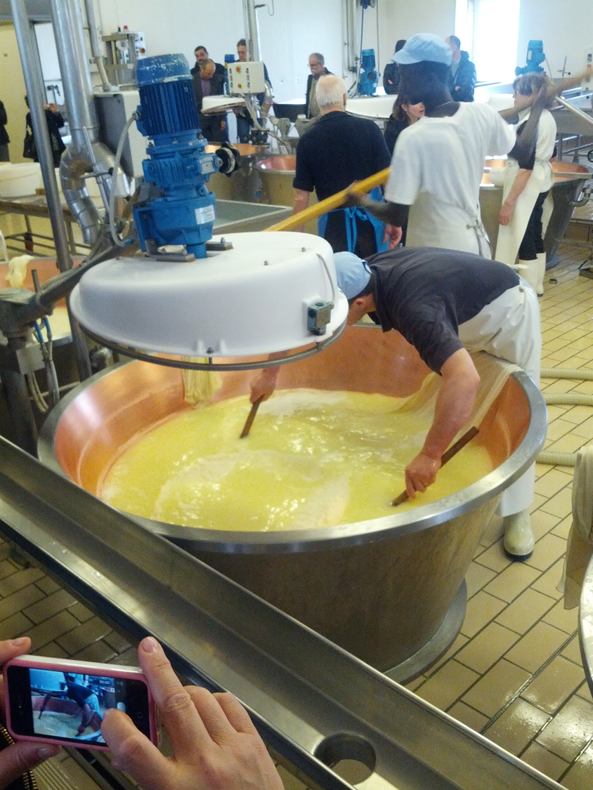
The upper part of the curd (mouth) remains floury (The smaller granules remain on the surface) while the bottom is compact and elastic (the heavier granules settle on the bottom).
When the whey becomes slightly cloudy it is placed in the mold wrapping the curd in a canvas.

Slide 16
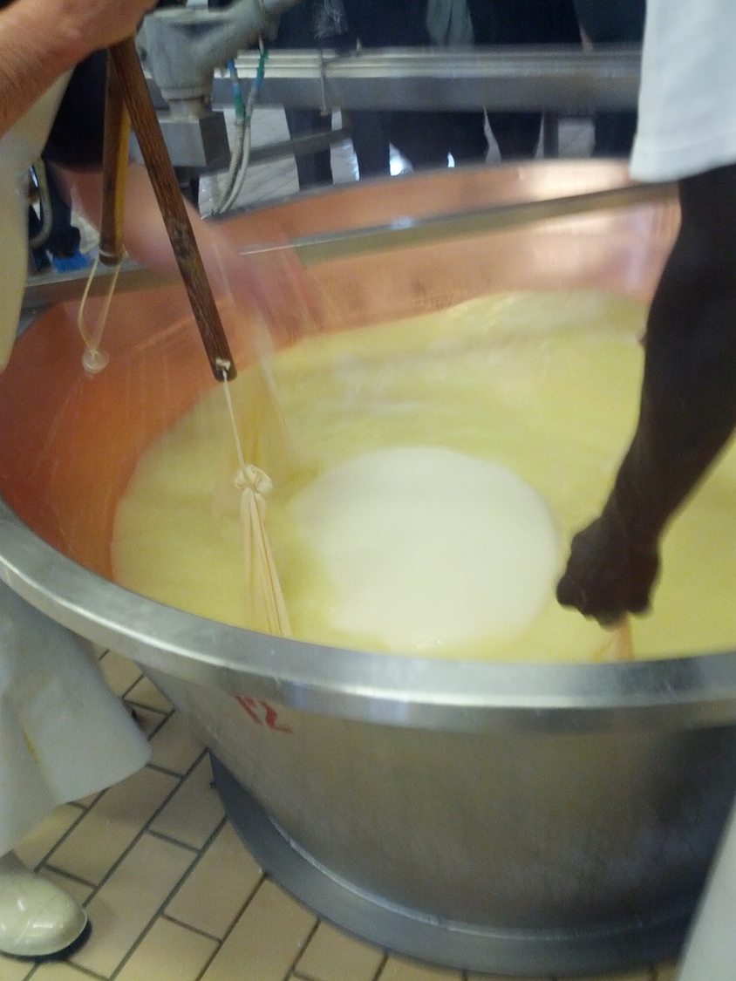
The curd is cut vertically into two parts.
Each part (about 45 kg) is laid down with the cut facing down.

Slide 17
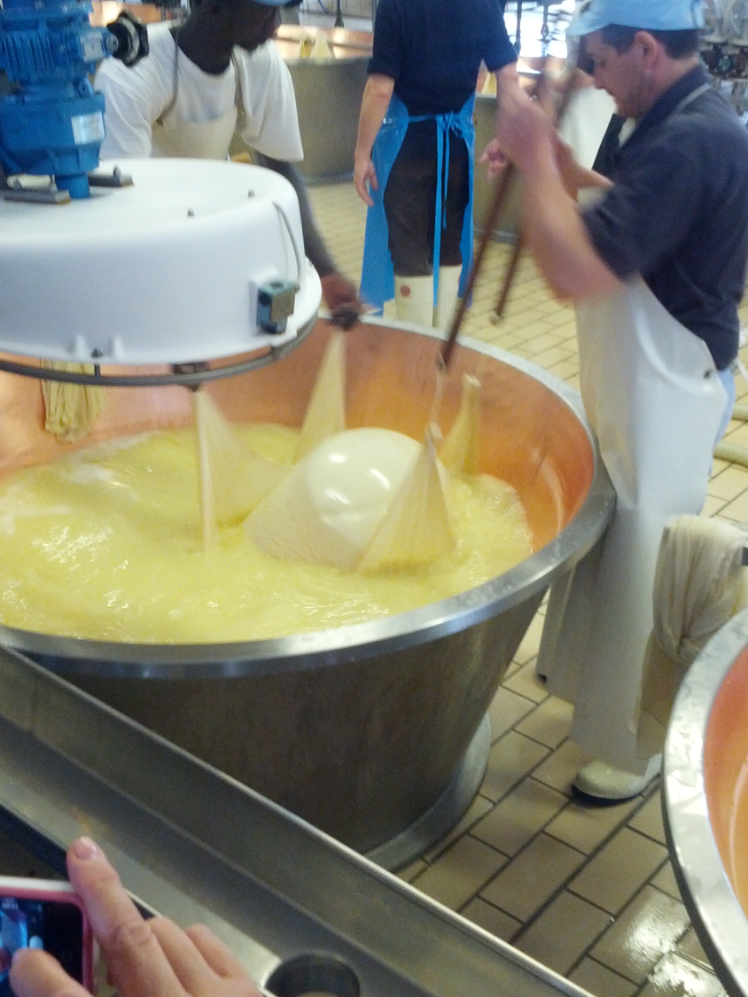
Subsequently the curd is turned over several times in the boiler leaving it immersed in the whey to give the convex shape.

Slide 18
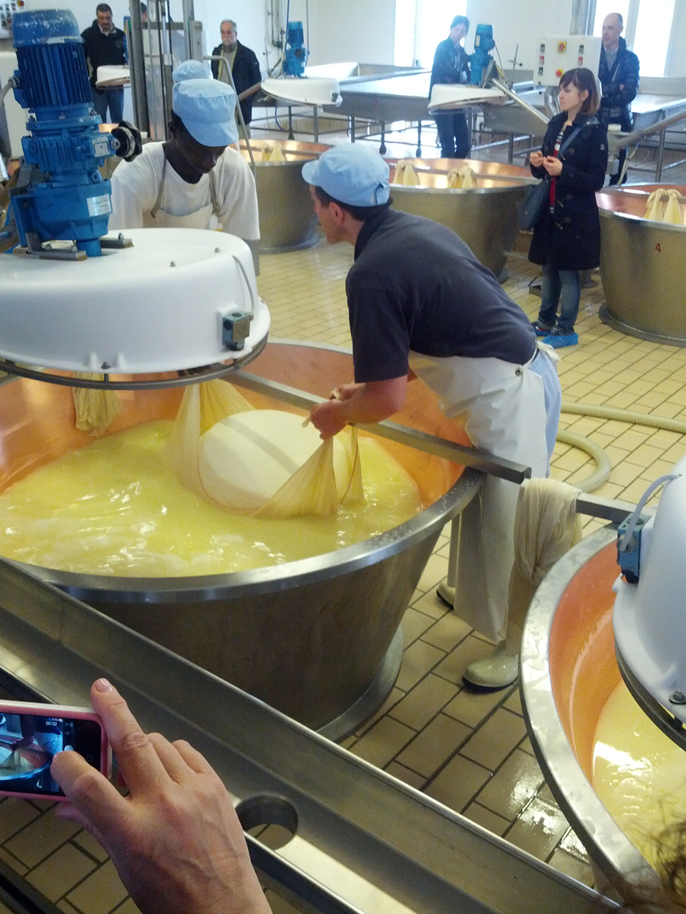
Once the right "shape" has been obtained (homogeneous convexity and circular shape) the two parts wrapped in the cloth are extracted from the serum.

Slide 19
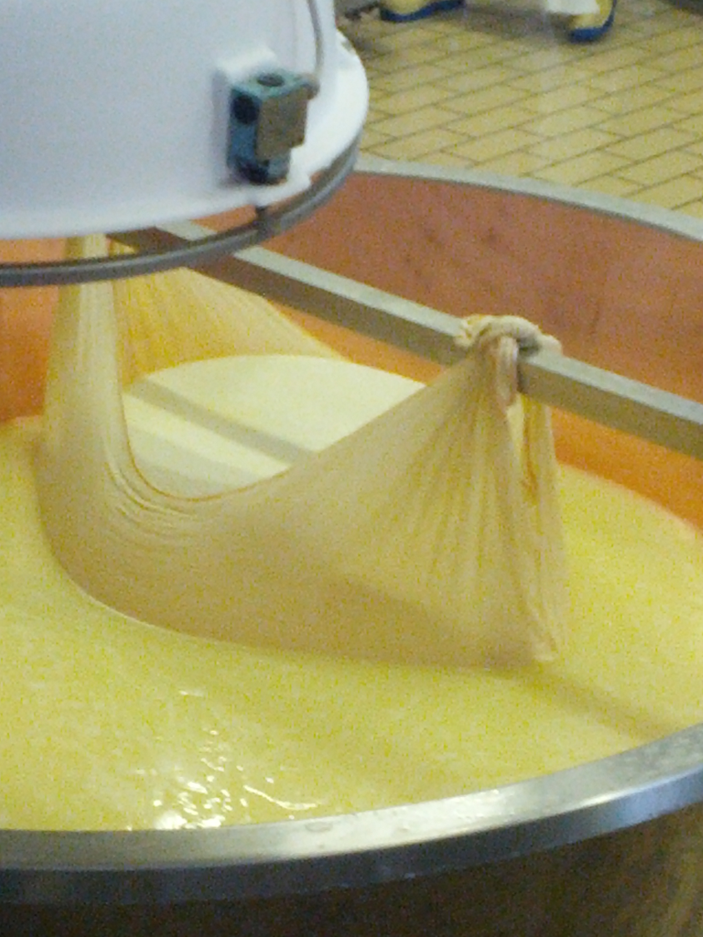
The forms remain hung for about 30 minutes to drain the whey and congeal the curd

Slide 20
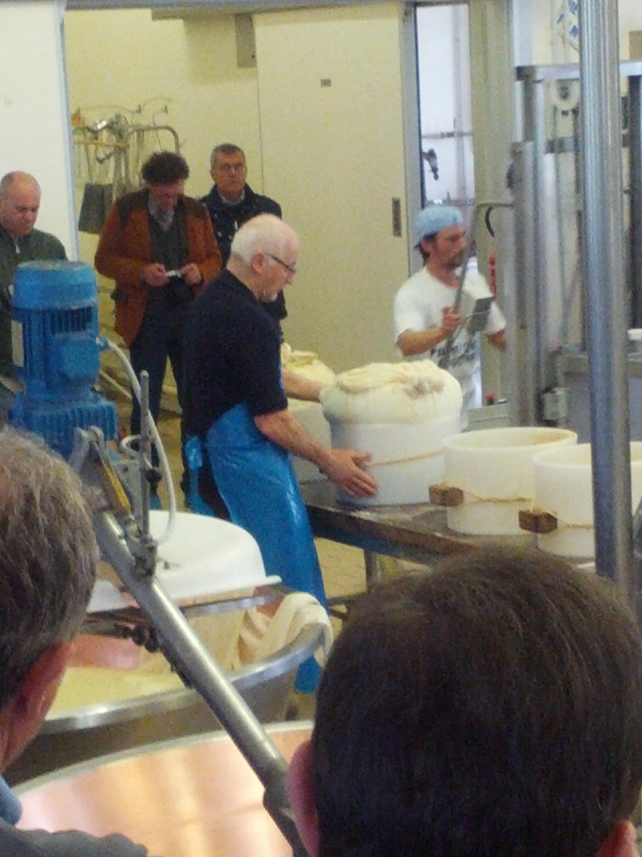
When the shape has reached a weight of 28-30 kg, it is placed in the plastic bandage with variable circumference.

Slide 21
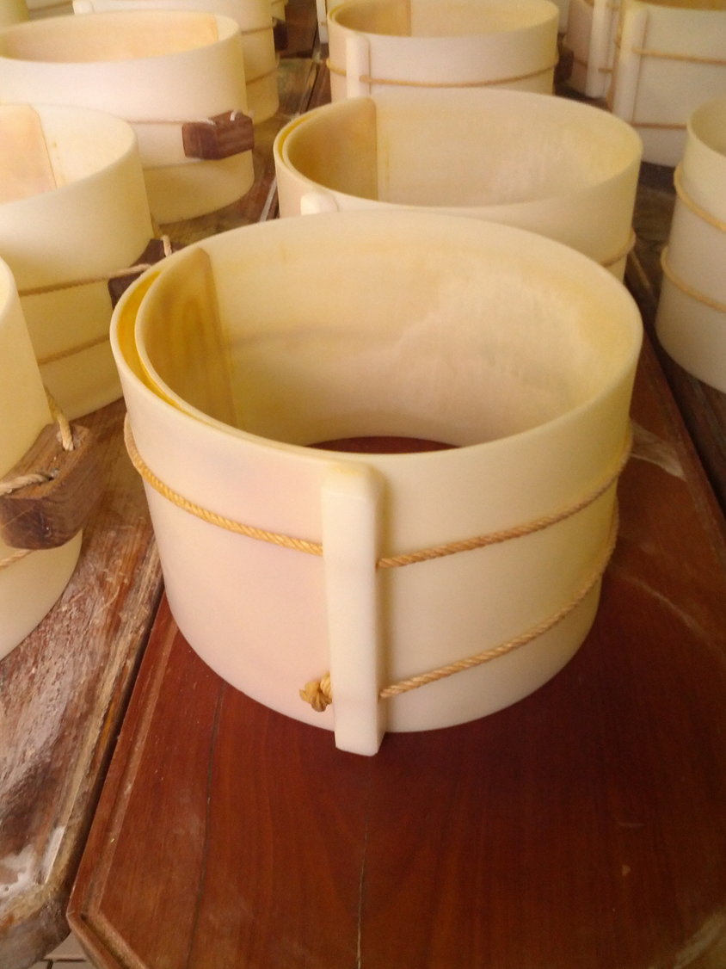
Plastic bandage with variable circumference:
tightening the ropes every 2-3 hours compresses the shape and facilitates bleeding

Slide 22
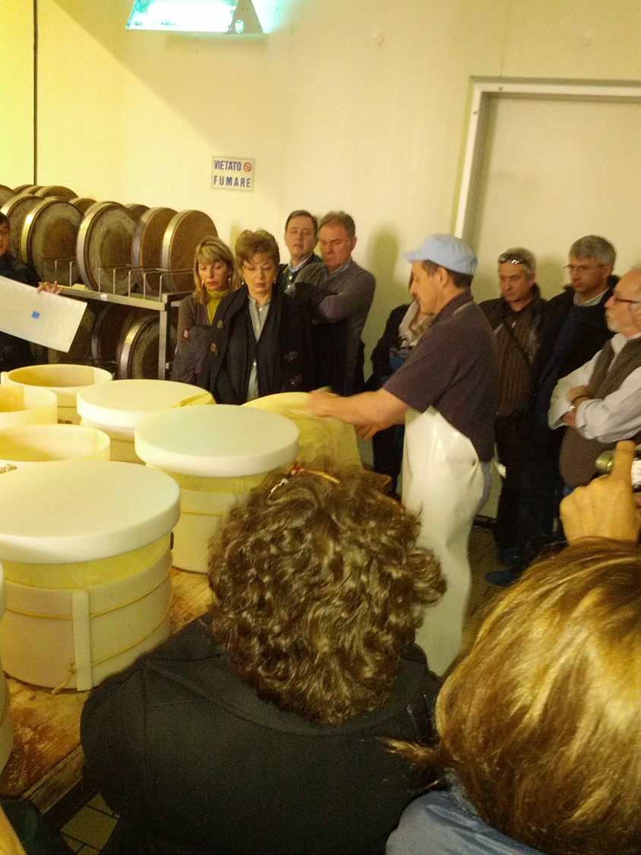
Turning of the forms:
the weights above the form are used to favour the draining and the curd is still immersed in the linen cloths which must be changed at every turning (at least 4-5 times) because it is soaked in serum.

Slide 23
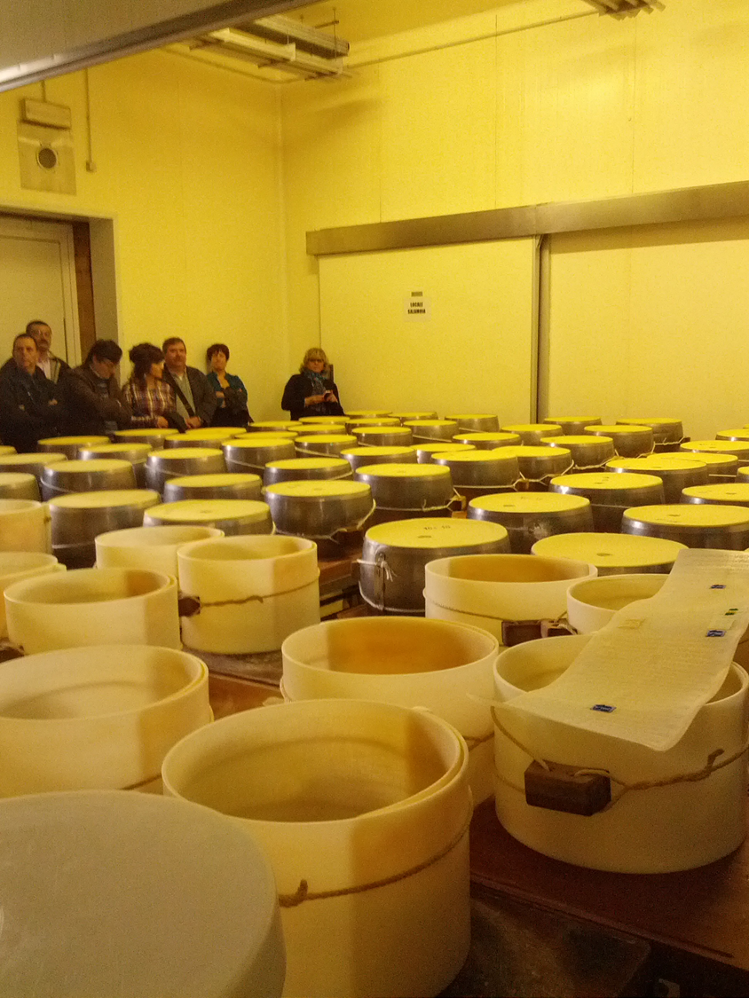
After 20-22 hours, after removing the canvas, a reusable band with the identification number of the dairy, the month and year of production, the PDO mark and the characteristic dotting with the origin mark: Parmigiano

Slide 24
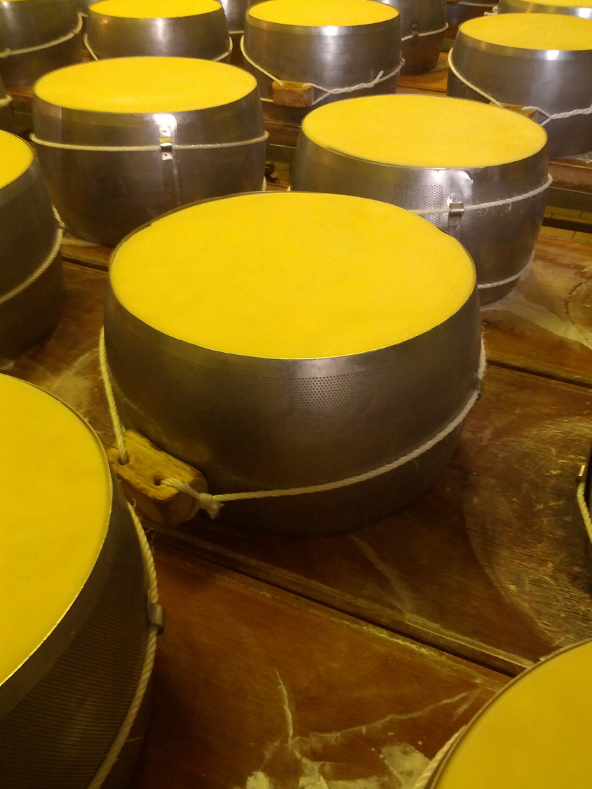
To acquire the characteristic convexity on the side, the last, on the second day, is placed in a new rounded stainless steel mold.

Slide 25
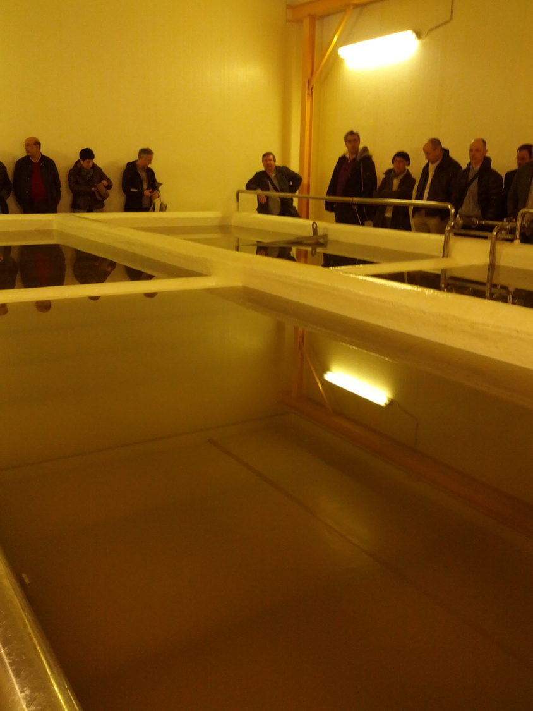
Brine:
24% salt solution (sodium chloride) is used for salting to give flavour and complete the purging of the serum by osmosis and, therefore, to allow the conservation of the cheese.

Slide 26
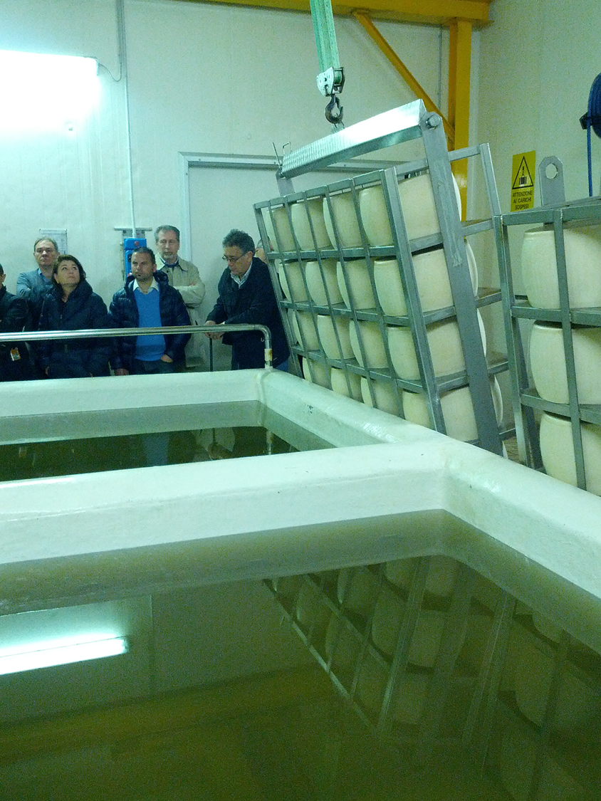
After 2-3 days the cheeses are placed in brine and remain there for 25-30 days at a temperature of 15°C.

Slide 27
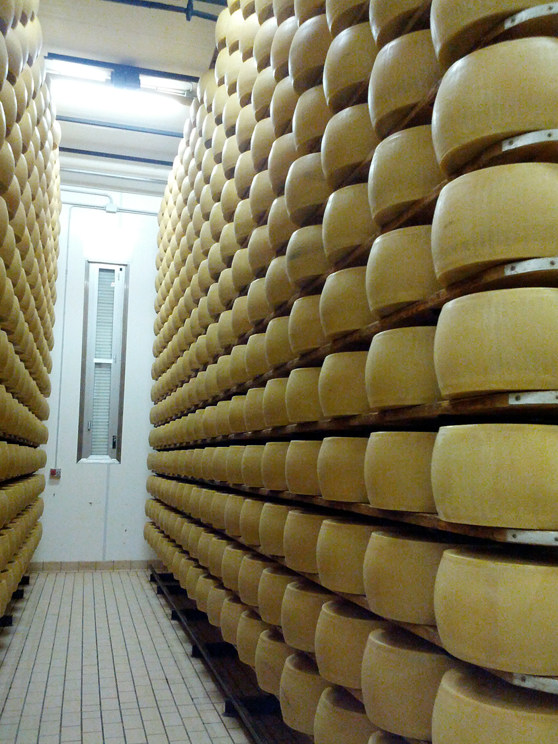
After drying at 20°C for 1 day in the hot chamber, the cheeses are placed on the "scalere" where the first phase of maturing takes place at 16-18°C with 80% relative humidity for 8-10 months.
Here there is a lactic fermentation operated by Pediococcus and Leuconostoc with lowering of the pH and formation of micro-holes.

Slide 28
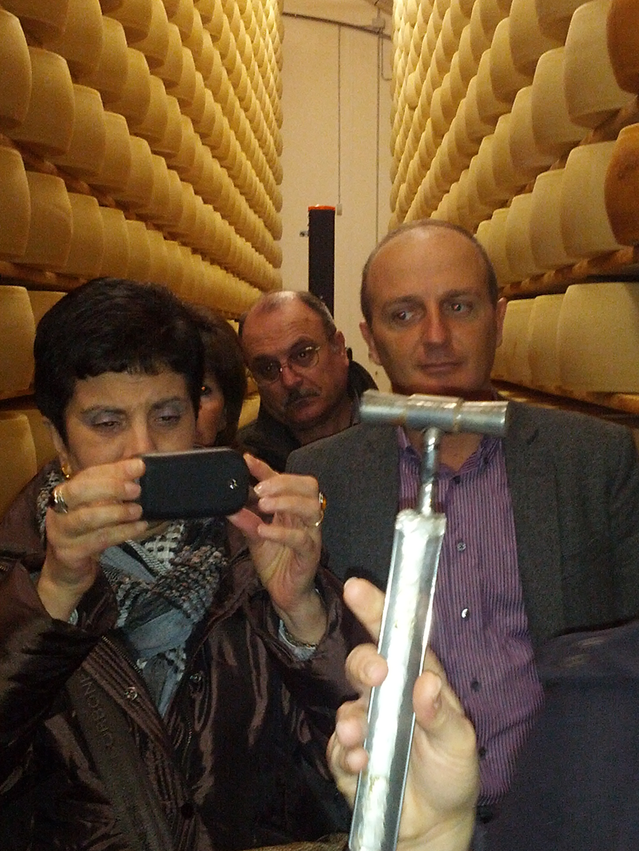
Periodically the cheesemakers together with the technicians of the consortium check the consistency of the pasta with a "hammer" and/or the presence of any diseases.

Slide 29
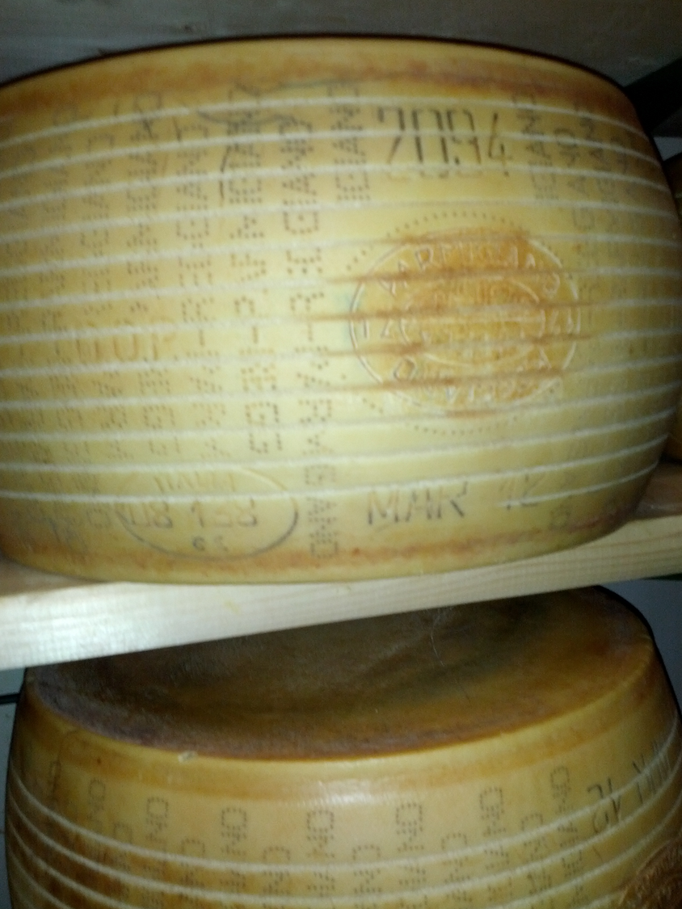
Moving the forms with too much fermentation or downgrading the product in drier rooms.

Slide 30
The second phase of maturing takes place at 12-15°C with 90% humidity for 12-36 months where proteolytic and lipolytic enzymatic activities take place with the production of aromatic substances.

Slide 31
If all went well Parmigiano is ready to be released for consumption with the date of production, the batch number and the DOP mark of the protection consortium.

Slide 32
Thank You!
💛

Slide 33
Thank You!
💛

