Slide 1
Homogenization
UNS
Ksenija Čobanović, PhD, Ass.Prof.,
Saša Krstović, PhD

Slide 2
Homogenization
Homogenization is a standard industrial process, which aims to reduce and even out the diameter of fat globules, in milk and cream, by applying high pressure.
The goal of homogenization is to increase the stability of milk fat emulsion, i.e. to prevent the separation of fat on the surface of milk during standing.

Slide 3
Homogenization
Homogenization breaks down fat globules, whose diameter in cow's milk varies from 1-5µm (0.1 - 22µm), and usually ranges from 3-4µm.
In the usual homogenization process, fat globules with a diameter of less than 2 µm are formed, and the number of globules can be increased up to 100 times, and the total surface area of the globules 6 to 10 times.
The average size of fat globules in goat's milk is 2 µm, so it is often said that goat's milk is naturally homogenized.

Slide 4
Homogenization
The homogenization process is applied in:
production of drinking milk (pasteurized and sterilized), where in addition to preventing the separation of milk fat on the surface, homogenized milk gets a fuller and richer taste, as well as increased viscosity.
In the production of fermented dairy products, homogenization, in addition to increasing the stability of milk fat, also achieves more difficult separation of milk serum due to the higher hydration of homogenized fat globules.
Homogenization is not recommended for milk intended for cheese production, especially semi-hard and hard cheese, because it leads to disruption of the technological properties of milk. Also, cream for butter making is not homogenized.

Slide 5
Homogenization process
Homogenization of milk is most often performed at a temperature of 50 - 60°C and a pressure of 150 - 200 bar (15-20 MPa).
The homogenizer is usually placed in the line of pasteurization of milk, i.e. the milk after preheating and separation/standardization goes to homogenization, and then returns to the pasteurizer for heating to the pasteurization temperature.
In addition to homogenizing the entire amount of milk, partial homogenization can be performed, when only cream or part of cream is homogenized after leaving the separator, and then the homogenized cream is mixed with skimmed milk and pasteurized.

Slide 6
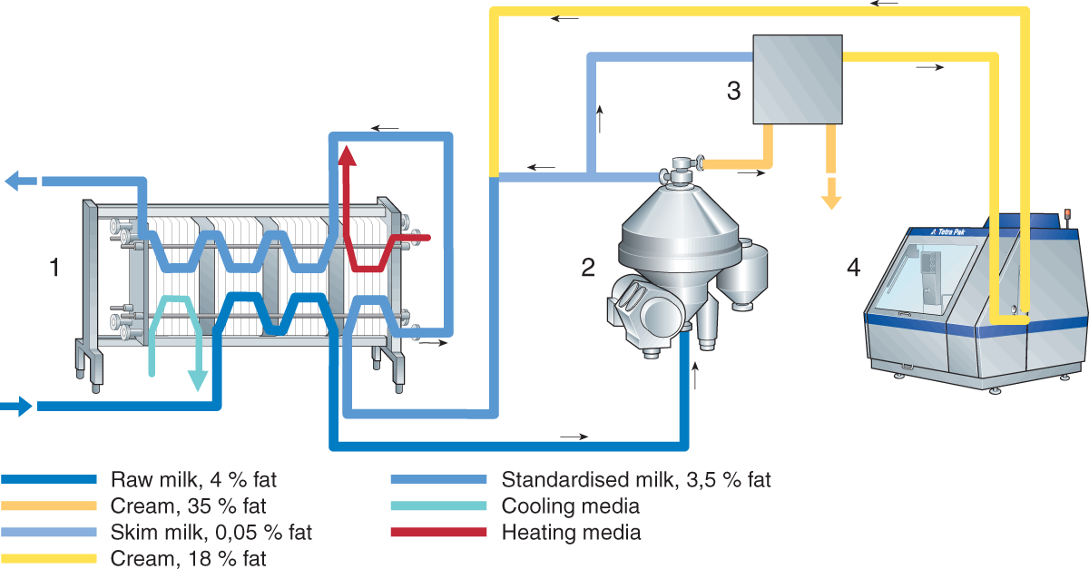
Raw milk, 4% fat
Cream, 35% fat
Skim milk, 0,05% fat
Cream, 18% fat
Standardised milk, 3.5% fat
Cooling media
Heating media
Product flow at partial stream homogenization (Dairy Processing Handbook ©Tetra Pak)

Slide 7
Homogenization process
Homogenization can be one-step or two-step.
In two-stage homogenization, the pressure is higher in the first stage and amounts to 15-25 MPa, and in the second stage it is lower, 5 - 10 MPa
Disruption of fat globules in first and second stages of homogenization
(Dairy Processing Handbook ©Tetra Pak)

Slide 8
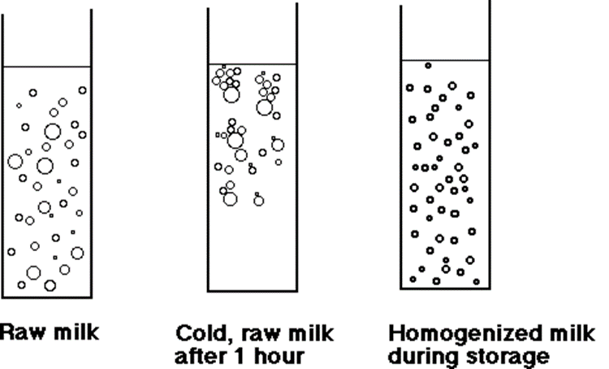
Appearance of fat globules in raw milk, cold raw milk and homogenized milk during the storage period
Raw milk
Cold, raw milk after 1 hour
Homogenized milk during storage

Slide 9
Homogenizer
The main part in the homogenizer is the homogenization head with valves, which can be of different constructions.
Non-homogenized milk passes through small valve openings and then fat globules/droplets are crushed
Homogenised product
Unhomogenised product
Homogenised product
Gap 0,1mm
Homogenization valve
(Dairy Processing Handbook ©Tetra Pak)

Slide 10
Homogenizer
After disruption or crushing of fat globules, the membrane of the fat globule regenerates by adsorption of proteins from milk.
Smaller fat globules contain more protein, especially casein, so homogenized milk is whiter.
Even after homogenization, milk fat is in the form of fat globules, and not as free fat.
Casein
Fat globule
Fat globule with proteins
Before homogenisation
After homogenisation
Appearance of fat globules before and after homogenization and distribution of casein micelles

Slide 11
Homogenization results
The main result of homogenization is obtaining a stable emulsion, which means that the size of the fat globule does not change significantly with time and with a significantly reduced tendency to move.
Other advantages are:
Smaller fat globules, which do not lead to the separation of the layer of cream during the standing of the milk.
Whiter colour and fuller taste, even in products with reduced milk fat content
Reduced sensitivity to fat oxidation
Better stability of fermented dairy products

Slide 12
Homogenization results
In addition to the advantages, the homogenization process can also cause certain disadvantages of milk, namely:
Homogenized milk cannot be efficiently separated,
Increased sensitivity to light,
Increased tendency to lipolysis, due to the larger total surface area of milk fat globules,
Reduced thermal stability,
Reduced ability to coagulate casein, after the homogenization process part of the casein is used to regenerate the membranes of fat globules,
Homogenized milk is not suitable for the production of semi-hard and hard cheeses, due to the coagulum, which is too soft and whey is difficult to separate.

Slide 13
Thank You!
💛

