Slide 1
Curriculum: Module 4 Fermented milk products
COAG Jaén

Slide 2
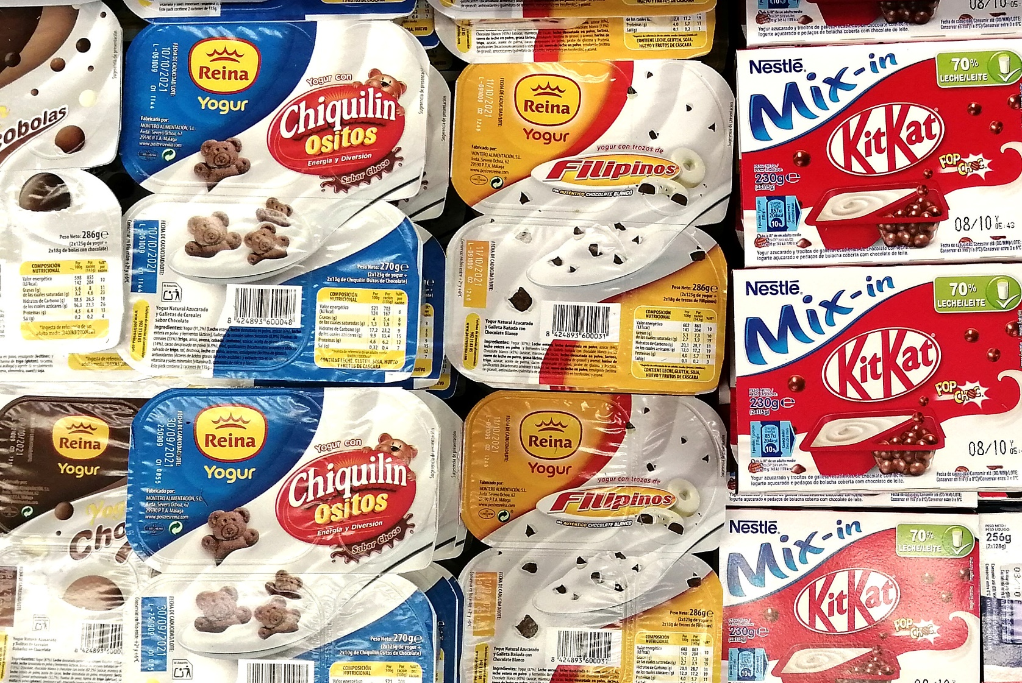
Structure: Fermented milk products
Yogurt and other fermented milks.
Types of yogurt and fermented milks.
Nutritional value.
Essential factors of composition and quality.
Raw materials used in yogurt elaboration.
Processing technology.
References / links.

Slide 3
4.1. Types of yogurt and fermented milks
Fermented milks or sour milks have been known since ancient times (North Africa and Babylon, 3,000-2,500 BC). In ancient Greece and Rome, sour milks were already used as a beverage or in recipes.
They are basically made from milk acidified with a selected culture or group of bacteria, which convert part of the lactose into lactic acid.
Many fermented milks (koumis, leben, dadhi, sour whey, yogurt, airan, kheran, tarho) have their origin in the nomadic cattle-herding peoples of Asia. Their spread throughout Europe is due to the arrival of these peoples, as well as the Germanic and Nordic nations.
Modern fermented milks with microorganisms such as Lactobacillus casei, Lactobacillus acidophilus or Bifidobacterium bifidus are now available on the market.

Slide 4
4.1. Types of yogurt and fermented milks
Name | Origin | Fermentative microorganisms
Yogurt (goat, sheep, cow) | Bulgaria, Turkey | Lactobacillus bulgaricus Streptococcus thermophilus
Kefir (cow) | Caucasus | Lactobacillus acidophilus Streptococcus casei Streptococcus lactis Streptococcus cremoris Streptococcus diacetylactis Candida kefir Kluyveromyces fragilis
Koumis (mare, cow) | Central Asia | Lactobacillus bulgaricus Lactobacillus acidophilus Streptococcus lactis Kluyveromyces lactis
Name | Origin | Fermentative microorganisms
Buttermilk (cow) | Anglo-Saxon countries | Lactobacillus bulgaricus Lactobacillus acidophilus Streptococcus lactis Streptococcus cremoris Leuconostoc cremoris
Biogarde | France | Lactobacillus acidophilus Streptococcus thermophilus Bifidobacterium bifidum
Ymer | Nordic countries | Leuconostoc cremoris Streptococcus lactis Streptococcus cremoris Streptococcus diacetylactis
Source: Condony et al. (1988)

Slide 5
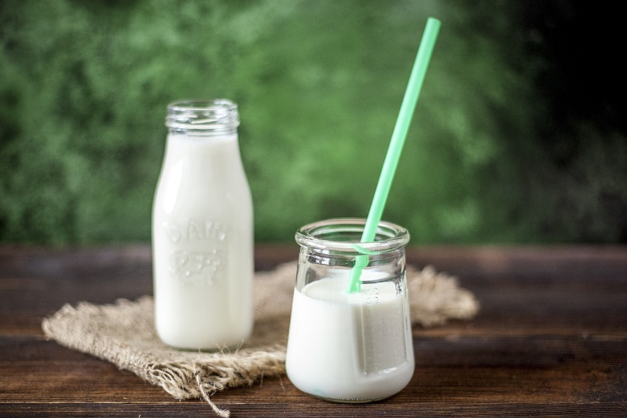
4.1. Types of yogurt and fermented milks
Name | Origin | Fermentative microorganisms
Acidophilic milk |  | Lactobacillus acidophilus
Bioghourt | France | Lactobacillus acidophilus Streptococcus thermophilus
Yakult | Japan | Lactobacillus casei
Source: Condony et al. (1988)
Free picture from Imo Flow in Pixabay

Slide 6
4.1. Types of yogurt and fermented milks
Yogurt is one of the most important fermented milks in our western culture.
"Yogurt" is a word of Turkish origin. Some authors place the origin of yogurt in Turkey (yogurut), while others attribute it to prokish made in Thrace (in the Balkans).
It seems that nomadic peoples used sacks, generally made of goatskin, to transport the fresh milk they obtained from the animals. The heat and the contact of the milk with the goatskin provided the multiplication of lactic bacteria that fermented the milk. Thus, the milk was turned into a semi-solid mass by coagulation.
Yogurt is the product of the fermentation of natural milk (cow's, goat's, buffalo's, etc.) produced by bacteria (Lactobacillus bulgaricus and Streptococcus thermophilus) that make it more digestible and nutritious than milk itself.

Slide 7
4.1. Types of yogurt and fermented milks
Traditional Greek yogurt (tiaourti) was made using mainly sheep's milk and drained (skimmed) after fermentation to produce a product with a high dry matter content and a very sour taste.
The Russian biologist Ylya Metchnikoff, a member of the Pasteur Institute and Nobel Prize winner in 1908, demonstrated the benefits of yogurt lactic acid bacteria in the gut for improved digestion.
In 1917, Isaac Carasso produced yogurt in Barcelona following industrial processes, as a product sold only in pharmacies.
After World War I, Greek restaurants started serving yogurt as a traditional drink. The first Greek industrial yogurt in Greece was made by fermenting cow's milk and concentrating it after fermentation by centrifugation.
In the 1950s, yogurt began to be distributed in dairies and later in grocery shops.

Slide 8
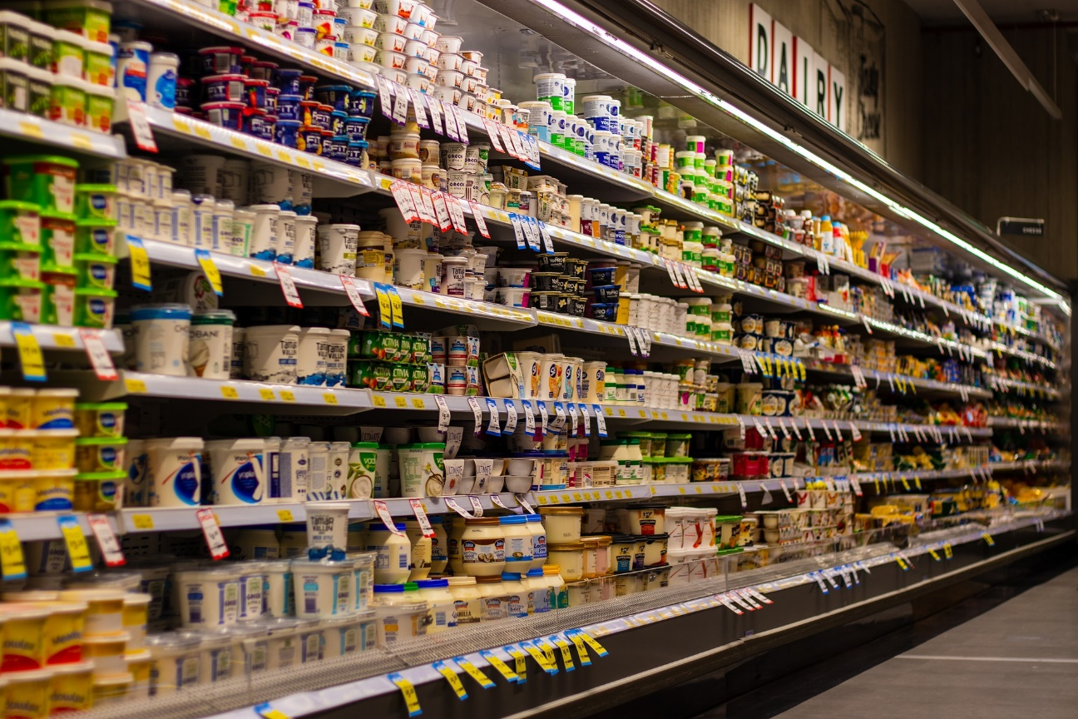
4.1. Types of yogurt and fermented milks
Nowadays, each country defines "yogurt" differently according to its own regulations, with changes in terms of composition or method of production. Thus, the same product may be considered yogurt in one country but a type of fermented milk in another: the key is the amount of live bacteria present.
Even some products are called yogurt while they are not made from milk! We are talking about soya yogurt or yogurt pasteurised after fermentation.
Free picture from Squirrel photos in Pixabay

Slide 9
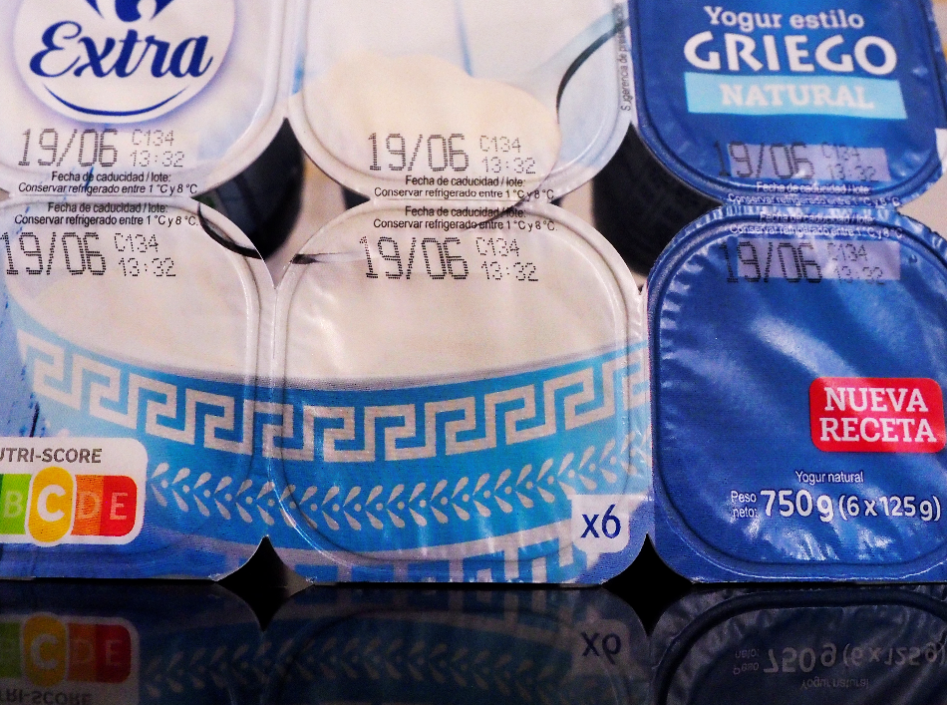
4.1. Types of yogurt and fermented milks
Types of yogurt
A) According to treatment after fermentation
Fresh yogurt: no heat treatment applied after fermentation; it needs cold storage (1-8 ºC).
Pasteurised yogurt after fermentation: a pasteurisation heat treatment is applied after fermentation, whereby the viability of the lactic bacteria is lost but the nutritional characteristics of the product are maintained; it does not require cold storage.
B) According to fat content
Enriched yogurt: cream is added.
Full-fat yogurt: made with whole milk.
Semi-skimmed yogurt: made with semi-skimmed milk.
Skimmed yogurt: made with skimmed milk.

Slide 10
4.1. Types of yogurt and fermented milks
C) According to consistency
Firm rennet yogurts: the yogurt, once homogenised and pasteurised, ferments in the same glass. These are natural, sweetened, flavoured, skimmed and sweetened yogurts.
Broken rennet yogurts: fermented in an industrial tank or fermentation tank, stirred, cooled and packaged (plain or combined with other ingredients). These are Greek yogurts, liquid yogurts, creamy yogurts and yogurt mousses.
D) According to the recipe.
Plain yogurt: this is the most basic yogurt, to which no flavours or sugar are added, nor is it pasteurised after fermentation.
Other types of yogurt (flavoured, sweetened, flavoured, Greek, with fruits): enriched with various ingredients: flavouring agents, sugars, fruits, etc.

Slide 11
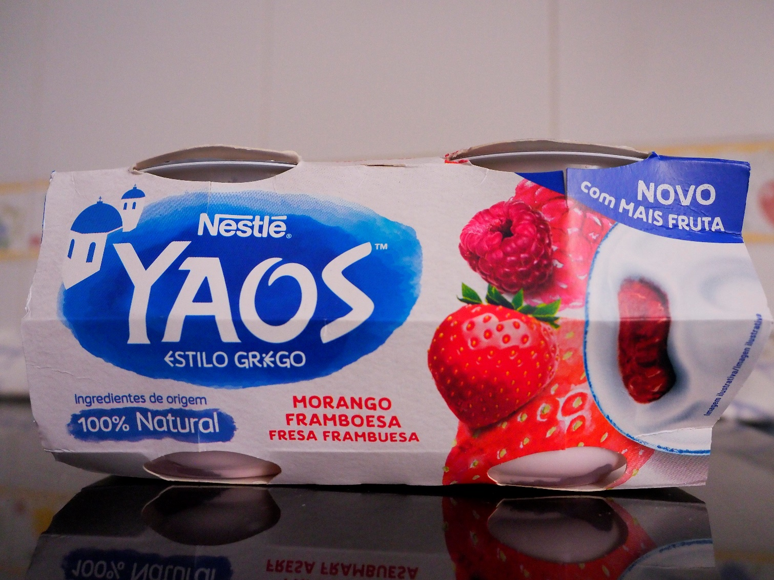
4.1. Types of yogurt and fermented milks
Greek-style yogurt: this is a type of concentrated, high-fat sheep's milk yogurt with the same fermenting strains as traditional yogurt. They are often made from cow's milk as their production has become industrialised. Many variations can be found on the market (protein 3,5-10 %, fat 0-10 %, combinations with fruit, honey or cereals, etc.). A typical Greek yogurt has a high protein level (>8%) and high fat content (8-9%), high yogurt taste and acidity; it is a very thick and creamy product.

Slide 12
Natural Greek style yogurt
Concentration to high protein level after fermentation
Skimmed milk
(eventually fortified)
Typical process & recipe:
Enrichment of the recipe in proteins by centrifugation after fermentation
High protein level (>8%)
0% to medium fat level (<5%)
Homogenization
Typical market: US & Greece
Health & wellness + Indulgence positioning
Additions of probiotics
All natural (without stabilizers)
Strained process
High protein concentration after fermentation
Pasteurization (92°C – 5 min)
Cooling to 42°C
Culture
Fermentation to pH= 4,70 – 4,50
Product & process challenges:
Slow pH decrease during separation process to ensure mild flavor to the end product
Fresh & clean mouthfeel
Smooth, shiny and creamy texture in low / 0% fat
variations and all natural recipes
Centrifugation at 42°C
Whey Cream
Smoothing
Cooling to 20-25°C
Advantages:
Possibility to reach high level of proteins with smooth
texture
Filling – Cooling – Storage <6°C
Source: Würth, D.

Slide 13
4.2. Nutritional value
Yogurts and fermented milks are rich in proteins of high biological value, easily assimilated calcium, B vitamins (especially B2 or riboflavin, but also folic acid, thiamine, vitamin B6 or pyridoxine and vitamin B5 or pantothenic acid) and fat-soluble vitamins (A, D, E and K), depending on the fat content. They also include carbohydrates and minerals.
The live cultures present in yogurts and fermented milks increase intestinal lactase activity and improve the digestion of lactose (milk sugar), making them suitable (generally) for people with lactose digestion problems.
Recommended daily servings of dairy products depend on age, sex and physiological state (children, adults and men over 60, 2-3 servings/day; teenagers, 2-4 servings/day; pregnant or breastfeeding women, athletes and women over 60, 3-4 servings/day; 1 serving= 2 yogurts).

Slide 14
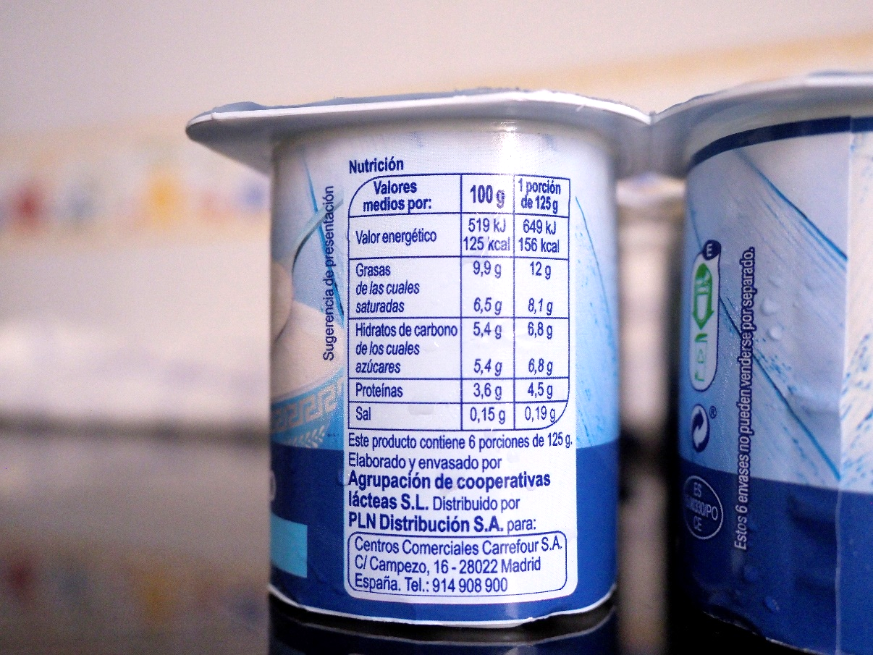
4.2. Nutritional value
It is advisable to consume whole dairy products, as fat-soluble vitamins and essential fatty acids are lost when the fat is separated.
Enriched products with fat-soluble vitamins (A, D, E and K) and essential fatty acids are recommended for overweighted people or those who are advised to consume semi or skimmed dairy products due to health problems.
In addition to its nutritional value, yogurt consumption benefits the body because it facilitates digestion (due to pre-digestion by the proteolytic enzymes of the microorganisms, which release free peptides and amino acids that are easily digested and absorbed; and due to the lower pH, which causes the precipitation of casein and facilitates the action of intestinal enzymes) and favours the absorption of calcium (because of the presence of lactic acid).

Slide 15
4.2. Nutritional value
The nutritional value of dairy products depends on the milk used in their production and the effects of processing (heat treatment, storage, skimming, etc.). In the case of fermented milks, the activity of microorganisms has an impact on the nutritional and biological value of nutrients in the final product. For example, skimmed products have a lower content of fat-soluble vitamins, which are unintentionally removed when the cream is extracted.
The energy value, macronutrient composition, vitamin and mineral content are similar to those of the starting milk, but from a nutritional point of view, fermented milks are a food with better digestibility, high enzyme concentration and a slight increase in B vitamins. All this makes them a food of high nutritional value.
The next two tables show the nutritional composition of several milk products.

Slide 16
4.2. Nutritional value
Nutritional composition
 | Water (g) | Energy (Kcal) | Protein (g) | Carbohydrates (g) | Lipids (g) | Calcium | Phosphorus | Zinc
Cow's milk (whole) | 88,4 | 65,9 | 3,1 | 4,7 | 3,8 | 124 | 92 | 0,38
Cow's milk (skimmed) | 91 | 37,6 | 3,9 | 4,9 | 0,2 | 121 | 97 | 0,54
Plain yogurt (whole) | 87,9 | 64,4 | 4 | 5,5 | 2,6 | 142 | 170 | 0,59
Plain yogurt (skimmed) | 89,1 | 47,8 | 4,3 | 6,3 | 0,32 | 140 | 109 | 0,44
Flavoured yogurt (whole) | 75,6 | 114 | 5,4 | 15,6 | 3,4 | 121 | 140 | 0,52
Yogurt with fruits (whole) | 78,7 | 95 | 3,8 | 14,3 | 2,3 | 109 | 130 | 0,3
Greek yogurt | 78 | 139 | 6,4 | 5,4 | 10,2 | 150 | 130 | 0,5
Fermented milk with Lactobacillus casei | 79,6 | 98,1 | 3 | 14,1 | 3,3 | 110 | 107 | 0,3
Fermented milk with Lactobacillus acidophilus | 79,5 | 98,5 | 3,1 | 14,1 | 3,3 | 105 | 107 | 0,7
Fermented milk with bifidobacteria (whole) | 88,6 | 62,6 | 3,6 | 4,4 | 3,3 | 141 | 107 | 0,4
Fermented milk with bifidobacteria (skimmed) | 89,3 | 44,3 | 4,9 | 5,5 | 0,3 | 164 | 135 | 0,5
Source: Ortega et al. (2004)

Slide 17
4.2. Nutritional value
Nutritional composition
 | B1 | B2 | B3 | B6 | B9 | B12 | C | A | D | E
Cow's milk (whole) | 0,04 | 0,19 | 0,73 | 0,04 | 5,5 | 0,3 | 1,4 | 46 | 0,03 | 0,1
Cow's milk (skimmed) | 0,04 | 0,17 | 0,9 | 0,04 | 5,3 | 0,3 | 1,7 | Tr | Tr | Tr
Plain yogurt (whole) | 0,04 | 0,18 | 0,44 | 0,05 | 3,7 | 0,2 | 0,7 | 9,8 | 0,06 | 0,04
Plain yogurt (skimmed) | 0,04 | 0,19 | 1,2 | 0,08 | 4,7 | 0,4 | 1,6 | 0,8 | 0 | Tr
Flavoured yogurt (whole) | 0,03 | 0,2 | 0,44 | 0,05 | 13,5 | 0,17 | 0,94 | 27,4 | 0,05 | 0,08
Yogurt with fruits (whole) | 0,03 | 0,2 | 1,4 | 0,013 | 18,1 | 0,18 | 0,7 | 14,5 | 0,04 | 0,03
Greek yogurt | 0,03 | 0,36 | 1,6 | 0,05 | 6 | 0,2 | Tr | 121 | 0,05 | 0,38
Fermented milk with Lactobacillus casei | 0,04 | 0,08 | 0,42 | 0,09 | 2,6 | 0,2 | Tr | 2,6 | 0,03 | Tr
Fermented milk with Lactobacillus acidophilus | 0,04 | 0,08 | 0,42 | 0,09 | 2,6 | 0,2 | Tr | 2,6 | 0,03 | Tr
Fermented milk with bifidobacteria (whole) | 0,04 | 0,18 | 0,42 | 0,09 | 5 | 0,3 | 1 | 33,5 | 0,2 | 0,3
Fermented milk with bifidobacteria (skimmed) | 0,04 | 0,21 | 0,42 | 0,11 | 5 | 0,3 | Tr | 2 | 0 | Tr
Source: Ortega et al. (2004)

Slide 18
4.3. Essential composition and quality factors
Real Decreto 271/2014, de 11 de abril, por el que se aprueba la Norma de Calidad para el yogur o yoghourt (Spanish regulation). Article 6: Essential composition and quality factors
1. All yogurts must have a pH of 4,6 or less.
2. The minimum fat content of yogurts, in the milk content, shall be 2 per 100 m/m, except for "semi-skimmed" yogurts, where it shall be less than 2 and more than 0.5 per 100 m/m, and for "skimmed" yogurts, where it shall be 0.5 per 100 m/m or less.
3. All yogurts shall have a minimum solids-non-fat content of 8.5 per 100 m/m in the milk part of the yogurt.
4. Yogurt content:
(a) For yogurts with fruits, juices and/or other foods, the minimum amount of yogurt in the finished product shall be 70 per 100 m/m.
(b) For flavoured yogurts, the minimum amount of yogurt in the finished product shall be 80 per 100 m/m.

Slide 19
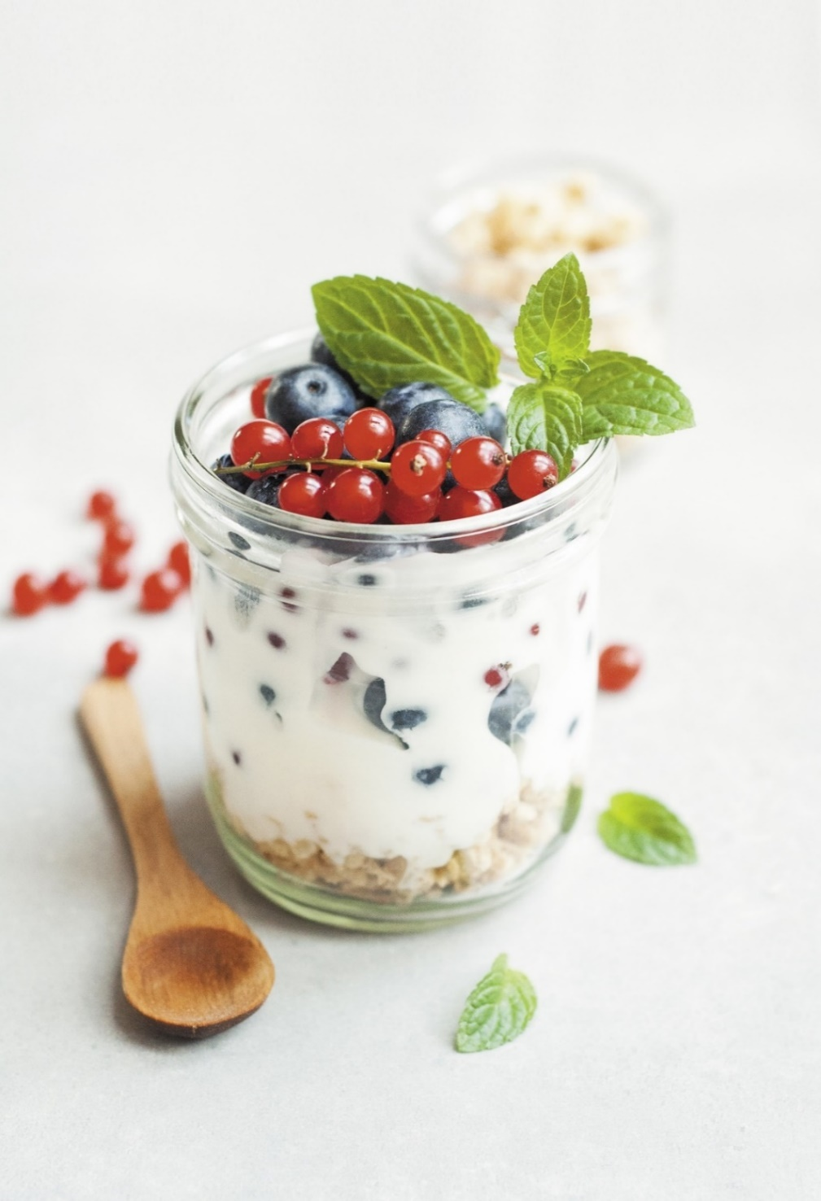
4.4. Raw materials used in yogurt production
Essential raw materials:
Milk. Any type of milk may be used. It can also be concentrated milk, fully or partially skimmed milk or a mixture of milks. Yogurt was originally made from sheep's and buffalo milk, sometimes adding cow's milk. Nowadays, cow's milk is the most commonly used.
Lactic ferments (strains of thermophilic lactic acid bacteria Lactobacillus bulgaricus and Streptococcus thermophilus).
Free picture from Dagny Walter in Pixabay

Slide 20
4.4. Raw materials used in yogurt production
Other ingredients (depending on the type of yogurt):
Pasteurised cream, powdered whey, milk proteins or powdered milk.
Sugars or sweeteners.
Fruit (chunks, pulp, jam, marmalade, jam, compote, syrup, juice, etc.).
Others (honey, cereals, nuts, chocolate, cocoa, coffee, spices, etc.).
Flavourings.
Pigments (colouring agents).
Gelatine.
Edible starches.
Stabilisers.
Preservatives.
Probiotics (Bifidobacterium lactis and Lactobacillus casei bacteria).

Slide 21
4.4. Raw materials used in yogurt production
Innovation, the growing trend towards healthy lifestyles and food intolerances have led to the emergence of new flavours and types of yogurt (even when they are not STRICTLY yogurts)
Drinking, concentrated (skyr, labneh, chakka, etc.), pasteurized, soya, “yogurts” pasteurised after fermentation, probiotic and frozen yogurts are good examples

Slide 22
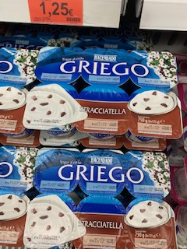
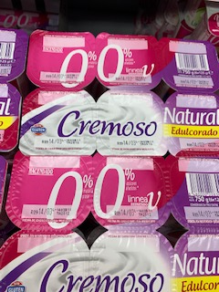
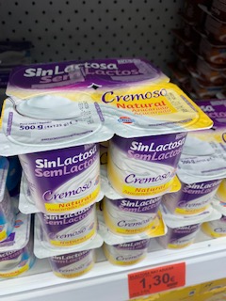
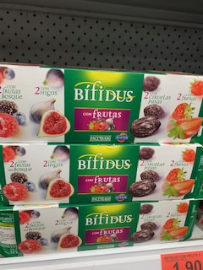
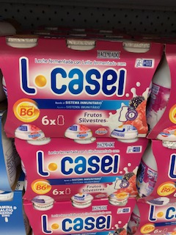
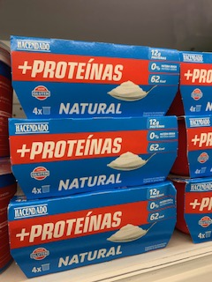
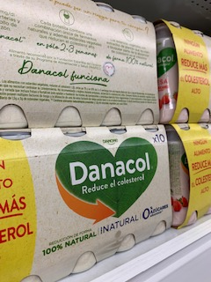
 | Greek yogurt | Skimmed yogurt | Lactose-free yogurt | Yogurt with bifidus (functional probiotics) | Yogurt with L Casei (functional probiotics) | Yogurt with proteins | Yogurt with natural sterols
Description | Greek yogurt is a fermented dairy product, being thicker, denser, creamier and with a more palpable taste than conventional yogurt and having a low level of lactose compared to other dairy products. | Skimmed yogurt is produced from skimmed milk. In nutritional terms, the only difference is that it is under 1% fat, although it contains the rest of the nutrients in similar proportions. | Lactose is a disaccharide carbohydrate, a sugar split into two components: glucose and galactose. Lactase is the enzyme produced naturally in the body that splits the two lactose components, which are absorbed in the intestine. | Bifidus contains the two yogurt bacteria (Streptococcus thermophilus and Lactobacillus bulgaricus) and an additional third live bacterium of the genus Bifidobacterium, which is present in an amount of up to 12.5 billion in each package of yogurt. | Lactobacillus casei is a specie of anaerobic bacteria found in the gut and mouth of humans. It is a probiotic, lactic acid-producing bacterium used in the production of fermented dairy products. | Protein-added yogurts have about 10% protein in their composition, compared to 3% in conventional yogurts. | These are dairy products enriched with plant sterols, which are natural extracts found in fruits, vegetables, vegetables, vegetable oils, nuts, cereals and other foods.
Process | In the traditional Greek recipe, the yogurt is made by removing the whey after fermentation to achieve a creamier texture. | Skimmed milk is milk with the fat removed by centrifuging. That fat is then used to make cream and butter. | Most people assume that "lactose-free" products do not contain lactose, but this is not true. What is done is adding the enzyme lactase. | If any bacteria other than those associated with yogurt production is added during the manufacturing process, the final product cannot be called yogurt: it is a fermented milk, as is the case with bifidus. | It is obtained by adding lactic ferments of the Lactobacillus casei type in the fermented milk production process, in order to provide it with alleged additional benefits. | Dairy products with added protein are obtained by using milk and a nutrient concentrate, which can be further powdered milk, fresh cheese or protein concentrates. In this way, the resulting product has a higher proportion of the food's own nutrients. | In this case, the fermented milk is added with natural plant sterols. The maximum daily intake of 3g/day should not be exceeded.
Benefits | Compared to normal yoghurt, it has more protein and more fat. It also has less lactose and less calcium because some of these nutrients can be lost through whey. | It is particularly suitable for diets where whole milk consumption is prohibited, as its cream contains saturated fatty acids that raise blood cholesterol levels. | It improves the digestibility of yogurts for lactose intolerant people. However, most yogurts have a low lactose content, as lactose is consumed by lactic ferments during fermentation. | Bifidobacteria are part of our gut microbiota from a young age. When consumed in the form of fermented milk, they have healthy probiotic properties. | Lactobacillus casei probiotics are live microorganisms that can improve our gut health and immune system. | Supplement to reinforce protein intake in a natural way or as a supplement in weight loss diets. | Several studies show evidences that sterols have the ability to reduce cholesterol absorption and thereby lower blood cholesterol levels.
Ingredients | Whole milk Cream Lactic ferments Lactose Milk protein | Skimmed milk Lactic ferments | Whole milk Lactic ferments Lactase | Whole milk Lactic ferments Bifidobacteria | Whole milk Lactic ferments Lactobacillus Casei | Whole milk Lactic ferments Milk powder/fresh cheese/concentrate | Whole milk Lactic ferments Natural sterols

Slide 23
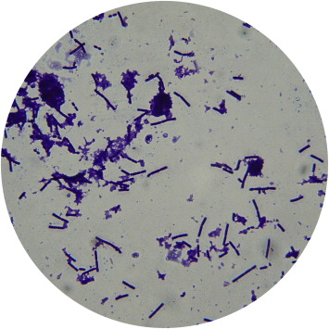
4.5. Processing technology
Yogurt is a dairy product obtained by bacterial fermentation of milk. It is obtained by the action of two bacteria, usually in a 1:1 ratio (Lactobacillus bulgaricus, responsible for acidification, and Streptococcus thermophilus, responsible for the characteristic flavours and aromas) on pasteurised milk, homogenised and standardised in fat and protein, which is increased in protein content with milk solids, milk powder or concentrated milk. The microorganisms producing lactic fermentation must be viable and present in the finished product in a minimum quantity of 1 per 10⁷ colonies per gram or millilitre (according to Spanish legislation; each country defines its own standards).
Source: W.M.A. Mullan, in Encyclopedia of Food Microbiology (Second Edition), 2014

Slide 24
4.5. Processing technology
It is advisable to consume whole dairy products, as fat-soluble vitamins and essential fatty acids are lost when the fat is separated.
Enriched products with fat-soluble vitamins (A, D, E and K) and essential fatty acids are recommended for overweighted people or those who are advised to consume semi or skimmed dairy products due to health problems.
In addition to its nutritional value, yogurt consumption benefits the body because it facilitates digestion (due to pre-digestion by the proteolytic enzymes of the microorganisms, which release free peptides and amino acids that are easily digested and absorbed; and due to the lower pH, which causes the precipitation of casein and facilitates the action of intestinal enzymes) and favours the absorption of calcium (because of the presence of lactic acid).

Slide 25
4.5. Processing technology
Production process:
1) Enrichment of the milk in dry extract. The dry matter content of the milk influences the viscosity and consistency of the final product, as well as its organoleptic characteristics.
2) Heat treatment. Pasteurization or similar is applied to the milk to reduce the microbial load.
3) Homogenisation. Mainly in whole milk, to prevent the separation of fat during the process.
4) Seeding. The starter cultures are added. The milk must have a low bacterial count, be free of antibiotics and disinfectants, not be contaminated by bacteriophages and not be mastitic milk (from sick cows) for a right developing of the starter culture.

Slide 26
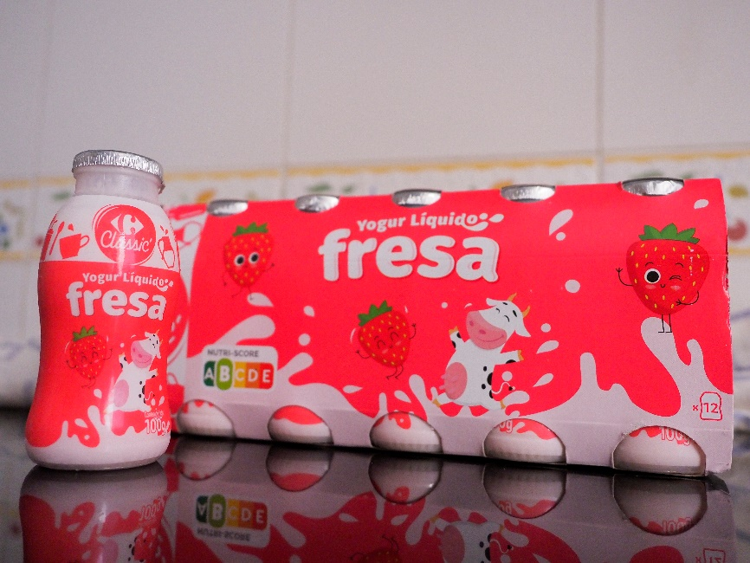
4.5. Processing technology
5) Incubation and fermentation. It is carried out at a temperature and time suitable for the optimal development of the inoculated cultures (42-45 ºC for about 2 hours). Lactic fermentation carried out by microorganisms that transform lactose into lactic acid (in a proportion of 0.9 to 1.2 %) reduces the pH of the medium (which limits the development of undesirable microorganisms), coagulates the milk and produces an acid taste. Other secondary metabolic components provide the aroma.
6) Addition of ingredients. Sugars and flavourings are added immediately after sowing (set yogurt) and fruits or other ingredients after cooling (whipped yogurt).
Watch the following videos for further information: https://www.youtube.com/watch?v=v7fG394NEHM
https://www.youtube.com/watch?v=ja6CfQirtxU

Slide 27
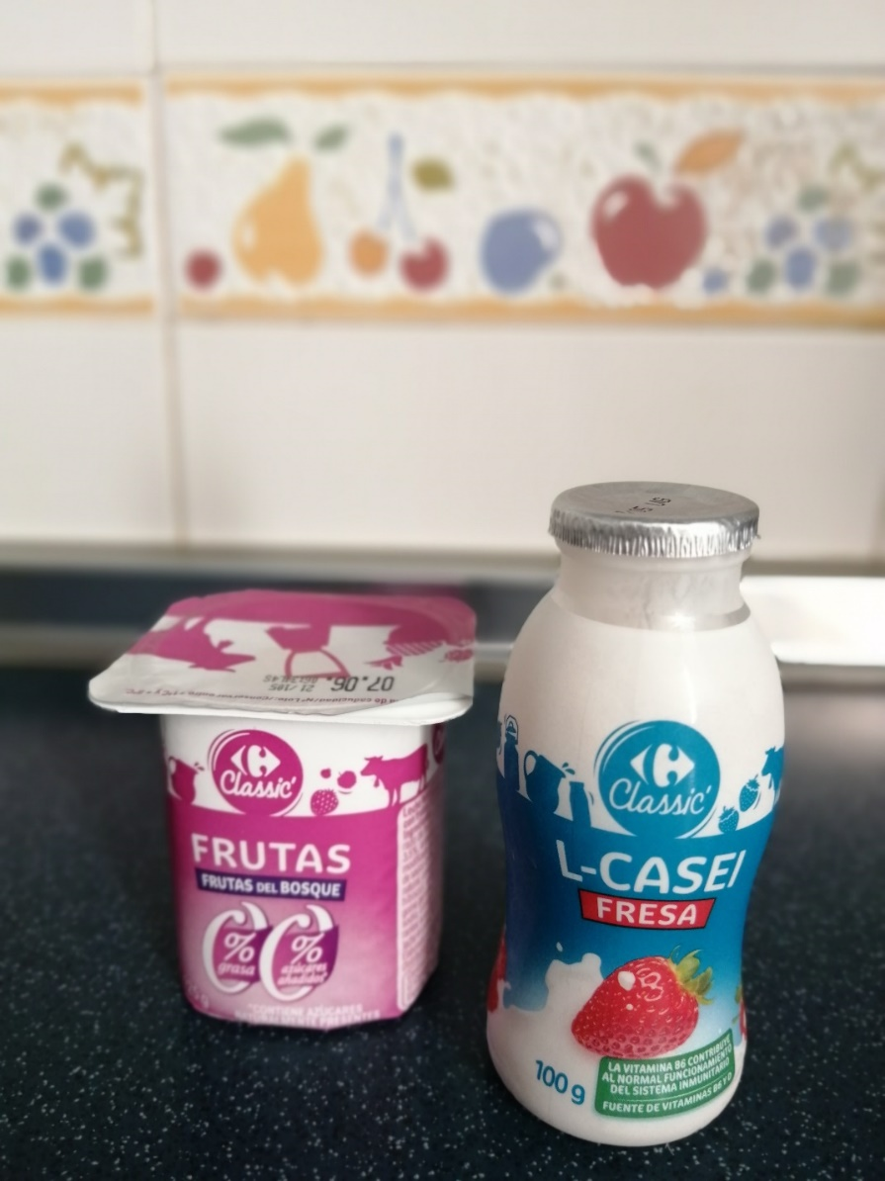
4.5. Processing technology
Milk collection
Milk standardization
Addition of minority components
Air removal
Milk homogenization
Production process
Pasteurization
Cooling
Addition of starter cultures
Addition of minority components
Fermentation
Packaging and capping
Cooling
Addition of minority components
Fermentation
Whipped
Cooling and storage
Packaging and capping
Set yogurt
Cooling and storage
Whipped yogurt
Source: Federación Nacional de Industrias Lácteas

Slide 28
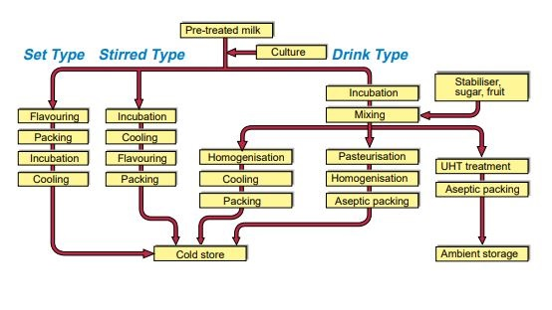
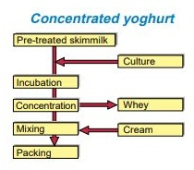
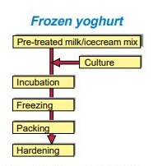
4.5. Processing technology
Production steps for yogurt production
Pre-treated milk
Set
Stirred
Culture
Drink
Concentrated
Stabiliser, sugar, fruit
Pre-treated skim milk
Incubation
Culture
Flavouring
Incubation
Mixing
Packing
Cooling
Incubation
Incubation
Flavouring
Homogenisation
Pasteurisation
Concentration
Whey
Frozen
UHT treatment
Cooling
Packing
Cooling
Homogenisation
Mixing
Cream
Aseptic packing
Pre-treated milk / ice cream mix
Packing
Aseptic packing
Packing
Culture
Incubation
Cold store
Ambient storage
Freezing
Source: Tetra Pak Dairy Processing Handbook (1995)
Packing
Hardening

Slide 29
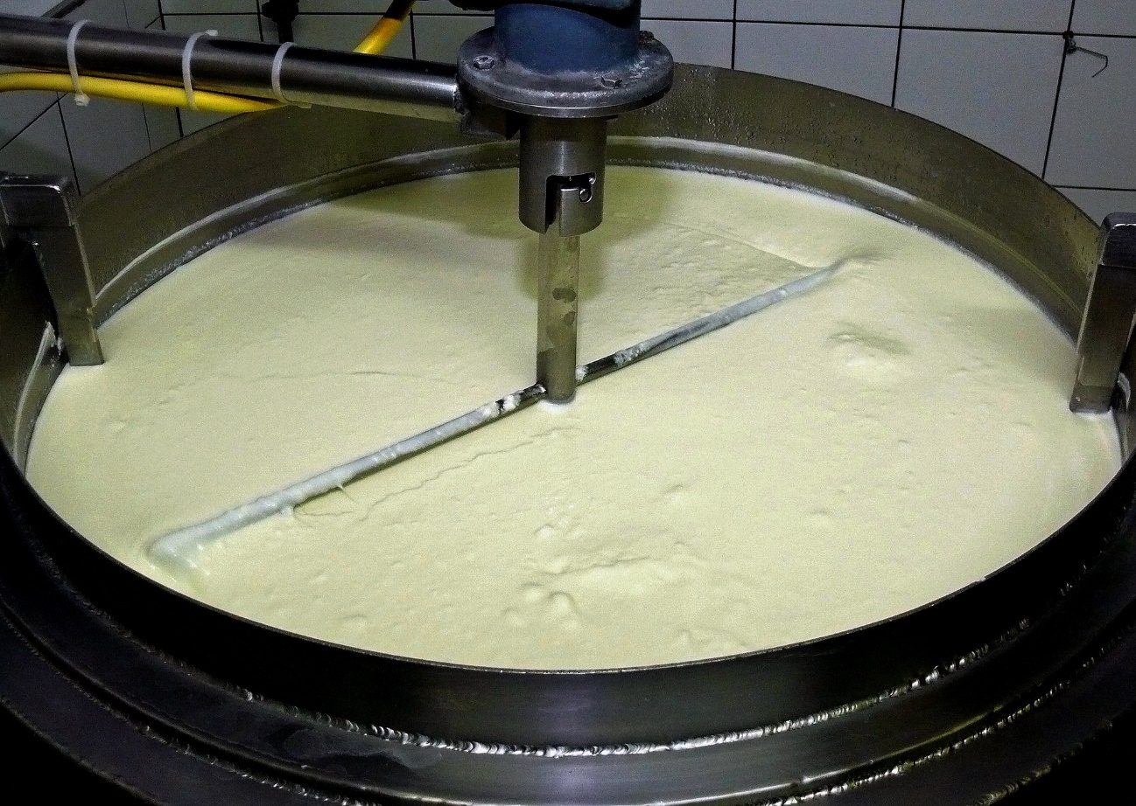
4.5. Processing technology
Yogurt processing machinery
MANUFACTURING
Plastic cup packaging machines
Milk powder mixers
Pasteurisers
Slow pasteurisation equipment
Homogenisers
Skimmers
Flavour injection pumps
Fermentation chambers
Cooling tunnels
PACKAGING
Plastic cup packaging machines
Twist-off glass packaging machines
Certified glass packaging machines
Complete lines with sterilised washing tunnel
Complete lines with packaging and closing tunnel
Complete lines with drying and labelling tunnel for yogurt jars
Free picture from moritz320 in Pixabay
Whipped yogurt

Slide 30
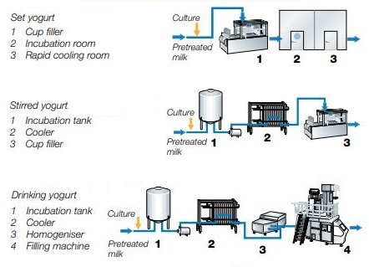
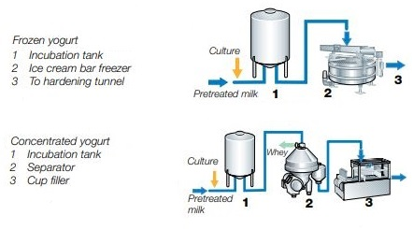
4.5. Processing technology
Example of machinery for several types of yogurt
Set yogurt
1 Cup filler
2 Incubation room
3 Rapid cooling room
Culture
Frozen yogurt
1 Incubation tank
2 Ice cream bar freezer
3 To hardening tunnel
Culture
Pre-treated
milk
Pre-treated
milk
Stirred yogurt
1 Incubation tank
2 Cooler
3 Cup filler
Culture
Concentrated yogurt
1 Incubation tank
2 Separator
3 Cup filler
Pre-treated
milk
Culture
Pre-treated
milk
Drinking yogurt
1 Incubation tank
2 Cooler
3 Homogeniser
4 Filling machine
Culture
Source: Dairy Processing Handbook ©Tetra Pak
Pre-treated
milk

Slide 31
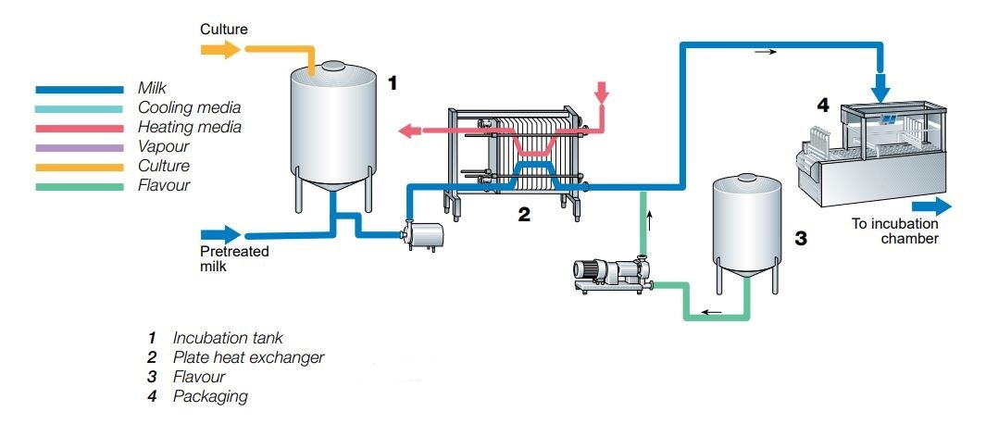
4.5. Processing technology
Final steps in set yogurt production
Culture
Milk / yogurt
Cooling media
Heating media
Vapour
Culture
Fruit / flavour
To incubation
chamber
Pre-treated
milk
1 Incubation tank
2 Plate heat exchanger
3 Flavour
4 Packaging
Source: Dairy Processing Handbook ©Tetra Pak

Slide 32
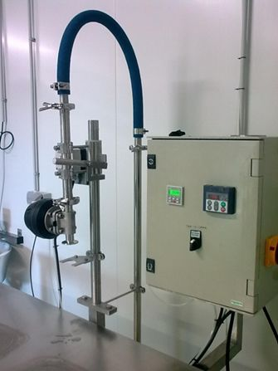
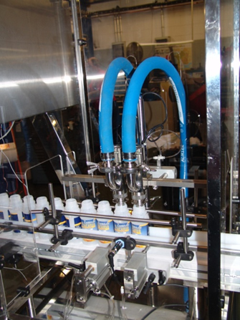
4.5. Processing technology
Example of machinery: dosing machine
For semi-automatic or automatic filling of containers (bottles, pre-formed cups, carafes, etc.) with food liquids (milk, yogurt, juice, etc.).
Liquid product dosing by lobe pump.
Individual flowmeters for each head to guarantee exact filling volumes in any container.
https://www.improlac.com/es/26/procesos-y-maquinas-dosificacion.html

Slide 33
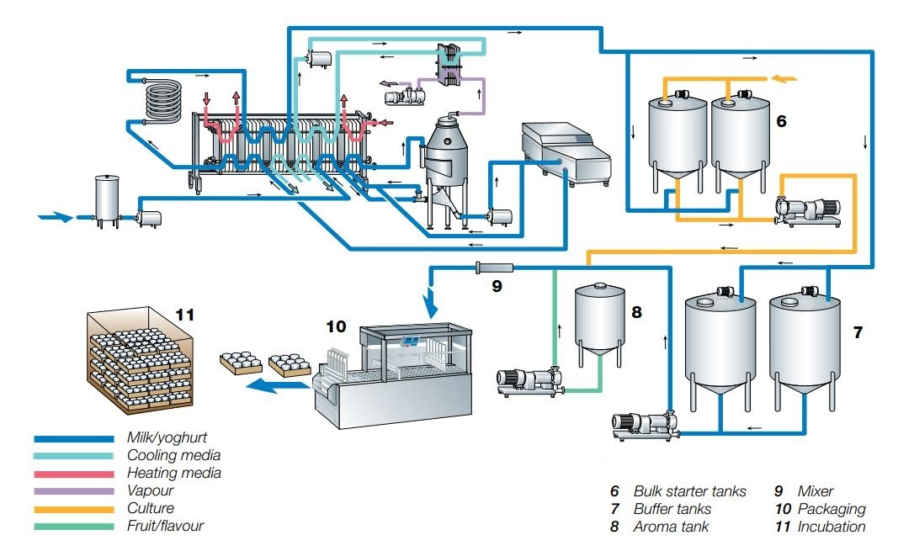
4.5. Processing technology
Production line for set yogurt
Milk / yogurt
Cooling media
Heating media
Vapour
Culture
Fruit / flavour
Source: Dairy Processing Handbook ©Tetra Pak
6 Buffer starter tanks
7 Buffer tanks
8 Aroma tank
9 Mixer
10 Packaging
11 Incubation

Slide 34
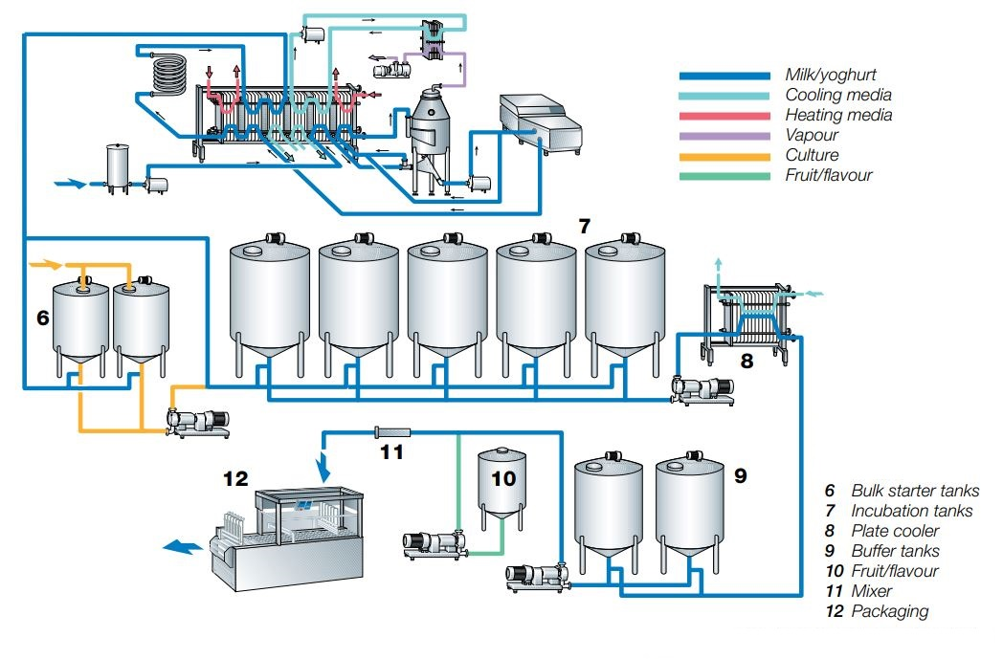
4.5. Processing technology
Production line for stirred yogurt
Milk / yogurt
Cooling media
Heating media
Vapour
Culture
Fruit / flavour
6 Buffer starter tanks
7 Incubation tanks
8 Plate cooler
9 Buffer tanks
10 Fruit/flavour
11 Mixer
12 Packaging
Source: Dairy Processing Handbook ©Tetra Pak

Slide 35
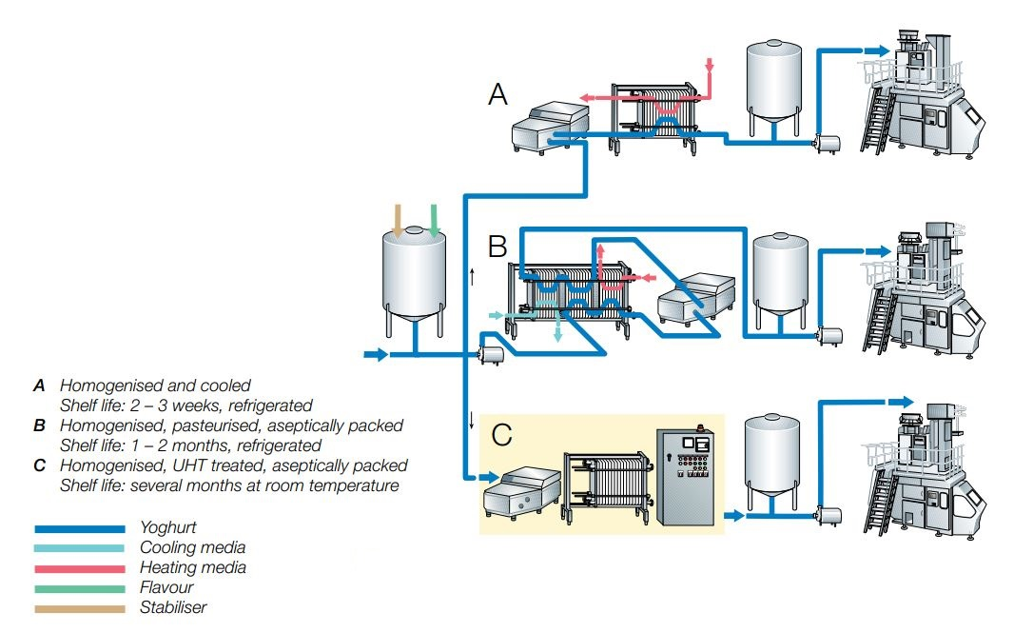
4.5. Processing technology
Process alternatives for drinking yogurt
A Homogenised and cooled
Shelf life: 2-3 weeks, refrigerated
B Homogenised, pasteurised, aseptically packed
Shelf life: 1-2 months, refrigerated
C Homogenised, UHT treated, aseptically packed
Shelf life: several months at room temperature
Yogurt
Cooling media
Heating media
Flavour
Stabiliser
Source: Dairy Processing Handbook ©Tetra Pak

Slide 36
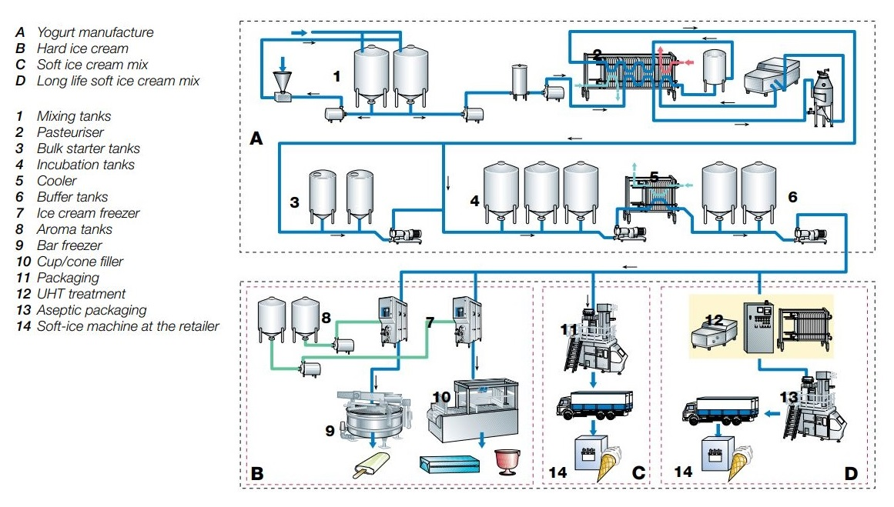
4.5. Processing technology
Alternatives for frozen yogurt production
A Yogurt manufacture
B Hard ice cream
C Soft ice cream mix
D Long life soft ice cream mix
1 Mixing tanks
2 Pasteuriser
3 Bulk starter tanks
4 Incubation tanks
5 Cooler
6 Buffer tanks
7 Ice cream freezer
8 Aroma tanks
9 Bar freezer
10 Cup/cone filler
11 Packaging
12 UHT treatment
13 Aseptic packaging
14 Soft-ice machine at the retailer
Source: Dairy Processing Handbook ©Tetra Pak

Slide 37
4.6. References / links
Condony, R. et al. (1988). Yogur: elaboración y valor nutritivo, Fundación Española de la Nutrición.
https://www.fen.org.es/publicacion/yogurt-elaboracion-y-valor-nutritivo
Dairy Processing Handbook ©Tetra Pak (1995).
https://dairyprocessinghandbook.tetrapak.com
Dirección General de Salud Pública y Alimentación (2007). Leches fermentadas en la Comunidad de Madrid: diagnóstico de situación del mercado y del etiquetado. Documentos Técnicos de Salud Pública, 106. Comunidad de Madrid.
http://www.madrid.org/bvirtual/BVCM009021.pdf
Federación Nacional de Industrias Lácteas. Monografía. Queso, yogur y otras leches fermentadas.
http://www.lacteosinsustituibles.es/p/archivos/pdf/monografia_queso_yogur_otraslechesfermentadas.pdf

Slide 38
4.6. References / links
Würth, D. (2017). Lácteos fermentados: defectos y causas, tendencias.
http://proleche.com/wp-content/uploads/2017/10/Charla20.pdf
Youtube links
92-Fabricando Made in Spain - Yogures
https://www.youtube.com/watch?v=v7fG394NEHM
Yogures 'made in Euskadi'
https://www.youtube.com/watch?v=ja6CfQirtxU

Slide 39
Thank You!
💛

