Slide 1
Separation of milk fat
UNS
Ksenija Čobanović, PhD.Ass.Prof
Saša Krstović, PhD

Slide 2
SEPARATION OF MILK FAT FROM MILK
Milk is an emulsion or suspension of milk fat in water containing a number of substances in solution (lactose, minerals, vitamins ...), as well as ingredients in a colloidal state (proteins).
Milk fat is found in milk in the form of small globules and has a lower density than other milk ingredients, it is separated on the surface of milk during standing or by means of a separator.
The most famous products that are obtained by concentrating milk fat are: cream, kaymak, butter and butterfat.

Slide 3
Natural separation of milk fat
Milk fat (920 kg/m³) has a lower density than skimmed milk (1030 kg/m³) and when milk stands still it is separated on the surface.
This property of separating milk fat has been used in the past to separate cream.
After milking, the milk was poured into containers that were placed in cold water or left in the cold air, and after 12 to 24 hours, the cream was removed from the surface.
This method is slow and impractical for modern industrial production, where milk fat is separated by means of a separator.

Slide 4
SEPARATION OF MILK FAT FROM MILK
The speed of fat separation from milk under the influence of gravity depends on:
The size of fat globules, it increases with increasing diameter of fat globules,
Differences in the density of skimmed milk and fat, it increases with increasing difference and
The viscosity of skim milk, it decreases with increasing viscosity of skim milk.

Slide 5
Separation of milk fat by using a separator
Separators are devices that separate milk fat from milk.
By separating the milk, the skimmed milk is separated from the milk fat.
The separation is based on the difference in the density of milk fat and skimmed milk, with the application of centrifugal force.
The centrifugal force acts much stronger than gravity, so using a separator makes the separation of milk fat much faster.

Slide 6
Types of separators
Separators used in the dairy industry can be divided on the basis of several criteria, the basic divisions are according to purpose, construction and operation.
According to the purpose in the dairy industry, there are:
Separators for skimming and partial purification of milk, curd, etc.
Clarifiers for milk purification and
Bactofuges for removing bacteria from milk.

Slide 7
Types of separators
According to the construction, there are:
Open separators, with open milk in-flow and open out-flow of skimmed milk and cream,
Semi-closed separators, with open milk in-flow and closed milk and cream outflow
Hermetically sealed separators, where the milk in-flow is hermetically sealed, as well as the out-flow of skimmed milk and cream.

Slide 8
Types of separators
100 L/H
600 L/H
10,000 L/H

Slide 9
Closed, self-cleaning separator

Slide 10
Types of separators
According to the power:
Manual
Mechanical (electric motor, pulley or steam turbine)
Combined (manual and mechanical).
Manual separator

Slide 11
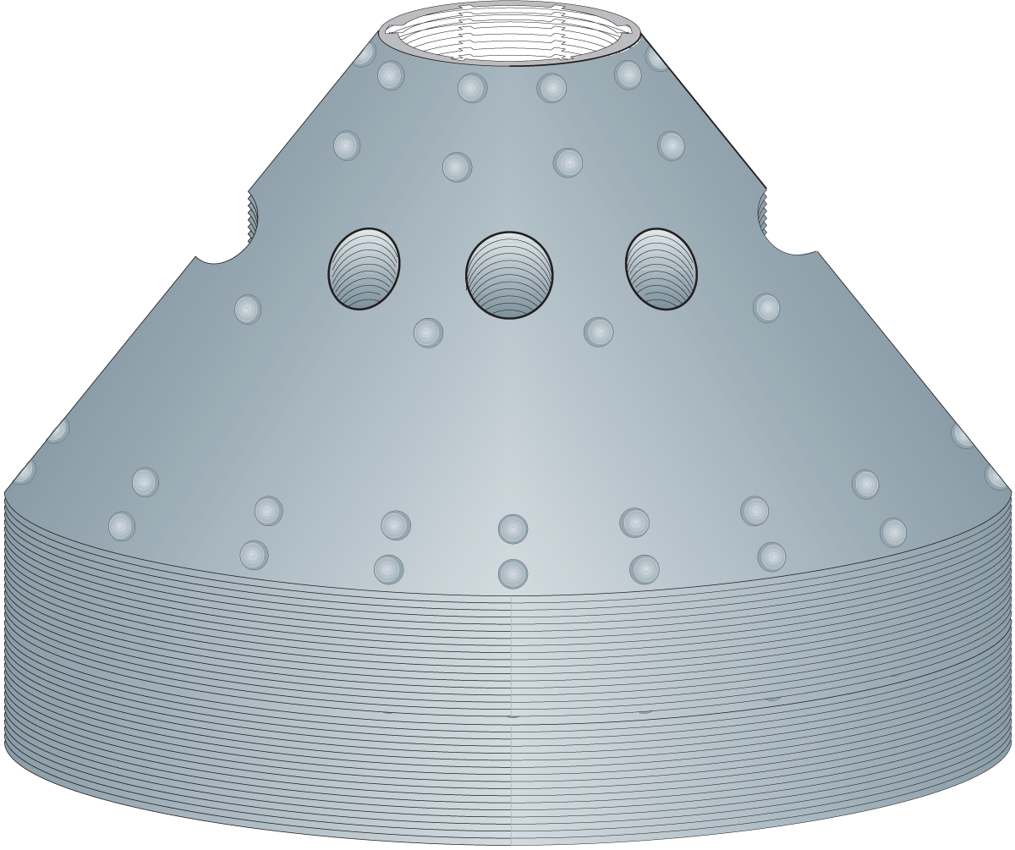
Operation principle
The separator for milk skimming is usually located in the pasteurization line, from where milk, after preheating in the pasteurizer, passes into the separator where the cream is collected.
The milk is released into the separator only when it reaches the prescribed number of revolutions (6,000-7,000 rpm).
During operation, the separator drum is continuously filled with milk, which is distributed through the openings in layers between the discs during rotation. There are 120 discs in the separator drum, which are placed one above the other, at an angle of 45°
Disc stack with distribution holes and caulks
(Dairy Processing Handbook ©Tetra Pak)

Slide 12
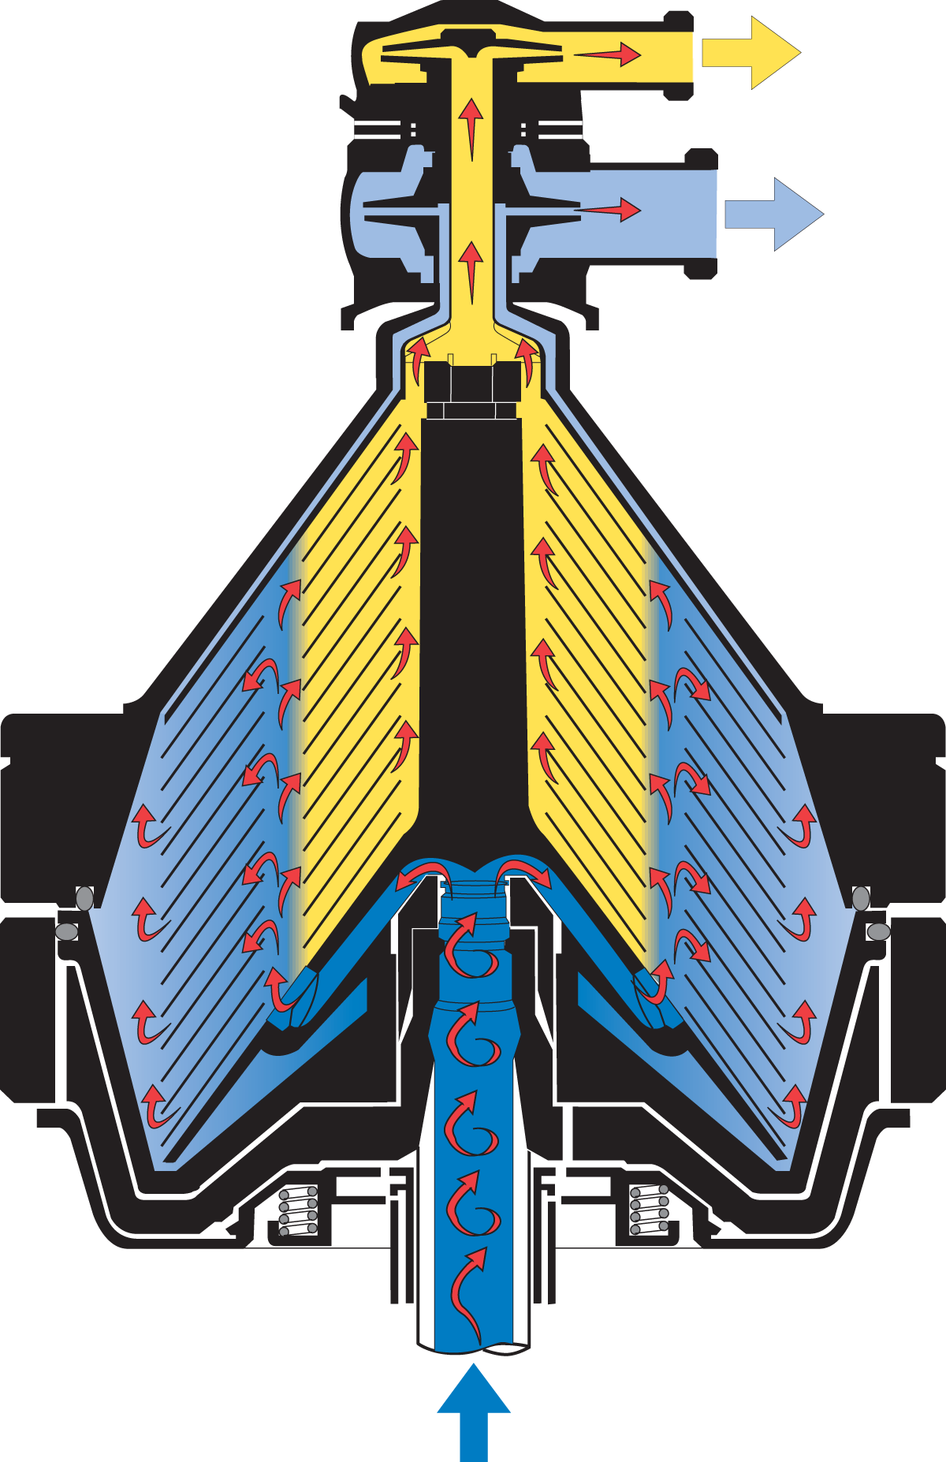
Operation principle
Cream
Skimmed milk
Fat globules, as specifically lighter, move towards the axis of rotation, and skimmed milk, as specifically heavier, moves towards the perimeter of the separator drum
Milk fat is drained in the form of cream through the opening for cream, and skimmed milk through the opening for skimmed milk
The smallest fat globules do not have time to settle, so they go away together with skimmed milk (about 0.05% milk fat).
Schematic representation of how the separator works
(Dairy Processing Handbook ©Tetra Pak)

Slide 13
Operation principle
Sectional view of part of the disc stack, showing the milk entering through the distribution holes, and separation of fat globules from the skim milk (Dairy Processing Handbook ©Tetra Pak) .

Slide 14
Operation principle
During operation, dirt accumulates in the separator drum, so the separator must be stopped, opened and cleaned.
New types of separators so-called self-cleaning separators, remove dirt automatically during operation
Separation of dirt particles in self-cleaning separators
(Dairy Processing Handbook ©Tetra Pak)

Slide 15
The efficiency of milk skimming is influenced by a number of factors:
Separator type (diameter and speed of rotation), with the increase of the diameter of the separator, the performance increases, and with the increase of the number of revolutions of the drum, the centrifugal force and the separation of fat from the milk increase.
Temperature of milk to be skimmed. In industrial milk processing, skimming is most often performed at a temperature of 40-45°C. Cold skimming leaves 0.15 to 0.30% of milk fat in skimmed milk, and skimming at temperatures above 60°C increases the corrosion of the separator, and the viscosity of milk increases due to albumin coagulation and thus reduces the efficiency of skimming.
Diameter of fat globules. Small globules of milk fat (less than 1x10-6m) move more slowly and are unlikely to separate.
Product viscosity. As the viscosity of the milk increases, the separation of fat globules decreases, and thus the effect of the separator decreases. Heated milk has a lower viscosity than cold milk, so heating milk improves separation. Also, milk with an increased degree of acidity, i.e., with a lower pH value, due to the increased viscosity, will be less skimmed.

Slide 16
STANDARDIZATION OF MILK FAT CONTENT
Raw cow's milk contains an average of 3% to 4.0% of milk fat.
In the production of different dairy products, it is necessary to standardize the milk fat content in order to achieve a uniform content in the final product.
Standardization of milk fat content is the process of adjusting the milk fat content in milk intended for the production of various dairy products.
Standardization can be achieved by using a separator or by mixing skimmed milk and milk/cream.
The standardization process yields milk with the required milk fat content.

Slide 17
Milk sepration and standardization process
Cream
Surplus
standardized cream
Whole milk
Skim milk
Standardized milk
(Dairy Processing Handbook ©Tetra Pak)

Slide 18
Thank You!
💛

